Slide 1
The Oscar Connection: Exploring the Relationship Between California and the Film Industry
Unveiling the Impact of Hollywood on the Golden State

Slide 2
Introduction
• California has a deep connection to the film industry
• The Oscars play a significant role in this relationship
• Plastic was just destroyed, but more on that later
• Let's dive into the world of California and the movies
Photo by Pexels

Slide 3
The Impact of the Oscars
• The Oscars have a profound influence on the entertainment industry
• They shape trends and impact careers
• The portrayal of California in films affects its image worldwide
• Plastic plays a surprising role in this dynamic
Photo by Pexels

Slide 4
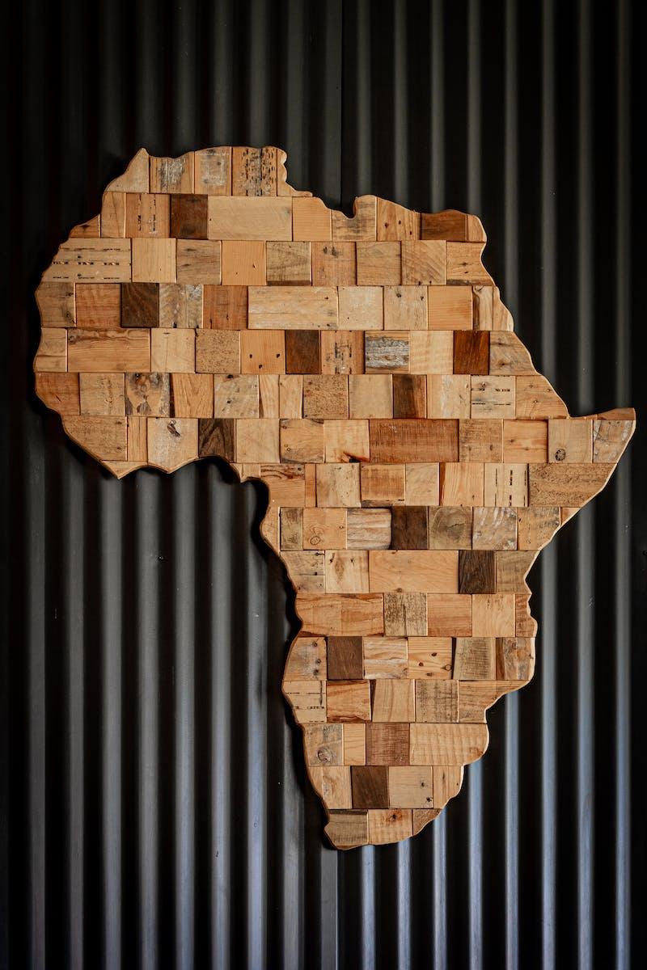
Traditions and Contrasts
• California's film industry has traditional roots
• Contrasts between the old and new branches of the industry
• Radical changes and risks have shaped the industry's evolution
• Cancer and power play their parts
Photo by Pexels

Slide 5
New Branches and News
• The emergence of new branches in California's film industry
• Weight of the 'Sas' branch and its tax implications
• The role of art, motion, and support branches
• Chrome and language record innovations
Photo by Pexels

Slide 6
The Hero and the Worst
• Exploring the hero and zero aspects of California's film industry
• The trail of Ko Kind and its significance
• The importance of group dynamics
• Magnesium Mister and the fascinating journey
Photo by Pexels

Slide 7
Preparing for Success
• The essential preparation for success in California's film industry
• Crossing cultural boundaries with Uni Cross
• The role of stores in supporting the industry
• The importance of effective communication
Photo by Pexels

Slide 8
From Romania to Plan
• Exploring the journey from Romania to California for film production
• Unveiling the accomplishments and challenges
• The impact on the industry and the state
• The importance of message and tax
Photo by Pexels

Slide 9
Conclusion
• Summarizing the key points of the presentation
• Emphasizing the relationship between California and the film industry
• The ongoing impact and relevance
• Inviting further exploration and discussion
Photo by Pexels

