Slide 1
How to Tie Dye a Shirt
Step-by-step guide for creating a colorful and unique shirt

Slide 2
Laying the Foundation
• Start by laying your shirt on a flat surface
• Pinch and twist the shirt from the middle
• Shape the shirt around the spiral using the sides
• Ensure the shirt looks neat and tight
Photo by Pexels

Slide 3
Securing the Shirt
• Secure the shirt with rubber bands
• Use around four rubber bands
• Tuck all parts of the shirt in neatly
• Reduce mess during the dying process
Photo by Pexels

Slide 4
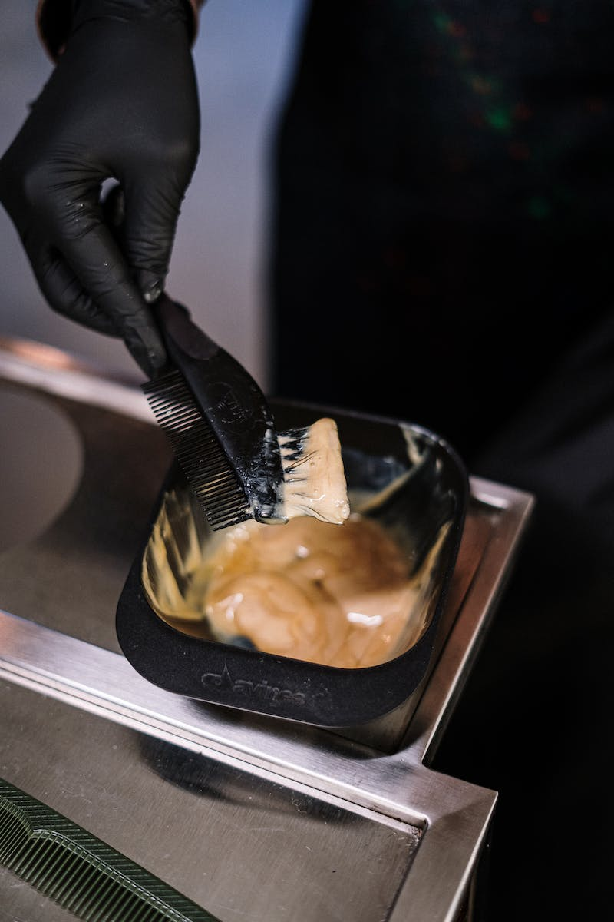
Preparing for Dyeing
• Put on gloves to avoid staining hands
• Start dyeing with the first color
• Dye one-third of the shirt
• Size of the section determines spiral lines' size
• Ensure no white spots by applying dye in cracks
Photo by Pexels

Slide 5
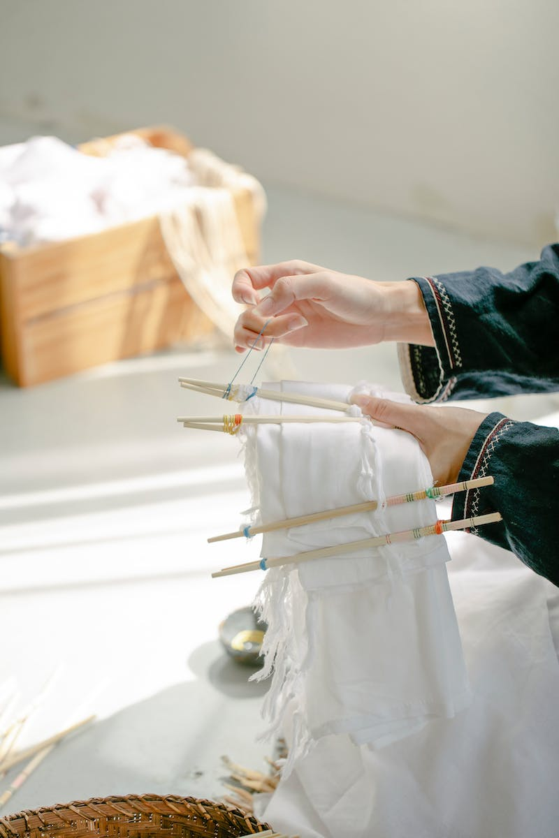
Adding Multiple Colors
• Adjust the first two colors to be equal
• Add the third color to the shirt
• Ensure all colors meet in the middle
• Create a rainbow effect
Photo by Pexels

Slide 6
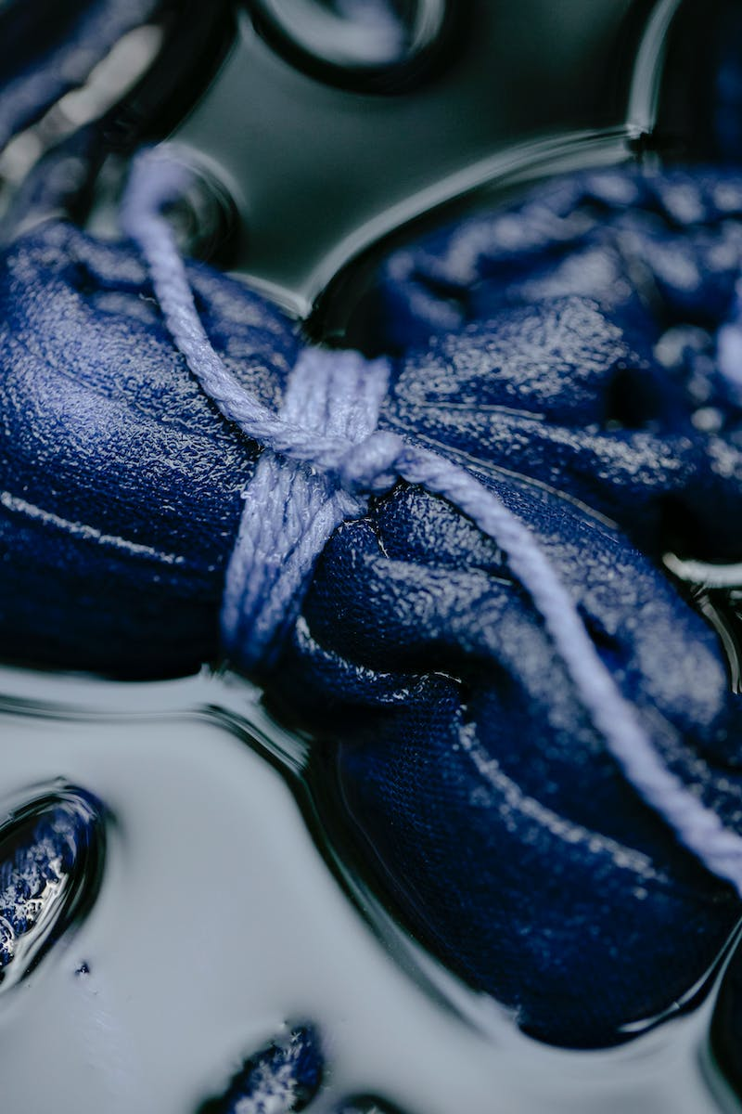
Flipping and Finishing
• Ensure the surface is clean before flipping the shirt
• Repeat the same process on the second side
• Align all colors on both sides
• Prevent excessive dripping by placing in a bag
• Store the shirt in a dry place for optimal drying
Photo by Pexels

Slide 7
Conclusion
• Watch our tutorial for more detailed explanations
• Enjoy your unique tie dye shirt!
Photo by Pexels

