Slide 1
Escaping the Flood in Wobbly Life
Adventures and Strategies to Survive the Rising Waters

Slide 2
Introduction
• A thrilling adventure awaits in the flood-stricken world of Wobbly Life
• Experience the fear and excitement of escaping the rising waters
• Discover strange phenomena and find safe havens amidst the flood
• Be prepared to face challenges and strategize to survive
Photo by Pexels

Slide 3
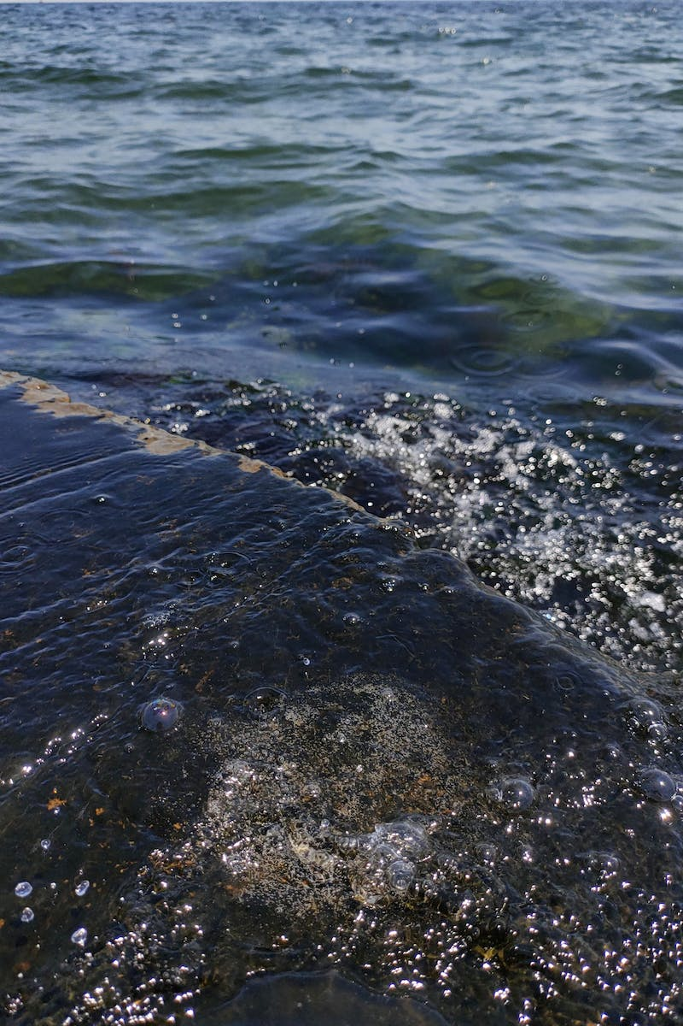
Observations of the Water
• Notice strange behaviors in the flood's progression
• Discover the potential for a safe escape through the beam g technique
• Identify the only safe spot on the mountain amidst the flood
• Explain the motivation for staying on top of the roof despite fear
Photo by Pexels

Slide 4
Signs of the Flood's Arrival
• Wait for viewer interaction (thumbs up) to trigger the flood
• Describe the receding ocean as a bad sign and express concern
• Realize the potential danger of being in the flooded areas
• Urge the audience to escape to higher ground
Photo by Pexels

Slide 5
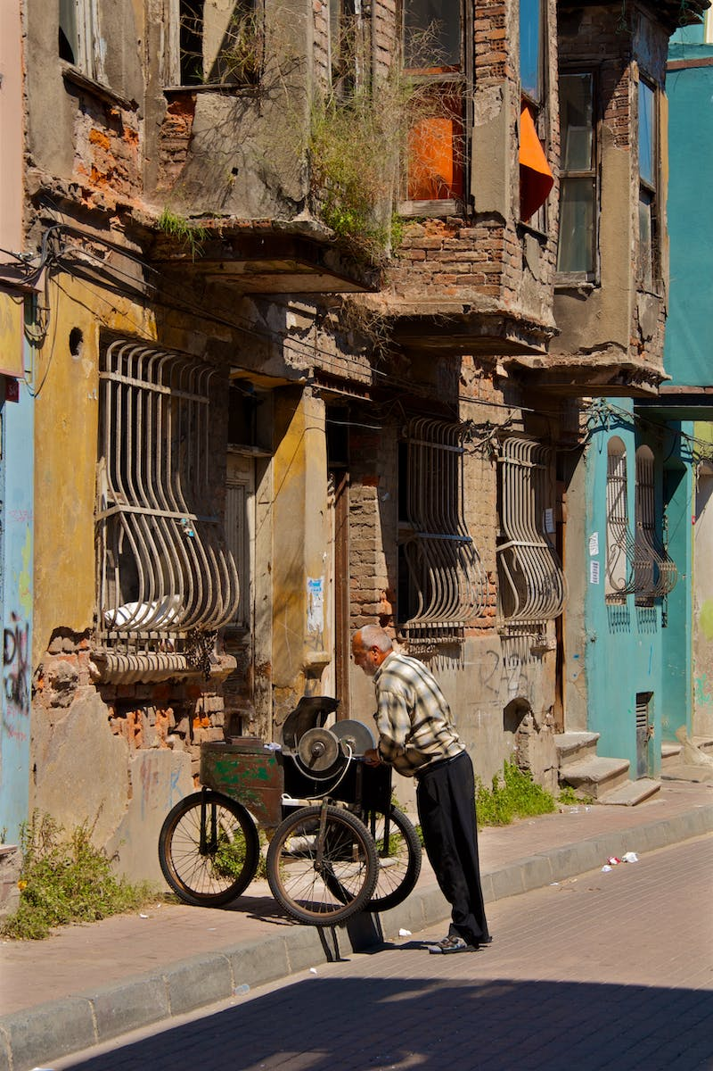
Finding a Safe Vehicle
• Search for a suitable and fast vehicle for the escape
• Consider the balance between speed and safety
• Opt for a sports cart as a potential choice
• Express disappointment at the vehicle's reduced speed
Photo by Pexels

Slide 6
Race Against the Flood
• Experience the adrenaline of racing against the rising waters
• Witness the neighborhood flooding and the urgency to escape
• Navigate obstacles and pursue higher ground
• Encounter humorous interactions with other characters
Photo by Pexels

Slide 7
Refining the Escape Strategy
• Evaluate the effectiveness of using a helicopter for the escape
• Question the ethics of taking a helicopter without finding one on the way
• Discuss the uncertainties surrounding the speed of the flood
• Contemplate the possibility of death amidst the rising waters
Photo by Pexels

Slide 8
Surviving the Toughest Area
• Consider starting further away from the flood for a challenge
• Discuss the difficulty of surviving the toughest area without a vehicle
• Highlight the importance of fast-thinking and resourcefulness
• Share the experience of successfully reaching higher ground
Photo by Pexels

Slide 9
The Last Resort
• Explore the Rubber Band Games tower as a potential safe spot
• Realize the limitations of the tower's safety as the flood reaches
• Suggest the use of a hot air balloon for escape
• Share the excitement and relief of successfully escaping the flood
Photo by Pexels

Slide 10
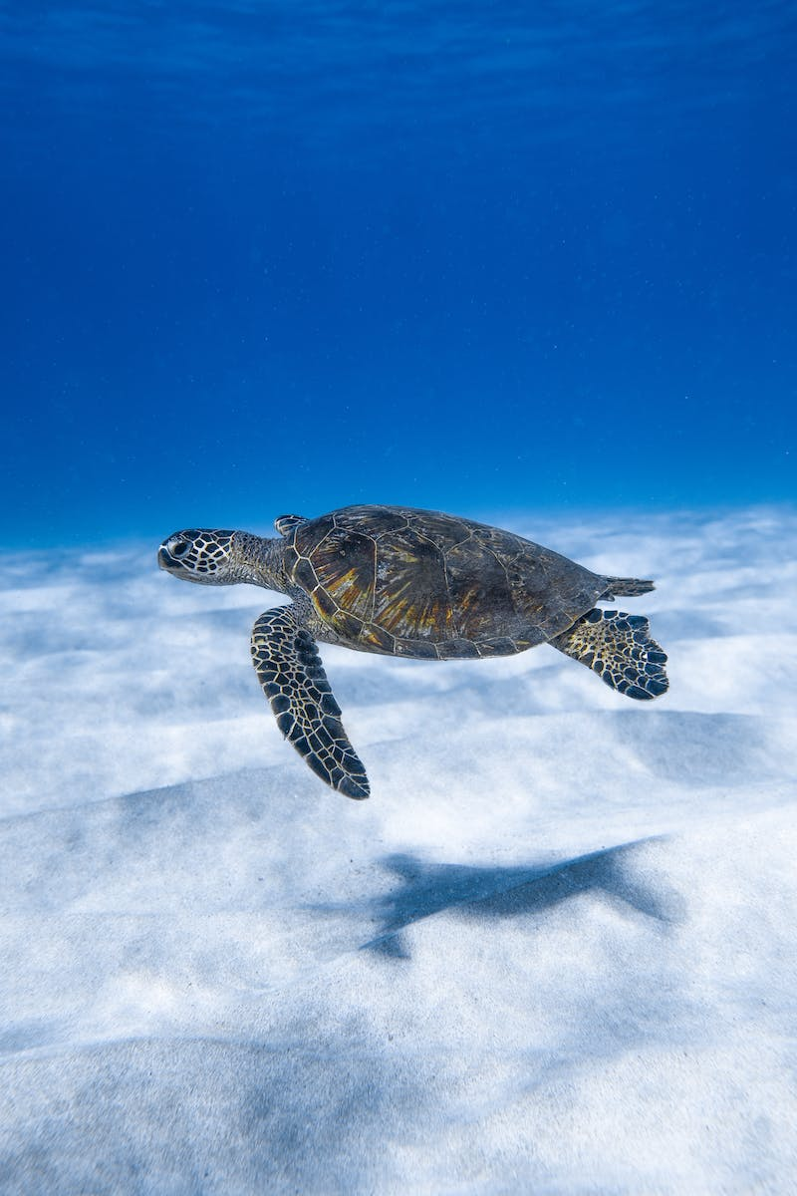
Conclusion
• Recap the thrilling adventures and strategies to escape the flood
• Encourage the audience to experience multiplayer and group rescues
• Highlight the joy and excitement of playing Wobbly Life
• Thank the audience for their attention and interest
Photo by Pexels

