Slide 1
The Influence of Anglo-Saxon Culture on the English Language
Exploring the Origins and Evolution of Old English

Slide 2
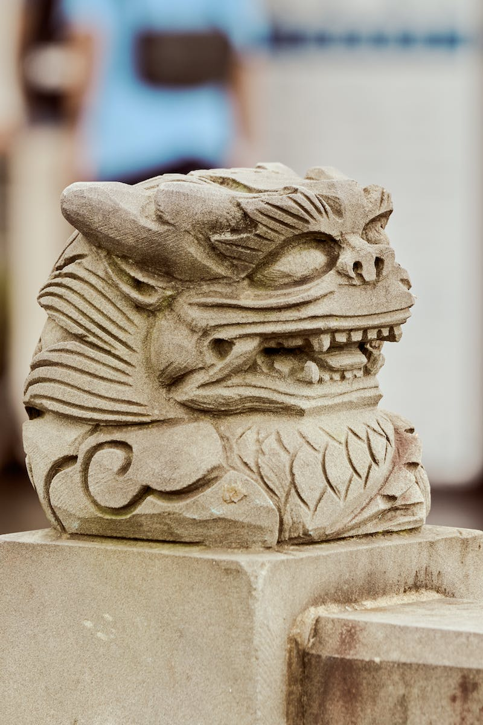
Introduction to the Anglo-Saxon World
• Anglo-Saxon culture and its impact on language
• Significance of geography and history of British Isles
• Importance of regional dialects and their role in shaping language
• Link between dialect and power, and dialect and culture
Photo by Pexels

Slide 3
Language and Verbal Artifacts
• Verbal artifacts as the primary focus in Anglo-Saxon culture
• Differentiating the course as a study of language history
• Exploring how words build structures for the mind
• Tense relationship between borrowed words and native coinage
Photo by Pexels

Slide 4
Borrowing in Old English
• Overview of periods of borrowing in Old English
• Continental borrowing before the Germanic migration
• Insular borrowing during the Christianization of Anglo-Saxon England
• Examples of borrowed words and their origins
Photo by Pexels

Slide 5
Continental Borrowings
• Explanation of borrowing during the continental period
• Influence of Roman presence and culture
• Examples of borrowed words related to war, trade, and cultural aspects
• Highlighting the significance of the word 'street' and its Roman origins
Photo by Pexels

Slide 6
Insular Borrowings
• Explanation of borrowing during the insular period
• Influence of Latin religious concepts and Celtic/Scandinavian languages
• Examples of borrowed words related to Christianity and Norse influence
• Highlighting differences in pronunciation and connotations
Photo by Pexels

Slide 7
Word Formation in Old English
• Overview of Old English word formation
• Role of compounding and its different forms
• Repetitive compounding and its effect on meaning
• Prefixes as a common way of creating new words
Photo by Pexels

Slide 8
Cadman's Hymn: Origin and Influence
• Story of Cadman and the angelic inspiration
• Translation of Latin concepts into Old English
• Role of alliteration and formulaic expressions
• Unique vocabulary and metaphorical language
Photo by Pexels

Slide 9
Conclusion: Legacy of Anglo-Saxon Culture
• Reflection on the influence of Anglo-Saxon culture
• Transition to future periods of English language development
• Implications for linguistics, literature, and cultural history
• Relevance of the study of Old English in modern contexts
Photo by Pexels

