Slide 1
The Value of iPhone 15 Pro
Discover the Features and Benefits

Slide 2
Introduction
• Lunch pricing confusion
• Ad claims free lunch
• Free for economy ultimate passengers only
• Water is available for everyone
Photo by Pexels

Slide 3
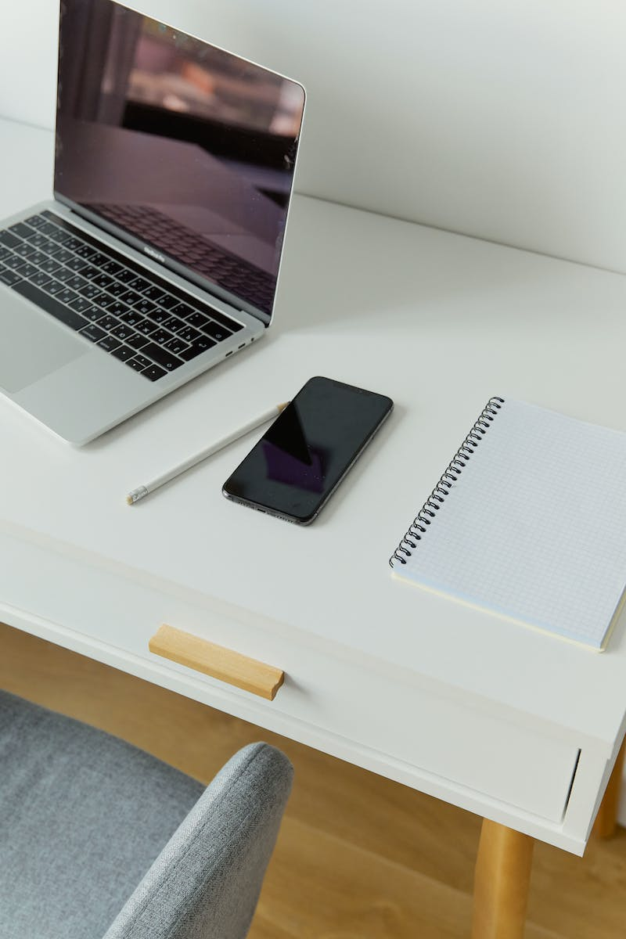
Best iPhone Deals
• AT&T guarantees best iPhone deals
• Even on the new iPhone 15 Pro
• Pro model with titanium build
• Keeping our word
Photo by Pexels

