Slide 1
Remembering Beslan: A Story of Resilience and Tragedy
Reflecting on the deadliest terrorist attack in Russian history

Slide 2
Introduction
• Beslan, a small republic in Russia, faced a devastating terrorist attack in 2004
• Over a thousand people were taken hostage, including 186 children
• After three days of captivity, a rescue operation resulted in 334 deaths
• This presentation explores the lasting impact of the Beslan tragedy and the resilience of its survivors

Slide 3
Surviving in Captivity
• Hostages endured three days without food or water in a cramped gym filled with explosives
• Some hostages found creative ways to stay calm, such as focusing on pets left at home
• The physical and emotional toll of the ordeal was immense
• Many hostages developed deep bonds and supported each other through the crisis
Photo by Pexels

Slide 4
Rebuilding Lives
• Hundreds of survivors suffered physical injuries, including head trauma and severe wounds
• Medical treatment and rehabilitation were crucial for recovery
• Family members and communities played a vital role in supporting survivors
• Despite the immense challenges, many survivors found strength and started rebuilding their lives
Photo by Pexels

Slide 5
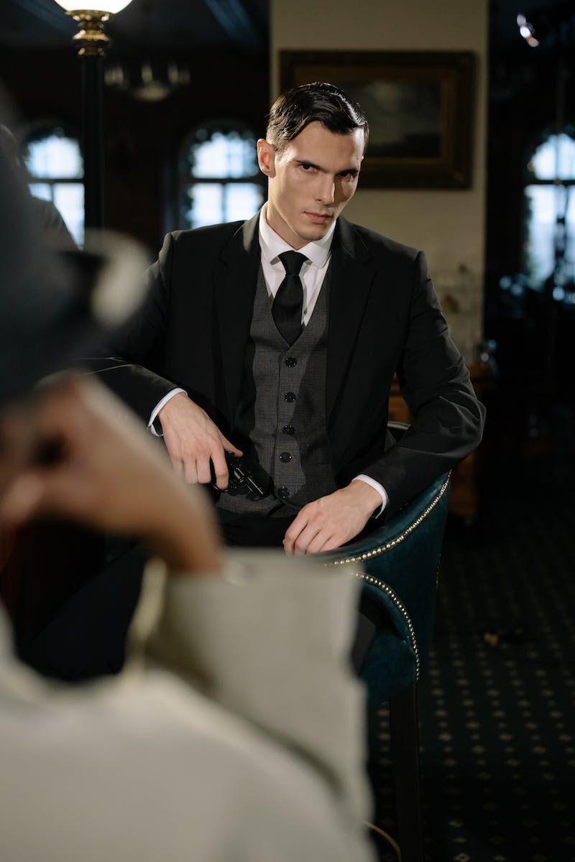
Investigating the Tragedy
• Journalists and investigators have sought to uncover the truth behind the Beslan crisis
• Questions arise about the intelligence failures and responses from security agencies
• The official version of events is scrutinized, and survivors' testimonies provide important insights
• Transparency and accountability are major factors in the healing process
Photo by Pexels

Slide 6
Lessons Learned
• The Beslan tragedy highlights the need for improved security measures and crisis response protocols
• Ensuring the well-being of survivors and preventing future attacks should be top priorities
• By remembering and sharing the story of Beslan, we honor the victims and promote awareness
• The pursuit of justice and the support for survivors must continue
Photo by Pexels

