Slide 1
Introducing Ect Life: The Future of Artificial Room Facilities
Revolutionizing Parenthood with Innovative Technology

Slide 2
Welcome to Ect Life
• World's first artificial room facility powered by renewable energy
• Allows couples to become true biological parents
• Perfect for women who had their uterus removed due to cancer or complications
• Addresses population decline in countries like Japan, Bulgaria, and South Korea
Photo by Pexels

Slide 3
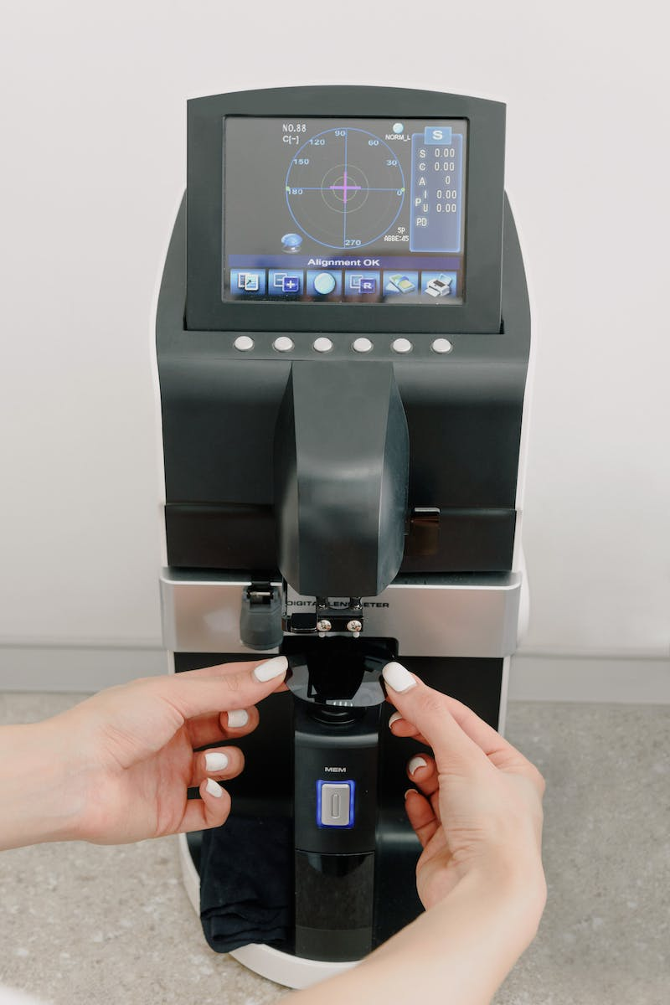
State-of-the-Art Labs
• Facility features seventy-five highly equipped labs
• Each lab can accommodate up to four hundred growth pods
• Replicate exact conditions inside the mother's uterus
• Single building can incubate up to thirty thousand lab grown babies per year
Photo by Pexels

Slide 4
Infection-Free Environment
• Growth pods made of germ-resistant materials
• Sensors monitor vital signs and report abnormalities
• Real-time data on baby's developmental progress
• High-resolution live view and time-lapse sharing on the app
Photo by Pexels

Slide 5
Bonding Experience and Personalization
• Speakers play words and music to stimulate baby's development
• App allows playlist selection and direct singing
• Virtual reality experience to see and hear from the baby's perspective
• Wireless hap suit enables sensing and sharing of baby's kicks
Photo by Pexels

Slide 6
Sustainable Nutrient Supply
• Two central bio reactors provide necessary nutrients
• Artificial umbilical cord delivers nutrients and oxygen
• Amniotic fluid simulation with vital hormones and growth factors
• Waste recycling system ensures a sustainable nutrient supply
Photo by Pexels

Slide 7
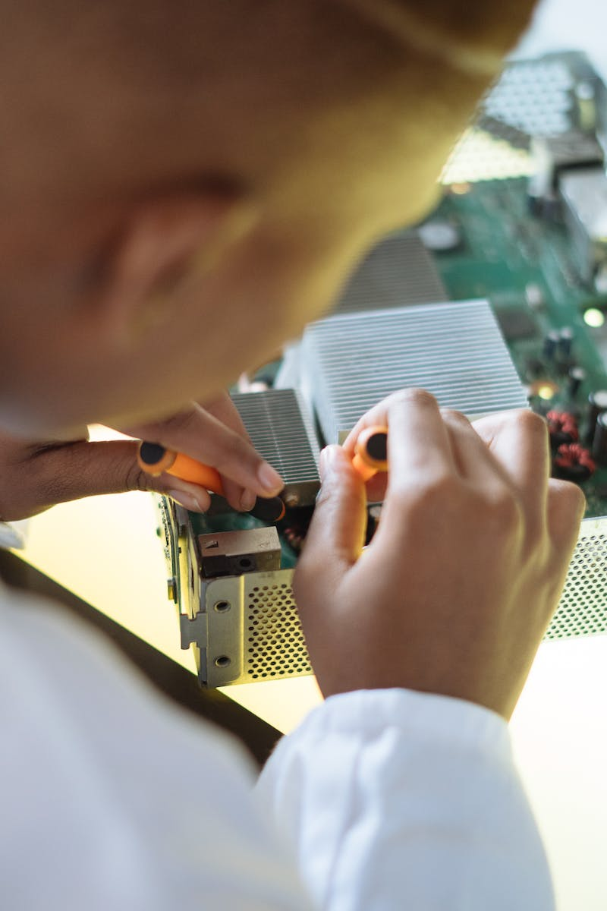
Genetic Engineering and Birth Process
• In vitro fertilization for viable and genetically superior embryo
• Crispr cas nine gene editing tool for genetic customization
• Customize eye color, hair color, physical traits, and intelligence
• Safe, pain-free birth process with a click of a button
Photo by Pexels

Slide 8
Sustainable and Accessible Solution
• Highly efficient, clean, and renewable energy sources
• Minimal energy needs for trouble-free full-term incubation
• Miniature bio reactors and long-lasting batteries for home use
• Promoting ease and convenience for families
Photo by Pexels

Slide 9
Conclusion and Future Possibilities
• Revolutionizing parenthood and addressing fertility challenges
• Building a happy family through Ect Life's personalized approach
• Rooted in scientific research and biotechnology advancements
• Limitless potential to reshape the future of reproduction
Photo by Pexels

