Slide 1
Psychological Safety: Creating an Environment of Rewarded Vulnerability
Unlocking the Power of Teamwork

Slide 2
What is Psychological Safety?
• Psychological safety is an environment of rewarded vulnerability.
• Vulnerability is exposure to the possibility of harm or loss.
• Harm or loss can be social, emotional, psychological, economic, or political.
• Psychological safety means acts of vulnerability are rewarded, not punished.
• Rewarding vulnerability is critical for team success.
Photo by Pexels

Slide 3
Importance of Rewarding Vulnerability
• Acting on vulnerability leads to learning, contribution, and challenging the status quo.
• Without rewarding vulnerability, teams stall or break down.
• Rewarding vulnerability enables individuals to bring their whole selves to work.
• Rewarding vulnerability is necessary for team growth and improvement.
Photo by Pexels

Slide 4
Threat Detection and Safe Environment
• Humans engage in threat detection to determine if an environment is safe or unsafe.
• Safe environments elicit performance responses, where individuals eagerly contribute and add value.
• Unsafe environments trigger fear responses, causing individuals to withdraw and avoid potential harm.
• Psychological safety determines the type of response individuals exhibit.
Photo by Pexels

Slide 5
Acts of Vulnerability
• Showing up, introducing oneself, and self-disclosure.
• Clarifying expectations and sharing personal problems or challenges.
• Identifying team weaknesses or past failures.
• Giving feedback, making comments, and suggesting alternative viewpoints.
• Challenging the status quo and admitting mistakes.
Photo by Pexels

Slide 6
Consequences of Punished Vulnerability
• Punished vulnerability activates the brain's pain centers.
• It triggers self-censoring instinct and defensive performance mode.
• Individuals become preoccupied with managing personal risk.
• Punished vulnerability hinders creativity, growth, and innovation.
Photo by Pexels

Slide 7
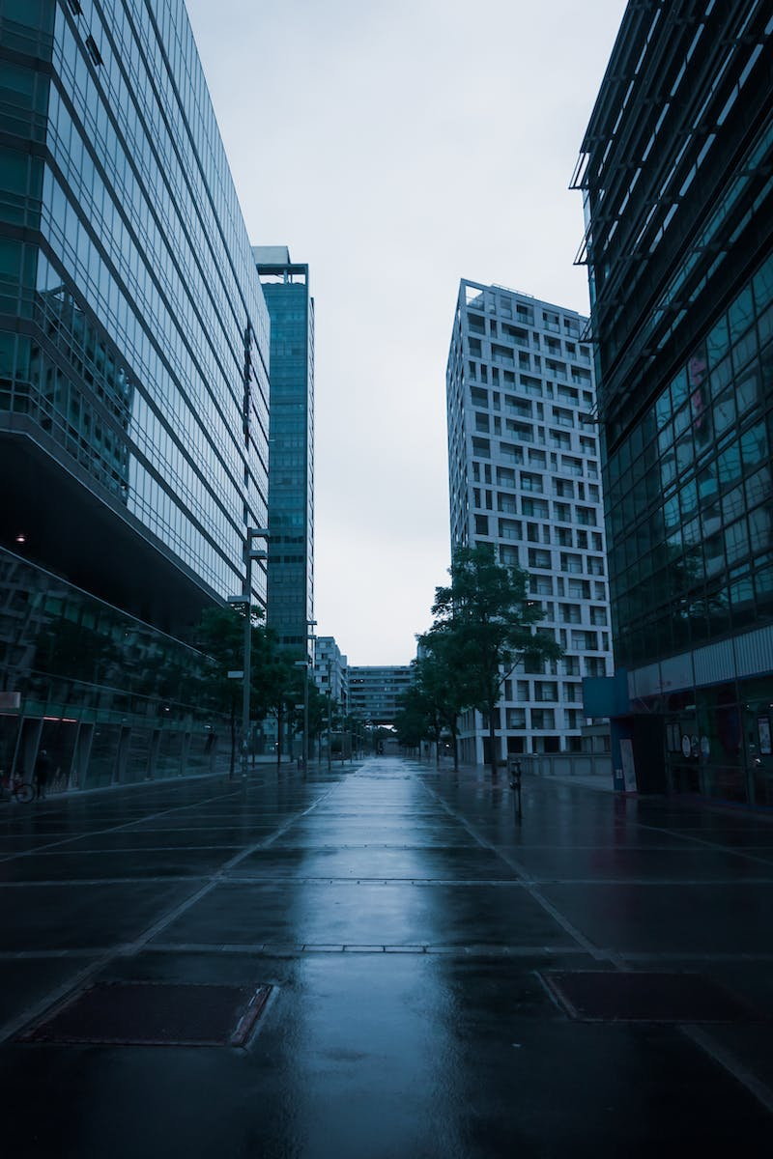
Blue Zone vs. Red Zone
• A Blue Zone is an environment of rewarded vulnerability and high psychological safety.
• A Red Zone is an environment of punished vulnerability and low psychological safety.
• The level of psychological safety determines the response of individuals.
• Creating a Blue Zone is a constant priority for teams.
Photo by Pexels

Slide 8
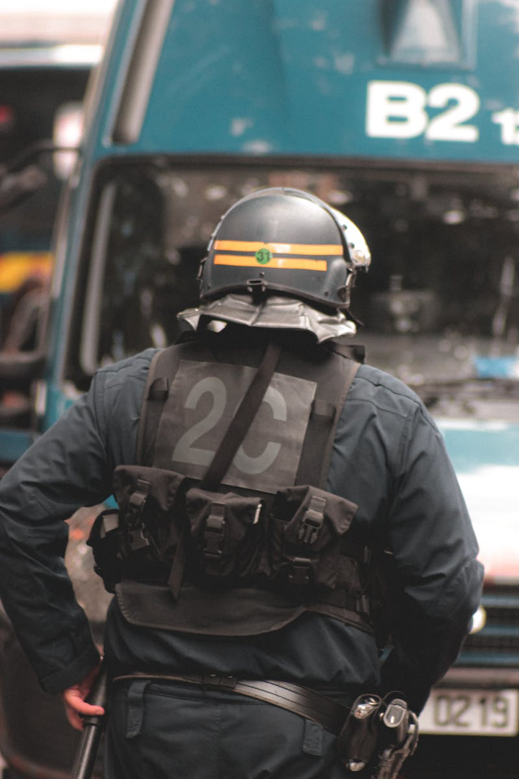
Perishable Nature of Psychological Safety
• Psychological safety is delicate and dynamic, not permanent.
• It requires constant effort and attention from the team.
• Similar to physical safety, psychological safety must be prioritized daily.
• Maintaining psychological safety ensures continuous team growth.
Photo by Pexels

