Slide 1
Understanding Fourier Transform
An Introduction to Digital Signal Processing

Slide 2
Introduction
• Explanation of the need to understand basic principles before diving into signal processing algorithms.
• The beauty of mathematics and its role in digital signal processing.
• Overview of the types of oscillations in nature.
• Introduction to the laboratory setup.
• Personal experience and motivation for learning math analysis.
• Explanation of the graphs and coordinate systems used in the presentation.
Photo by Pexels

Slide 3
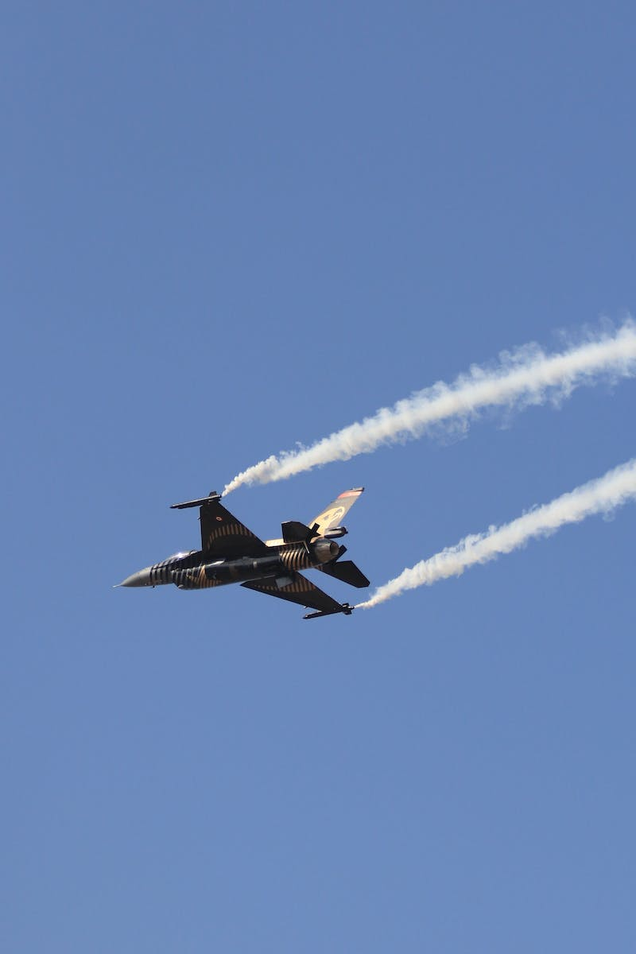
Fourier Transform
• Explanation of how Fourier transform is essential in digital signal processing.
• Introducing the concept of complex plane and its representation of complex numbers.
• Visual representation of the amplitude of oscillations on a graph.
• Demonstration of the transformation process using a rotating line on the complex plane.
• Relating the length of the line on the complex plane to the amplitude of the signal.
Photo by Pexels

Slide 4
Frequency Analysis
• Explanation of how frequency analysis helps understand the periodicity of a signal.
• Finding the period of oscillation and calculating the frequency.
• Demonstration of the movement of the center of mass on the complex plane.
• Relating the position of the center of mass to the number of oscillation cycles.
• Observing the behavior of the signal as the frequency of rotation matches the signal frequency.
Photo by Pexels

Slide 5
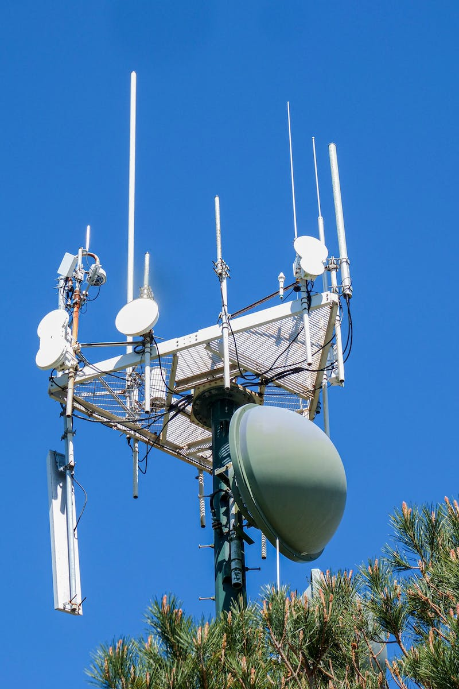
Zero Frequency
• Exploring the significance of zero frequency in signal rotation.
• Demonstrating the representation of zero frequency on the complex plane.
• Visualizing the behavior of the signal when the frequency of rotation is zero.
• Understanding the influence of negative signal values on the rotation.
• Observing the change in the shape of the signal when the frequency of rotation matches the signal frequency.
Photo by Pexels

Slide 6
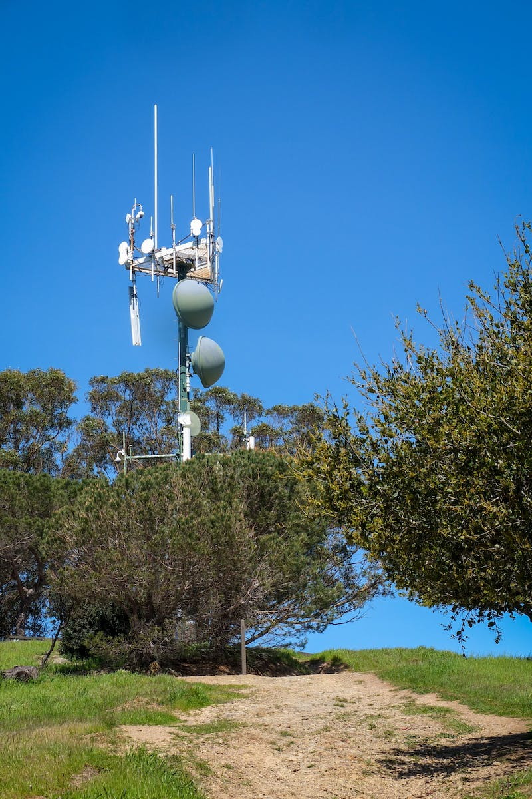
Multiple Frequencies
• Exploring the decomposition of a signal with multiple frequencies.
• Demonstration of a signal with two different frequencies.
• Observation of the decomposition process and extraction of individual components.
• Incorporation of an additional frequency component in the signal.
• Confirmation of the successful decomposition of multiple frequencies.
Photo by Pexels

Slide 7
Fourier Transform Formula
• Introduction to the mathematical formulas for the Fourier transform.
• Deriving the discrete Fourier transform formula.
• Relating the rotation of the complex plane to the functions representing the horizontal and vertical coordinates.
• Conversion of the discrete formula to the integral form.
• Comparison to the classical definition of the Fourier transform.
Photo by Pexels

