Slide 1
The Impact of Climate Change on Global Agriculture
Adapting to a Changing Landscape

Slide 2
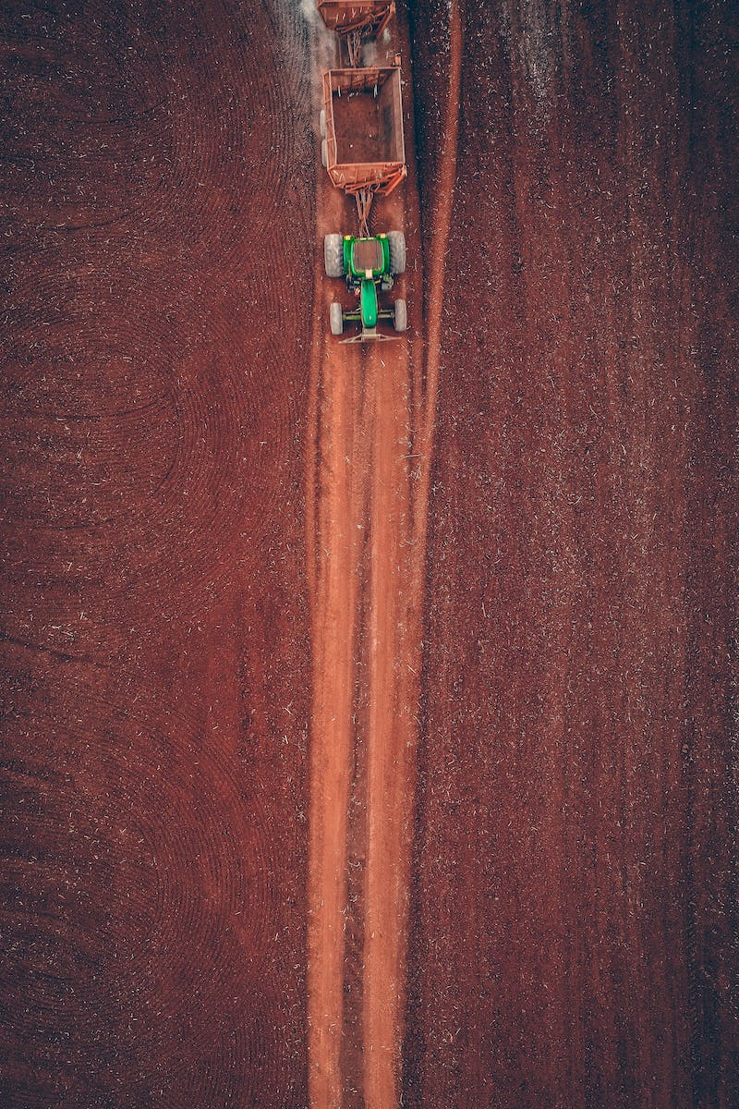
Introduction
• Climate change is a pressing global issue.
• Agriculture plays a crucial role in ensuring food security.
• This presentation explores the impact of climate change on global agriculture.
• We will discuss the challenges and potential solutions for adapting to a changing climate.
Photo by Pexels

Slide 3
Temperature Effects
• Rising temperatures affect crop growth and development.
• Heat stress can reduce crop yields and quality.
• Certain crops may become unsuitable for cultivation in certain regions.
• Extreme hot weather events can cause irreversible damage to crops.
Photo by Pexels

Slide 4
Changing Precipitation Patterns
• Shifts in precipitation patterns affect water availability for agriculture.
• Droughts can lead to water scarcity and crop failure.
• Intense rainfall events can cause soil erosion and nutrient loss.
• Changes in monsoon patterns impact crop planting and harvesting seasons.
Photo by Pexels

Slide 5
Pests and Diseases
• Warmer temperatures create favorable conditions for pests and diseases.
• Invasive species can damage crops and reduce yields.
• Changes in pest distribution affect pest management strategies.
• Increased disease pressure poses challenges for crop protection.
Photo by Pexels

Slide 6
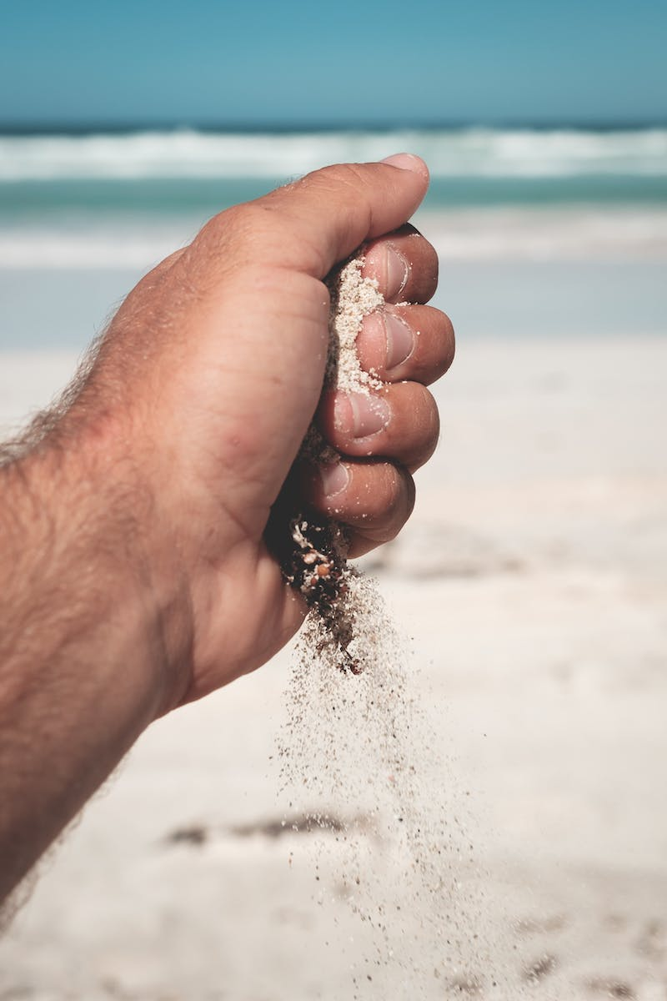
Adaptation Strategies
• Improved water management and irrigation techniques.
• Development and use of climate-resilient crop varieties.
• Implementation of agroforestry systems to enhance resilience.
• Investment in technology and precision farming practices.
Photo by Pexels

Slide 7
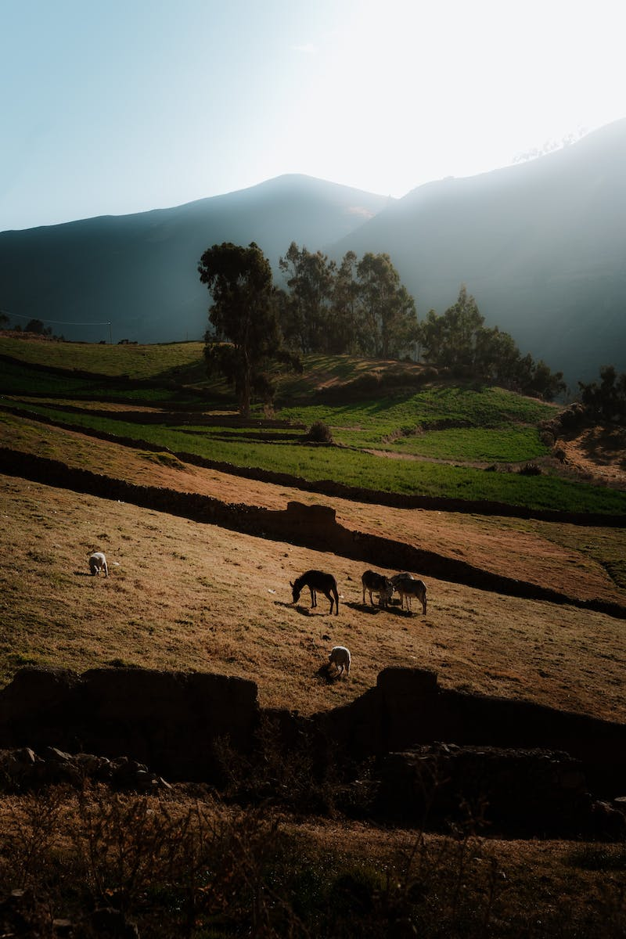
Conclusion
• Climate change poses significant challenges to global agriculture.
• Adaptation is essential for ensuring food security and sustainability.
• Collaboration between farmers, researchers, and policymakers is crucial.
• Investing in climate change mitigation measures can help reduce future impacts.
Photo by Pexels

