Slide 1
The Mystery of Language Acquisition
Exploring the origins and mechanisms of human language

Slide 2
Introduction: Language Sets Humans Apart
• Animals communicate, but lack sophisticated grammar
• Humans learn language effortlessly
• Why do we possess this unique ability?
Photo by Pexels

Slide 3
Innate Ideas vs. Tabula Rasa
• Debate on whether knowledge is innate or acquired
• Plato vs. John Locke and other Empiricists
• Are we born with inherent knowledge or do we acquire it through experience?
Photo by Pexels

Slide 4
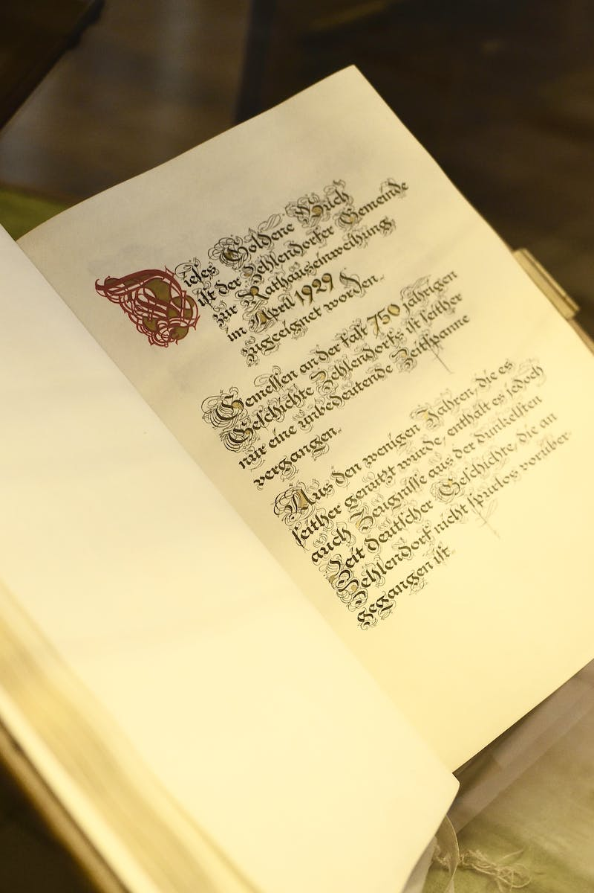
Chomsky's Poverty of Stimulus
• Children acquire language even with limited information
• Formation of complex grammatical structures
• Language acquisition requires more than input
Photo by Pexels

Slide 5
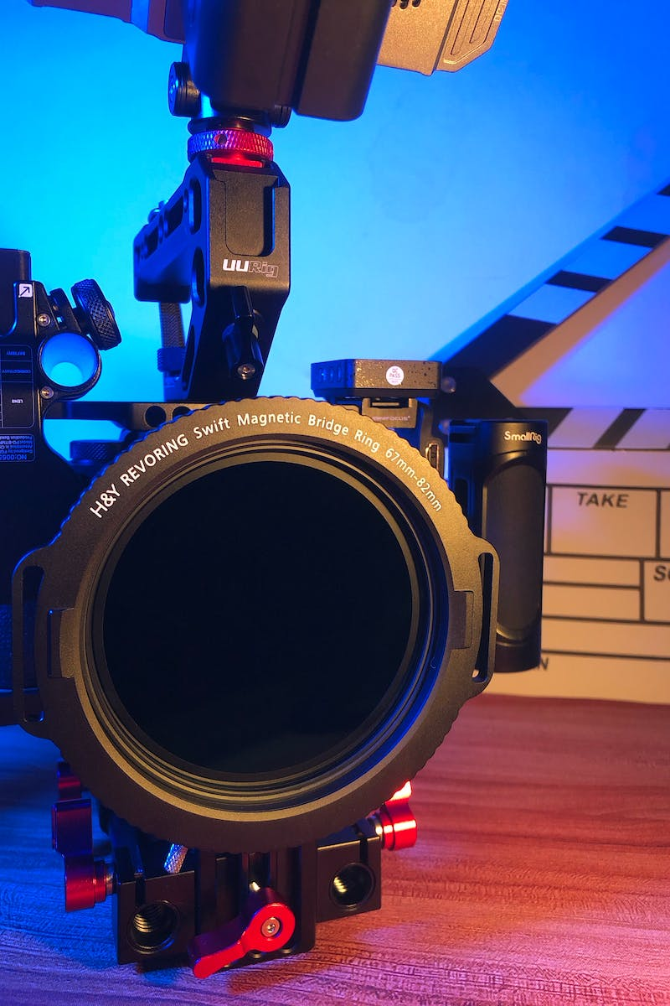
The Language Acquisition Device (LAD)
• Chomsky's theory of an innate language acquisition device
• Innate structures in the brain
• A natural propensity to organize spoken language
Photo by Pexels

Slide 6
Universal Grammar
• Language structure as a universal grammar
• Our brains pre-wired for language
• Language learning starts with innate structures
Photo by Pexels

Slide 7
Conclusion: Nature and Nurture
• Language acquisition as a combination of nature and nurture
• Innate structures enable language learning
• Experience and exposure shape language development
Photo by Pexels

