Slide 1
The Impact of Atmospheric Pollution on Health and Economics
Exploring the Link Between Air Quality and Asthma

Slide 2
Introduction: Understanding the Problem
• Atmospheric pollution poses a significant challenge to societies worldwide.
• Poor air quality has far-reaching implications for both health and the economy.
• Asthma, a common respiratory condition, is closely linked to polluted air.
• This presentation aims to shed light on the impact of atmospheric pollution on asthma and its economic consequences.
Photo by Pexels

Slide 3
Understanding Asthma: The Basics
• Asthma is a chronic respiratory disease characterized by airway inflammation and sensitivity.
• It affects millions of people worldwide, making it a significant public health concern.
• Common symptoms include shortness of breath, chest tightness, coughing, and wheezing.
• Triggers include airborne substances like pollutants, dust mites, and pollen.
Photo by Pexels

Slide 4
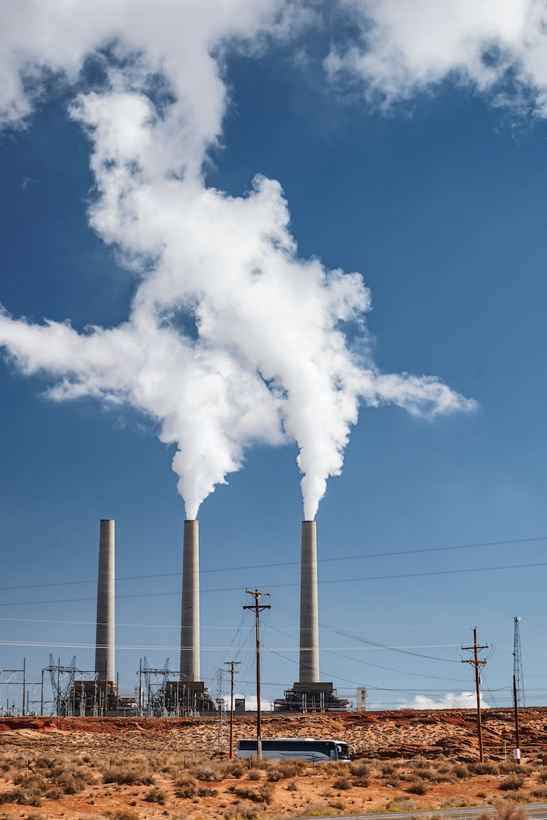
The Link Between Atmospheric Pollution and Asthma
• Research has established a clear link between exposure to air pollutants and asthma development.
• Particulate matter, ozone, and nitrogen oxide are among the pollutants associated with higher asthma prevalence.
• Children in polluted areas are especially vulnerable, with early exposure leading to long-term respiratory issues.
• Improved air quality has shown promising effects in reducing asthma symptoms and hospital admissions.
Photo by Pexels

Slide 5
Economic Consequences of Asthma Related to Atmospheric Pollution
• Asthma imposes a significant economic burden on individuals, families, and society as a whole.
• Direct costs include medical expenses, hospital visits, and medication.
• Indirect costs arise from reduced productivity, missed work or school days, and increased healthcare utilization.
• The economic impact extends to healthcare systems, insurance providers, and employers.
Photo by Pexels

Slide 6
Addressing the Problem: Strategies for Improvement
• Improving air quality requires multi-faceted approaches and cooperation between governments, industries, and individuals.
• Regulations and policies are needed to limit pollutant emissions and promote sustainable practices.
• Investment in cleaner technologies and renewable energy sources is crucial.
• Promoting awareness and education about the impact of air pollution on health can drive individual behavior change.
Photo by Pexels

