Slide 1
Understanding Chronic Kidney Disease
Exploring the Functions and Impact of Kidneys

Slide 2
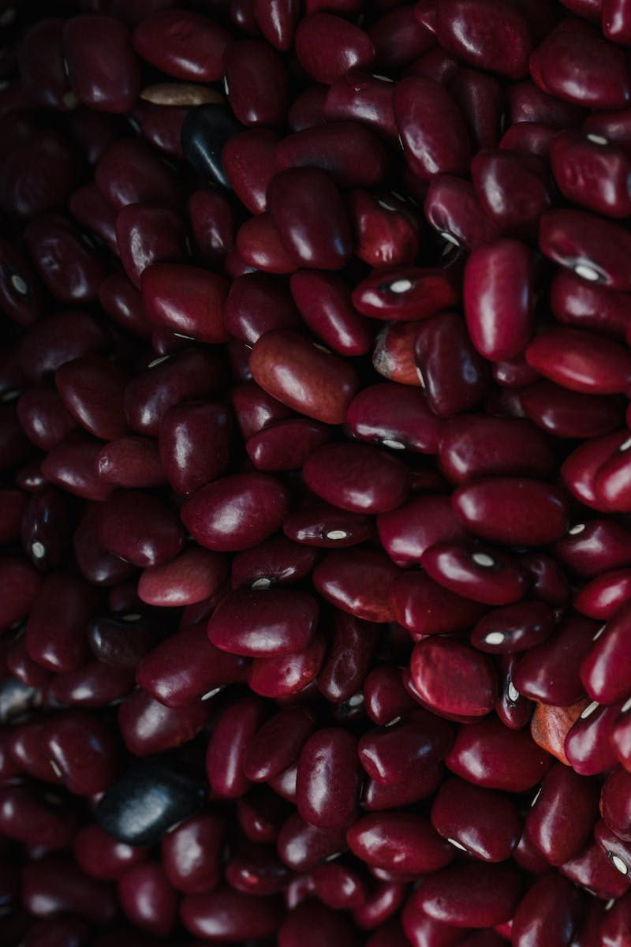
Introduction
• Chronic kidney disease (CKD) is a broad term
• CKD involves a gradual decline in kidney function
• Kidneys regulate blood composition, remove waste products, maintain electrolyte balance, and produce hormones
• Blood enters the kidney through the renal artery and passes through tiny arterioles called glomeruli
• Glomerular filtration generates primary filtrate, which moves through the renal tubules
• The rate of glomerular filtration is known as the glomerular filtration rate (GFR)
Photo by Pexels

Slide 3
Causes of CKD
• Hypertension is a common cause of CKD
• Hypertension leads to thickening of the arterial walls supplying the kidneys, resulting in reduced blood flow
• Other causes of CKD include diabetes, systemic diseases, infections, prolonged medication use, and exposure to toxins
• CKD can lead to glomerulosclerosis, fibrosis, and chronic kidney failure
Photo by Pexels

Slide 4
Effects of CKD
• CKD affects the elimination of waste products
• Accumulation of toxins in the blood can lead to symptoms such as nausea and loss of appetite
• Neurological effects include encephalopathy, which can manifest as asterixis (flapping tremor)
• CKD can also cause pericarditis and increase the risk of bleeding
• Imbalance of electrolytes, especially potassium, can lead to dangerous complications
Photo by Pexels

Slide 5
Diagnosis and Treatment
• Diagnosis of CKD is based on the decline in glomerular filtration rate (GFR)
• GFR below 90 indicates suspicion, while GFR below 60 confirms irreversible kidney damage
• Kidney biopsy may be performed to assess changes like glomerulosclerosis
• Treatment of CKD involves addressing the underlying cause
• In severe cases, dialysis or kidney transplantation may be necessary
Photo by Pexels

