Slide 1
The Life and Legacy of Alexander Pushkin
The Russian poet who shaped Russian language and literature

Slide 2
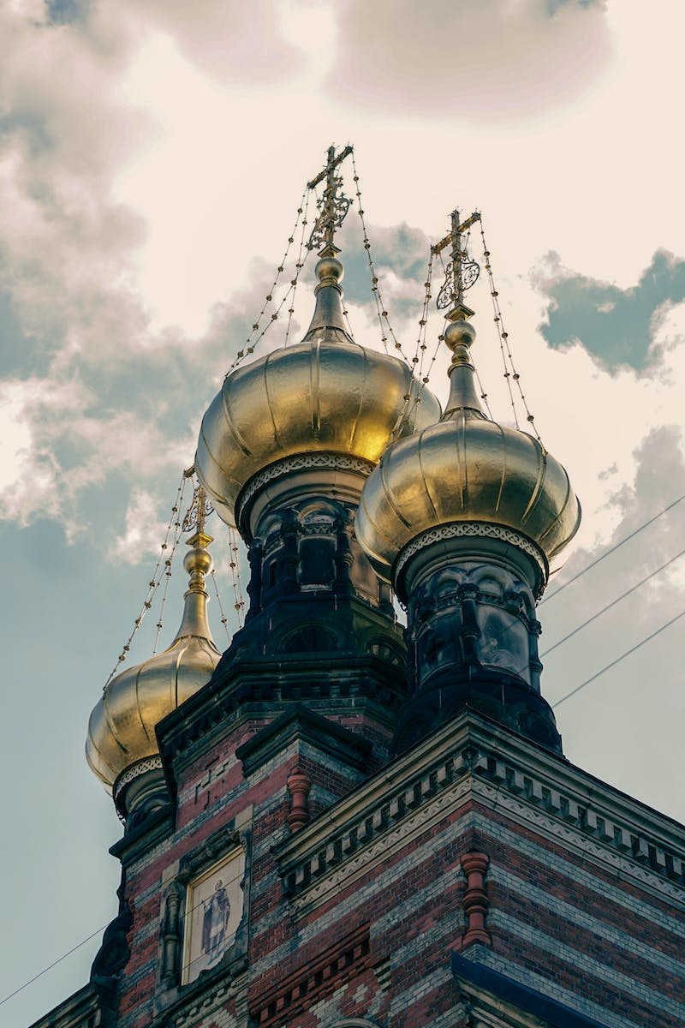
Introduction
• Overview of the presentation
• Summary of Alexander Pushkin's significance
• Setting the context in 17th century Russia
• Birth of Alexander Pushkin
• Significance of 'No Man's Sky' video game
Photo by Pexels

Slide 3
Pushkin's Early Life
• Birth of Alexander Pushkin
• Influence of Peter the Great
• Conversion to Orthodox Christianity
• Education in France
• Military participation
Photo by Pexels

Slide 4
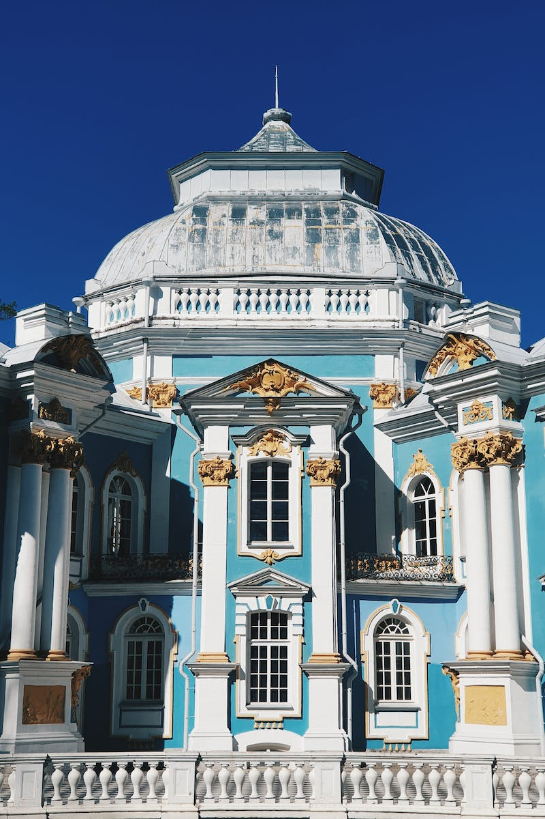
Literary Career
• Admission to Tsarskoye Selo Lyceum
• Challenges and achievements
• Publication of first poem
• Relationships with literary figures
• Establishment of 'The Contemporary' literary journal
Photo by Pexels

Slide 5
Political and Personal Challenges
• Exile to Moldova
• Involvement in secret societies
• Conflict with Louis-Charles-Frederic de Heeckeren
• Controversial reputation
• Failed duel with Georges-Charles de Heeckeren
Photo by Pexels

Slide 6
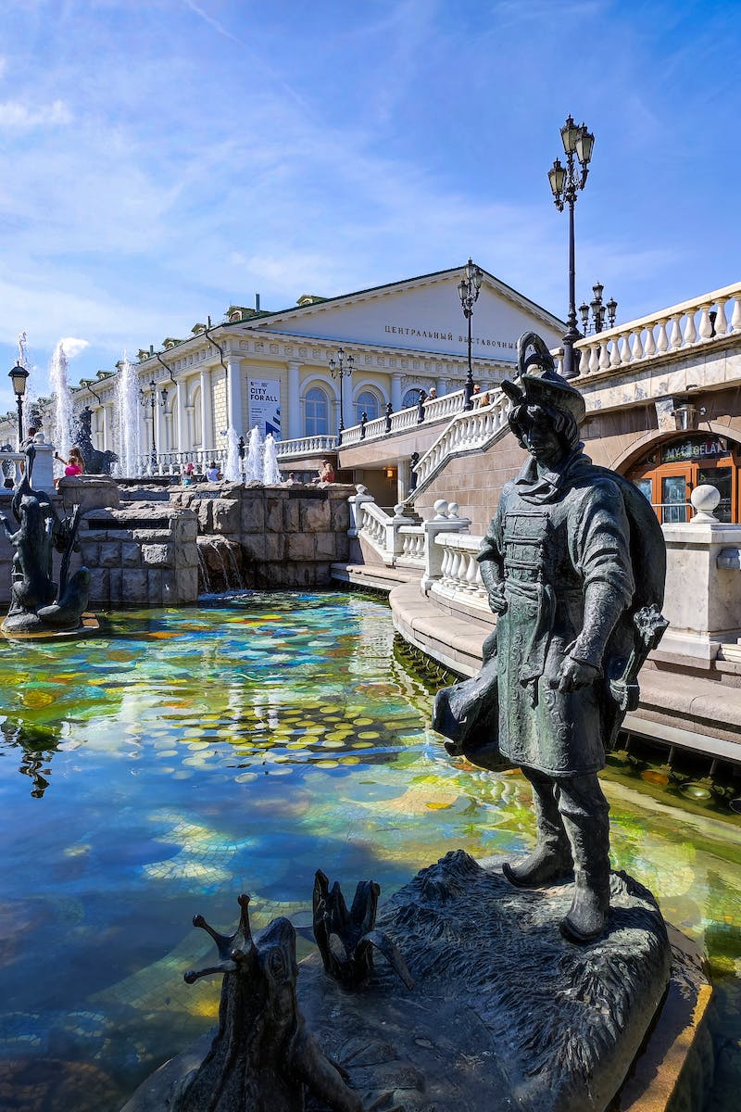
Love and Tragedy
• Marriage to Natalia Goncharova
• Financial difficulties
• Writing projects during quarantine
• Publications and reputation
• Relationship with Georges Dantes
Photo by Pexels

Slide 7
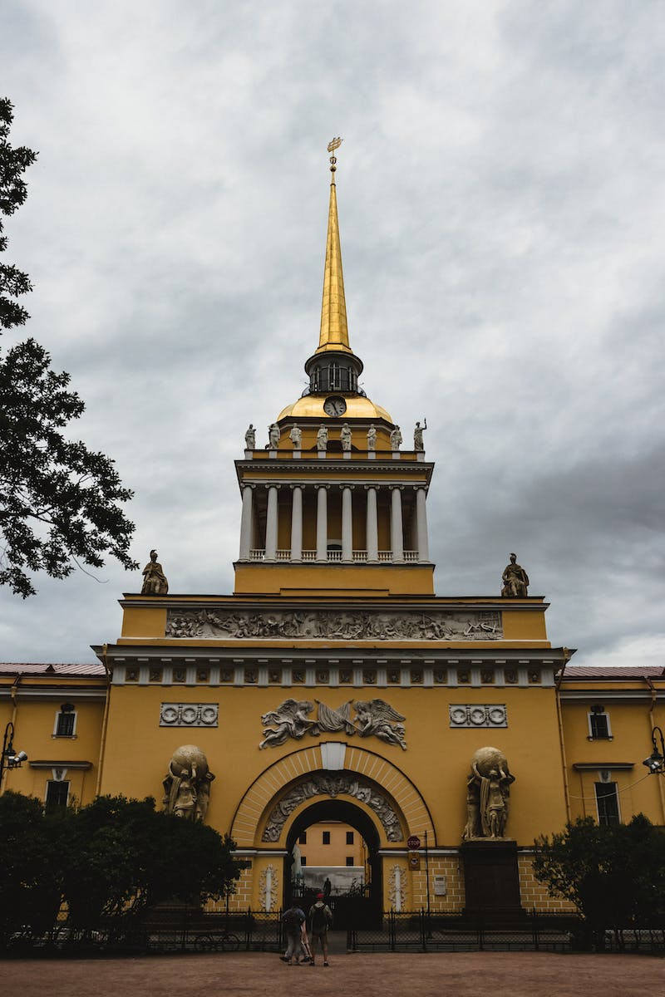
Legacy and Impact
• Evaluation of Pushkin's contribution
• Influence on Russian literature
• Pugachev's Rebellion
• Lasting relevance of Pushkin
• Cultural and artistic influence
Photo by Pexels

