Slide 1
The Impact of Social Media on Society
Exploring the effects of social media on individuals and communities

Slide 2
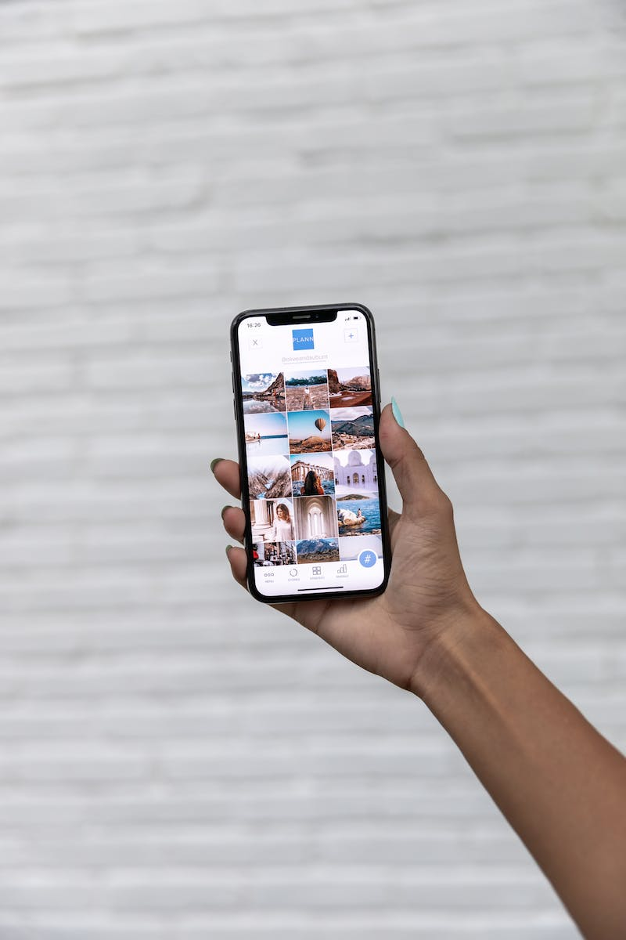
Introduction
• Social media has become an integral part of our daily lives
• It has revolutionized the way we communicate and connect with others
• However, it has also raised concerns regarding privacy and mental health
• This presentation will delve into the impact of social media on society
Photo by Pexels

Slide 3
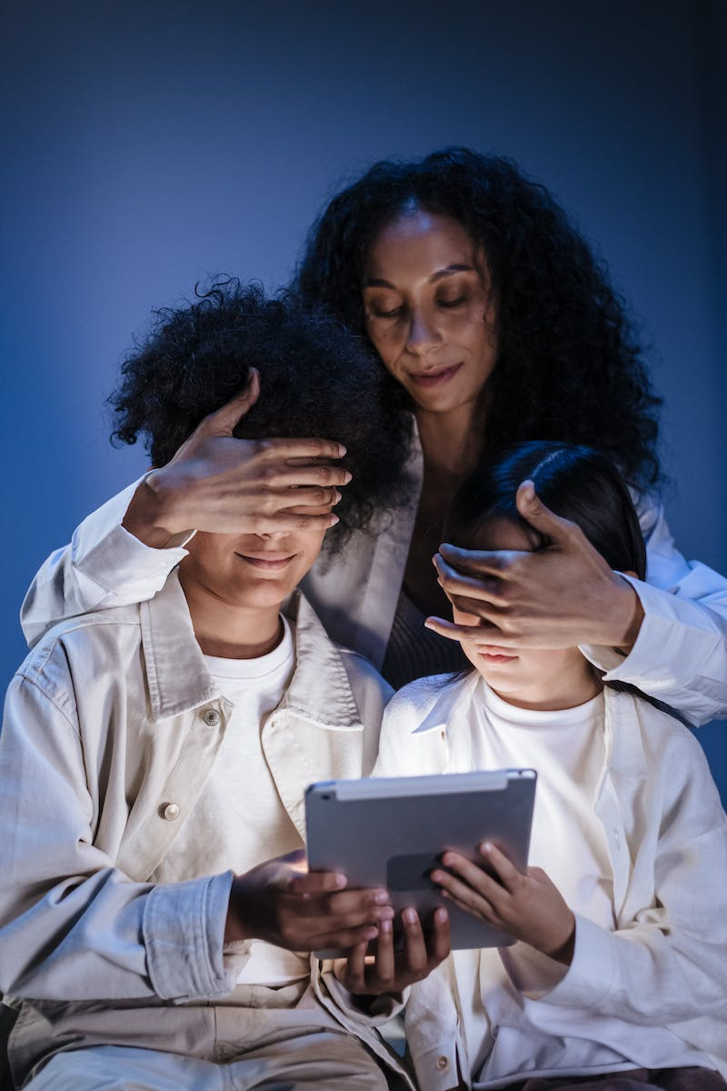
The Power of Social Media Influencers
• Social media influencers have gained significant influence over their followers
• They have the power to shape opinions and drive consumer behavior
• However, there are concerns about authenticity and transparency in influencer marketing
• It is important to consider the impact of these influencers on society
Photo by Pexels

Slide 4
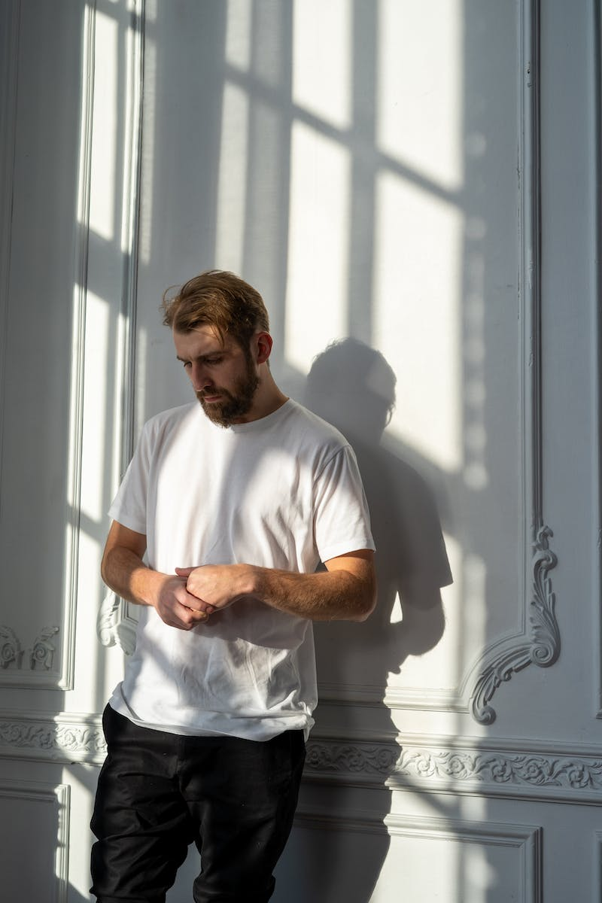
Social Media and Mental Health
• Studies have shown a link between excessive social media use and mental health issues
• Platforms like Instagram can contribute to feelings of inadequacy and low self-esteem
• Cyberbullying on social media can have severe consequences on mental well-being
• It is crucial to understand the impact of social media on mental health
Photo by Pexels

Slide 5
The Spread of Misinformation
• Social media has become a breeding ground for the spread of misinformation
• Fake news and conspiracy theories can easily gain traction on these platforms
• This has serious implications for trust in institutions and democratic processes
• We must address the challenge of combating misinformation on social media
Photo by Pexels

Slide 6
Conclusion
• Social media has undoubtedly transformed society in various ways
• It has connected people across the globe, but also raised concerns
• We need to strike a balance between harnessing the benefits and mitigating the negative impacts
• As individuals and as a society, we must navigate the social media landscape responsibly
Photo by Pexels

