Slide 1
Elements of Visual Art
Lesson Three of Contemporary Philippine Arts from the Regions

Slide 2
Introduction
• Welcome to lesson three of contemporary Philippine arts from the regions.
• Today's lesson is about the elements of visual art.
• The elements of visual art provide a starting point for understanding and creating art.
• There are seven elements of art: line, shape, form, space, texture, color, and value.
Photo by Pexels

Slide 3
Line
• Line refers to the continuous mark made by a moving point on a surface.
• Line can be used in various ways to suggest shape, structure, depth, movement, emotions, and more.
• Different types of lines convey different concepts, values, and feelings.
• Examples of lines include horizontal, vertical, diagonal, zigzag, curved, and jagged lines.
Photo by Pexels

Slide 4
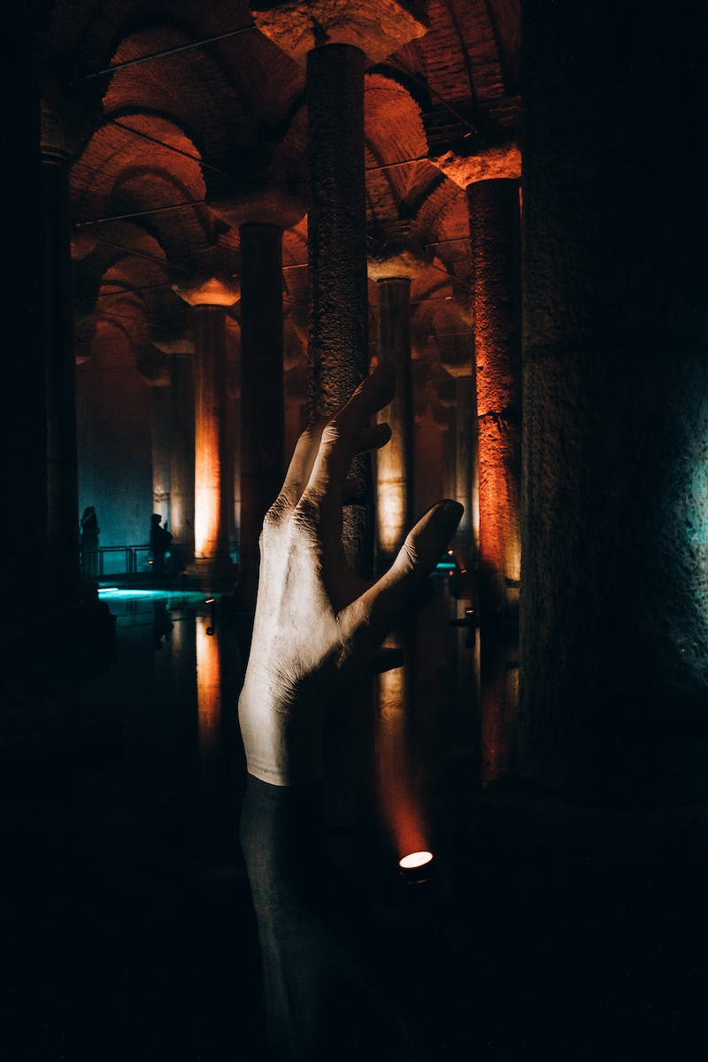
Line in Sculpture & Installation Art
• Line is often integrated into sculpture and installation art.
• An example is Megan Ge's outdoor installation 'Were Rewritten by Machine in New Technology', which features colored tape lines resembling flames.
• Another example is Philip Case Smith's 'One Fourth Mile Arc', an installation at Laguna Beach made of mirrors reflecting the sunsets.
Photo by Pexels

Slide 5
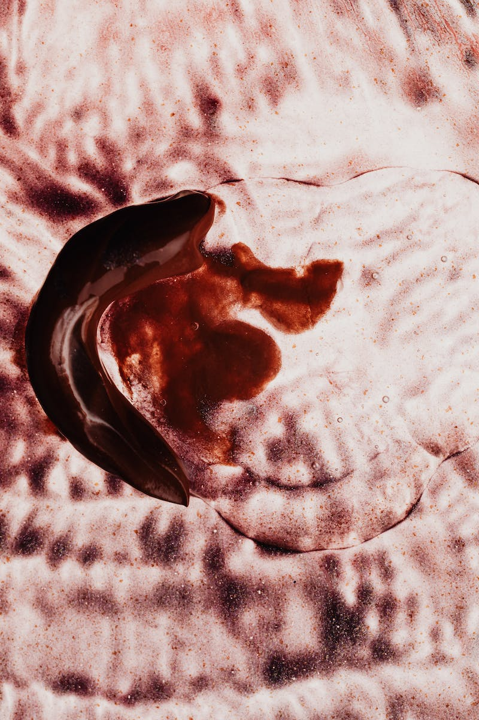
Horizontal Lines
• Horizontal lines suggest a feeling of rest or repos.
• Examples of objects or imagery with horizontal lines are sunsets.
Photo by Pexels

Slide 6
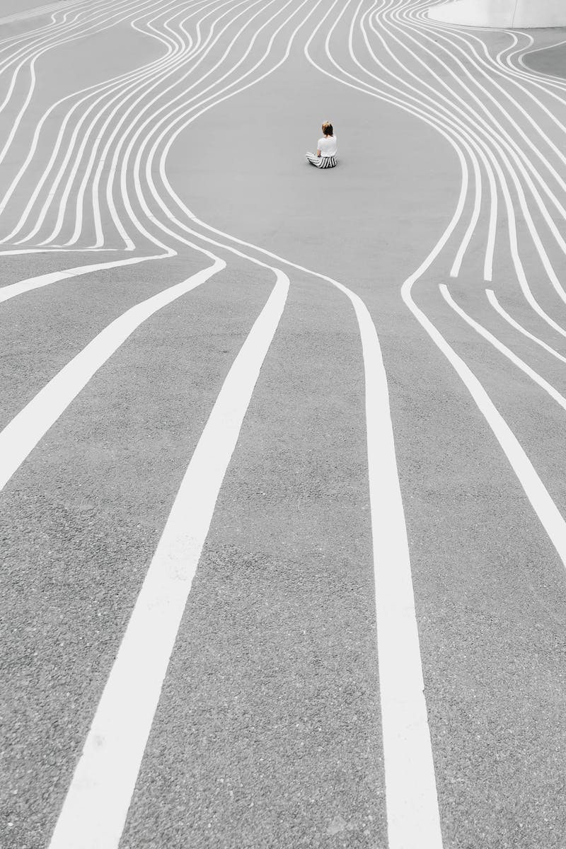
Vertical Lines
• Vertical lines often show dignity, formality, and strength.
• Examples include trees, buildings, and lamp posts.
Photo by Pexels

Slide 7
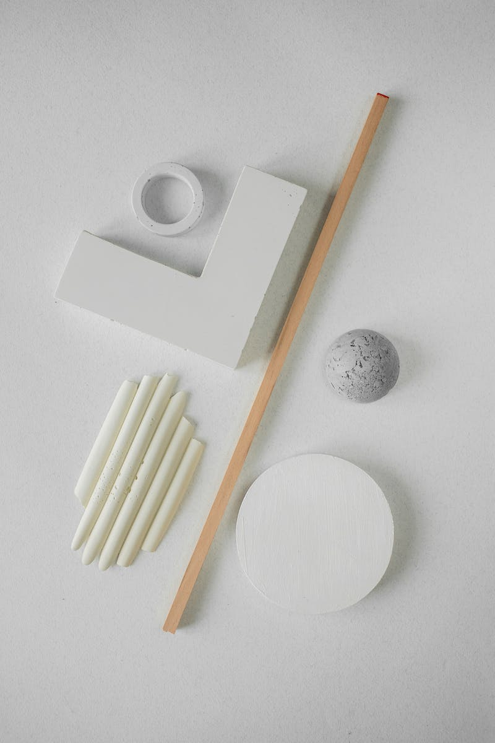
Diagonal Lines
• Diagonal lines can suggest action and excitement.
• Examples of zigzag lines are zigzag roads or stairs.
Photo by Pexels

Slide 8
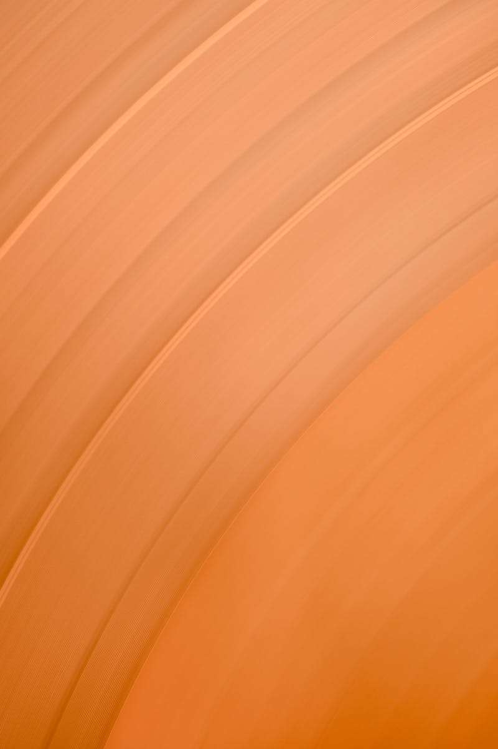
Curved Lines
• Curved lines suggest grace, beauty, and playfulness.
• An obvious example would be the human body.
Photo by Pexels

Slide 9
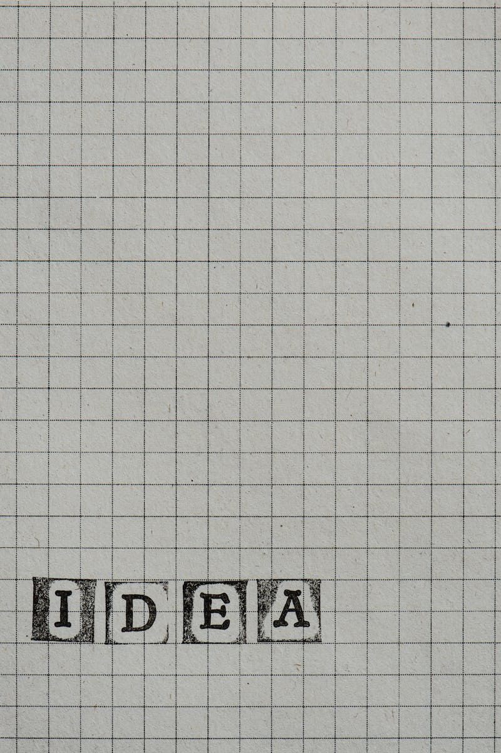
Jagged Lines
• Jagged lines suggest turmoil and anxiety.
• No specific examples are provided.
Photo by Pexels

Slide 10
Shape
• Shape is when the beginning of a line connects with its own end or intersects with another.
• Shapes indicate the general outline of an object and can be two-dimensional.
• There are two types of shapes: geometric and organic.
Photo by Pexels

Slide 11
Geometric Shapes
• Geometric shapes are basic shapes like squares, rectangles, circles, and cubes.
• Examples of geometric shapes can be found in crystal shapes and processed gemstones.
• Artists like Hans use cut paper to mimic geometric shapes in their artwork.
Photo by Pexels

Slide 12
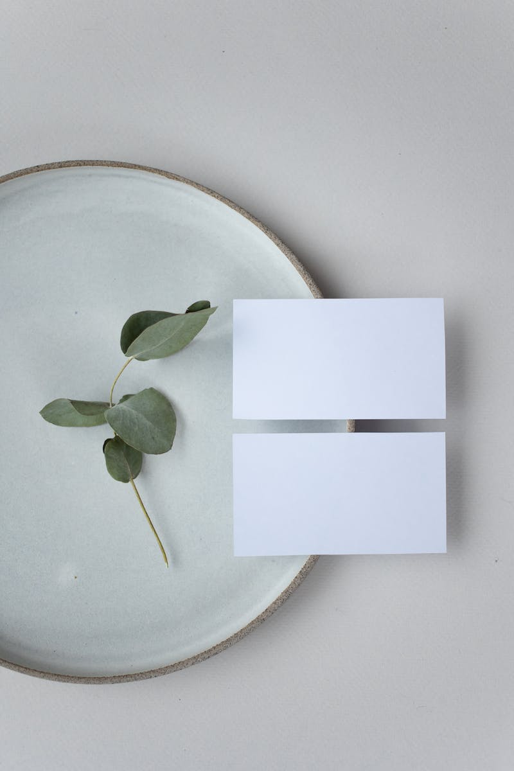
Organic Shapes
• Organic shapes are free-form and often derived from nature and living organisms.
• Examples of organic shapes can be found in Victoria Addis' painting 'The Builders'.
• Another example is On Mat's 'P the sea', inspired by organic shapes under the sea.
Photo by Pexels

Slide 13
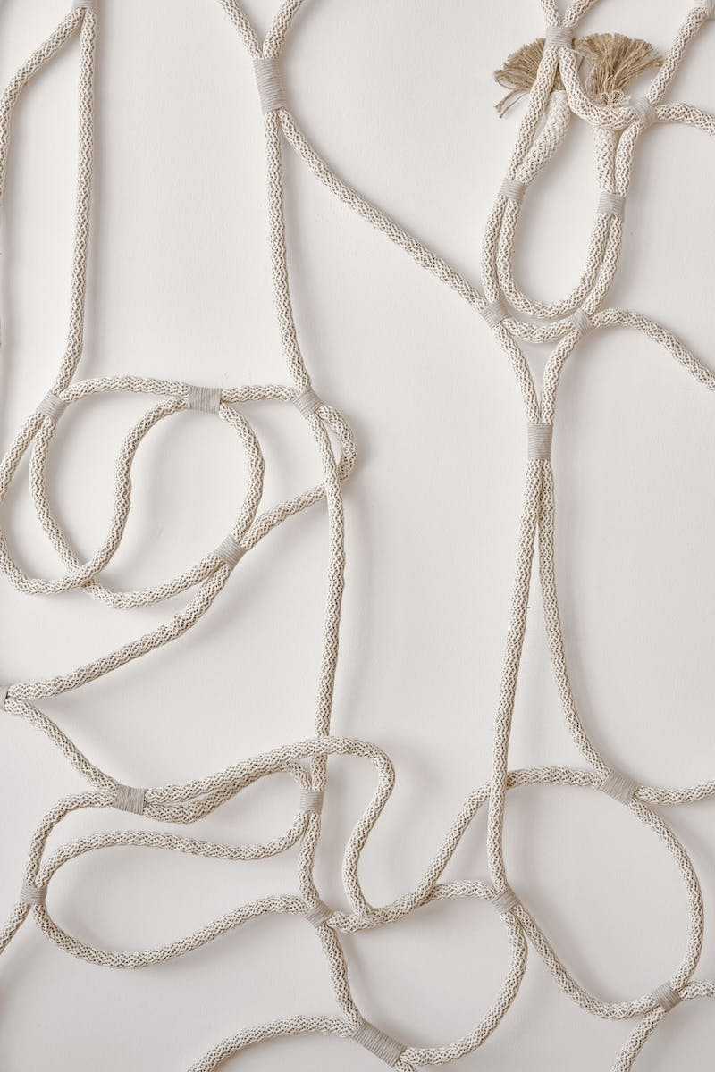
Form
• Form refers to the volume of a shape, including its height, width, and length.
• It is often associated with sculpture, 3D design, and architecture.
• An example of form in art is Michelangelo's sculptures 'David' and 'Pieta'.
Photo by Pexels

Slide 14
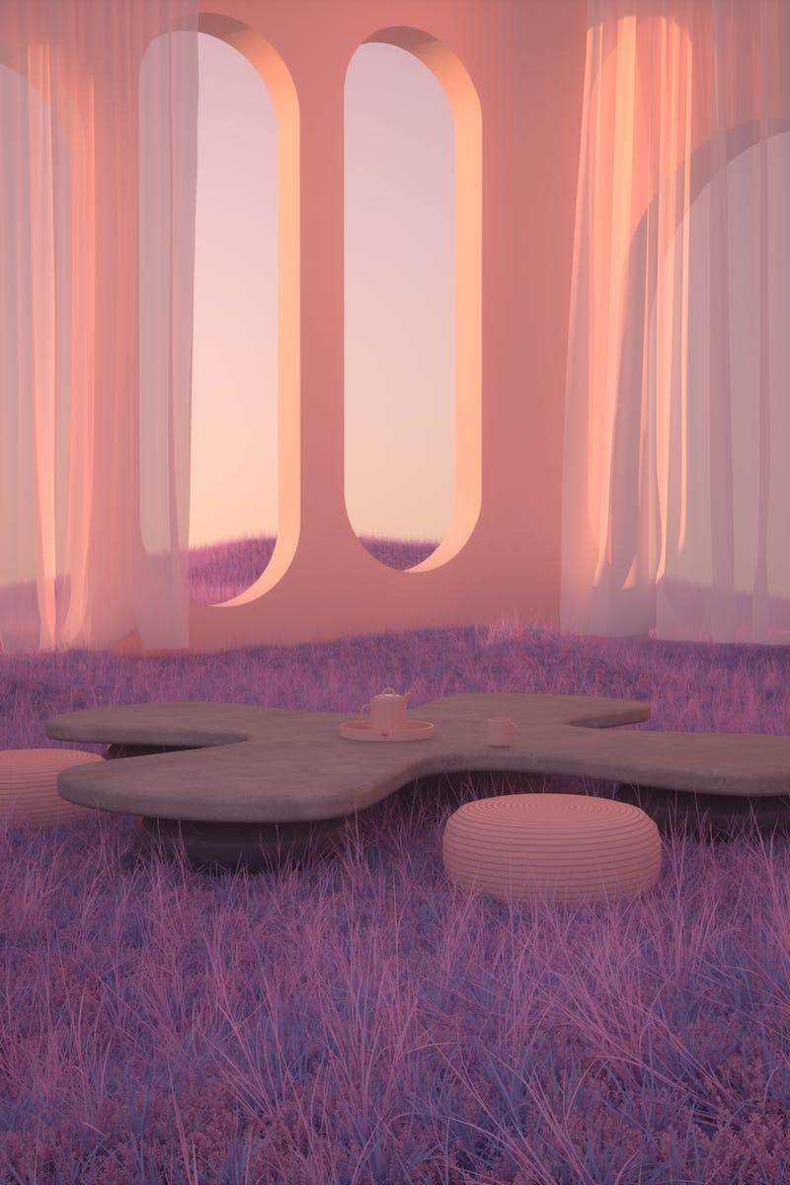
Illusion of 3D
• Form can also relate to the illusion of three-dimensionality on a two-dimensional surface.
• An example is Fiona Tan's artwork 'Humpback Whale', which uses the corner of the room to create a pop-out effect.
• Another example is Peter's artwork, where the corner of the building is utilized to achieve a 3D effect.
Photo by Pexels

Slide 15
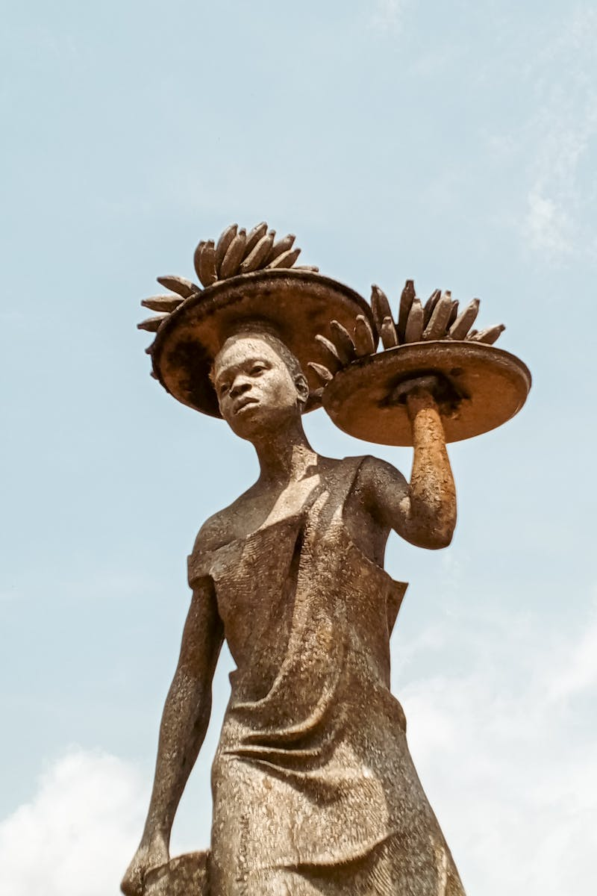
Conclusion
• This concludes part one of Lesson Three on the elements of visual arts.
• Stay tuned for the next video. Thank you!
•
Photo by Pexels

