Slide 1
The Power of Control Programs
Exploring Input, Processing, and Output Devices

Slide 2
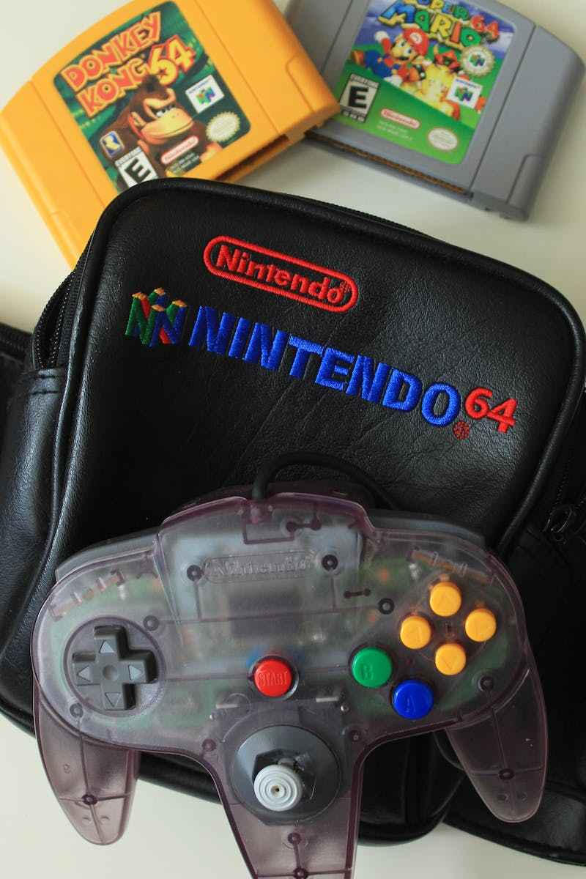
Introduction
• Control programs play a crucial role in various devices
• Input devices like webcams and voice recorders provide data
• Processing devices, such as Raspberry Pi, handle data processing
• Output devices, like speakers, deliver the processed information
Photo by Pexels

Slide 3
Input Devices
• Input devices collect data for control programs
• Webcams capture visual information
• Voice recorders capture audio data
• Multiple input devices can be used simultaneously
Photo by Pexels

Slide 4
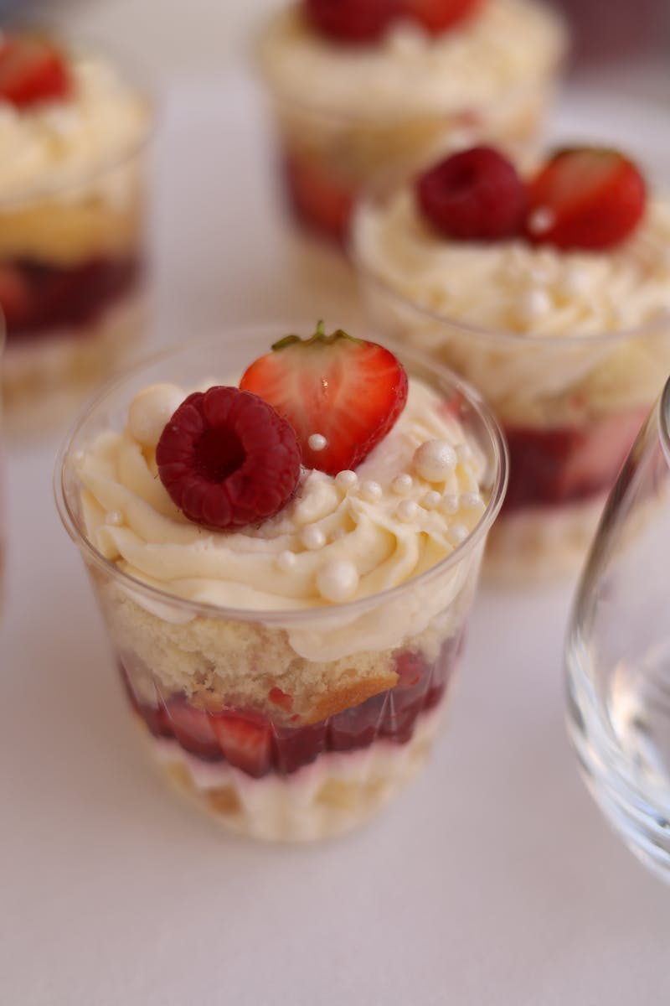
Processing Devices
• Processing devices are responsible for data processing
• Raspberry Pi is a popular processing device
• Processing units like CPUs enhance data manipulation
• Efficient processing leads to accurate output
Photo by Pexels

Slide 5
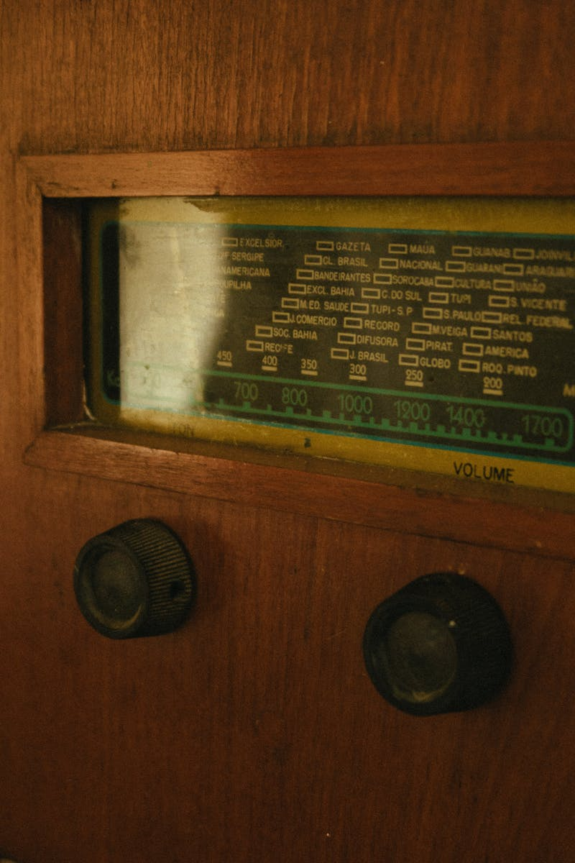
Output Devices
• Output devices display or transmit processed information
• Speakers provide audible output
• Any device capable of output can be used
• Output devices enhance user experience
Photo by Pexels

Slide 6
Integration Across Office Applications
• Control programs often require integration with office tools
• Microsoft Word and PowerPoint offer necessary features
• Photoshop enables advanced image manipulation
• Search engines like Google and Mozilla assist in research
Photo by Pexels

