Slide 1
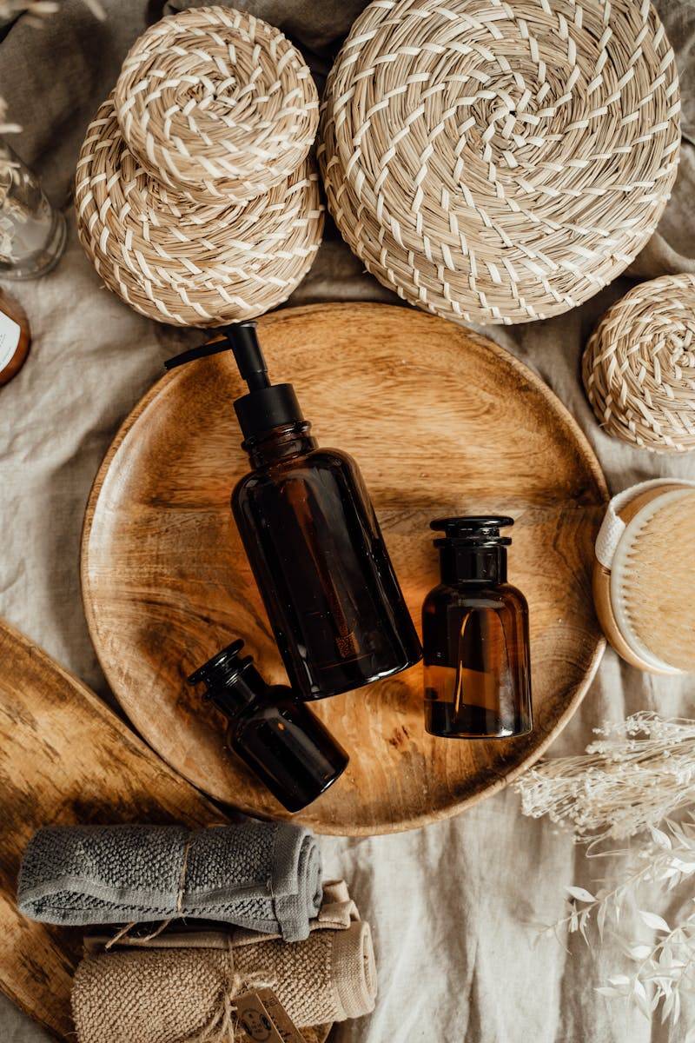
Әсем Әлем Косметикалар Beauty Industry Insights
Photo by Pexels

Slide 2
01
Beauty Industry Overview
Table of Contents
02
Product Categories
03
Market Trends
04
Consumer Behavior
05
Future Outlook

Slide 3
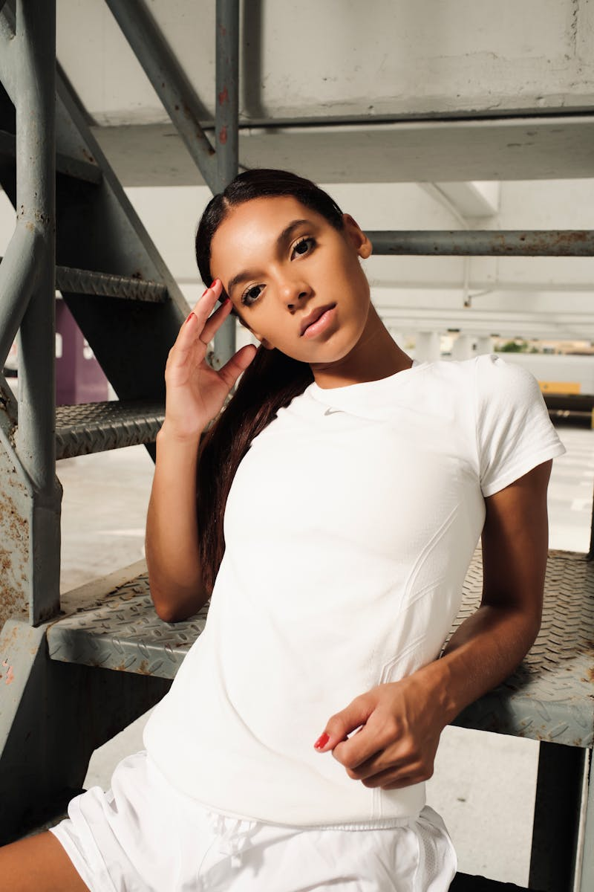
1
Beauty Industry Overview
Understanding the Cosmetic World
The beauty industry represents a multi-billion dollar market with continuous growth and innovation. Increasing focus on personal care and beauty products drives market expansion worldwide. Cosmetics sector has transformed significantly with new technologies and changing consumer preferences. Beauty industry contributes significantly to global economy through manufacturing, retail, and services.

Slide 4
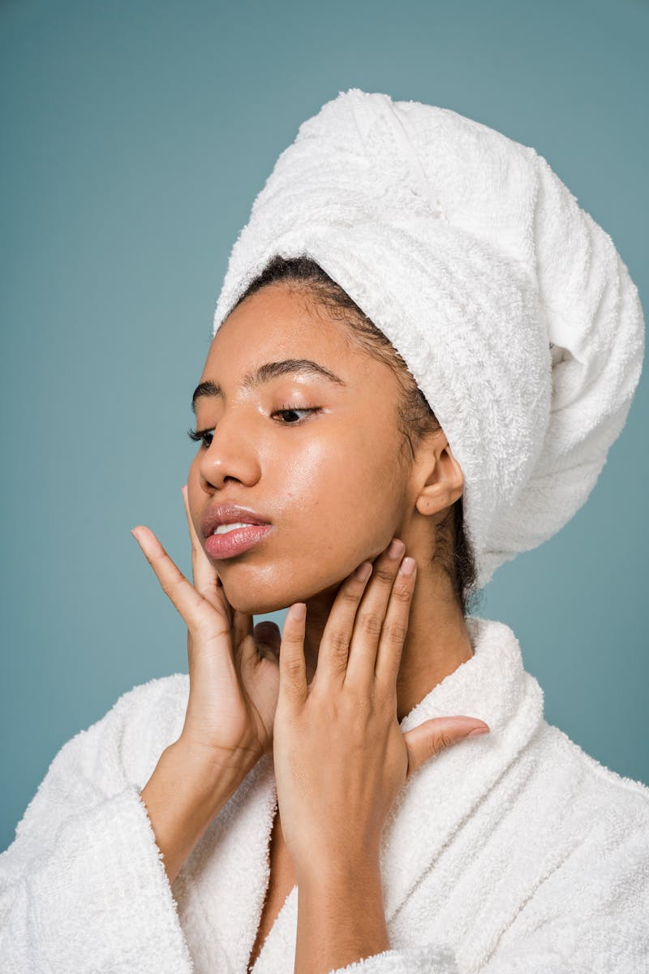
2
Product Categories
Types of Cosmetic Products
Face creams, cleansers, moisturizers, and specialized treatments for various skin types. Makeup products including foundations, lipsticks, eyeshadows, and nail polishes. Perfumes, colognes, and scented products for personal fragrance enhancement. Shampoos, conditioners, styling products, and treatments for hair health and appearance.

Slide 5

3
Market Trends
Current Beauty Industry Developments
Growing preference for organic, natural, and sustainable beauty ingredients. Advanced technologies like AI and AR transforming beauty product development and application. Customized beauty solutions tailored to individual skin types and preferences. Increased emphasis on eco-friendly packaging and environmentally conscious production methods.

Slide 6

4
Consumer Behavior
Beauty Purchase Patterns
Consumers often develop strong preferences for specific cosmetic brands and products. Social media, beauty influencers, and peer recommendations significantly impact purchase decisions. High standards for product effectiveness, safety, and user experience drive consumer choices. Consumers balance quality expectations with budget considerations when selecting beauty products.

Slide 7

5
Future Outlook
Beauty Industry Predictions
Rapid advancement in cosmetic formulations and delivery systems expected in coming years. Beauty market growth continuing across emerging markets and new consumer segments. E-commerce and digital platforms becoming primary channels for beauty product sales and marketing. Increasing convergence between beauty products and wellness, health-focused formulations gaining popularity.

