Slide 1
The Rise of Artificial Intelligence
How AI is Transforming Our World

Slide 2
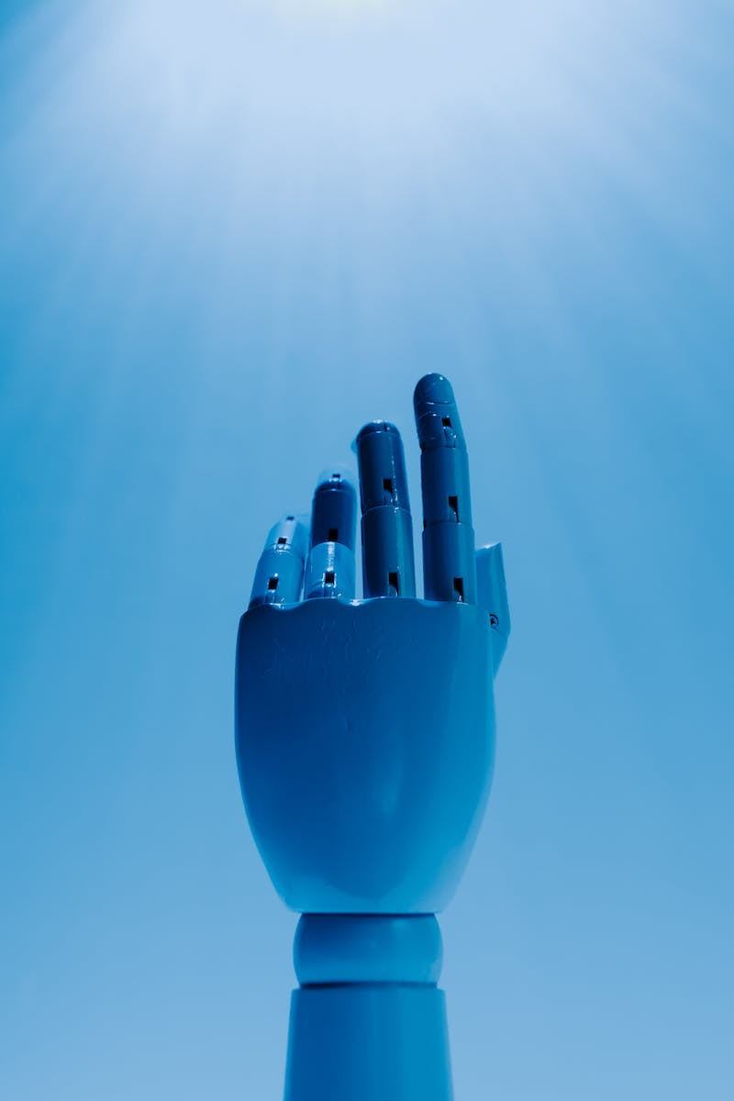
Introduction: The New Era of Artificial Intelligence
• Artificial intelligence is being integrated into various aspects of our lives
• Monopolists like Google, Meta, Microsoft, and Apple are releasing AI-powered products
• AI programs are becoming more accessible and user-friendly
• Even people unfamiliar with AI will experience its impact in social networks and everyday products
Photo by Pexels

Slide 3
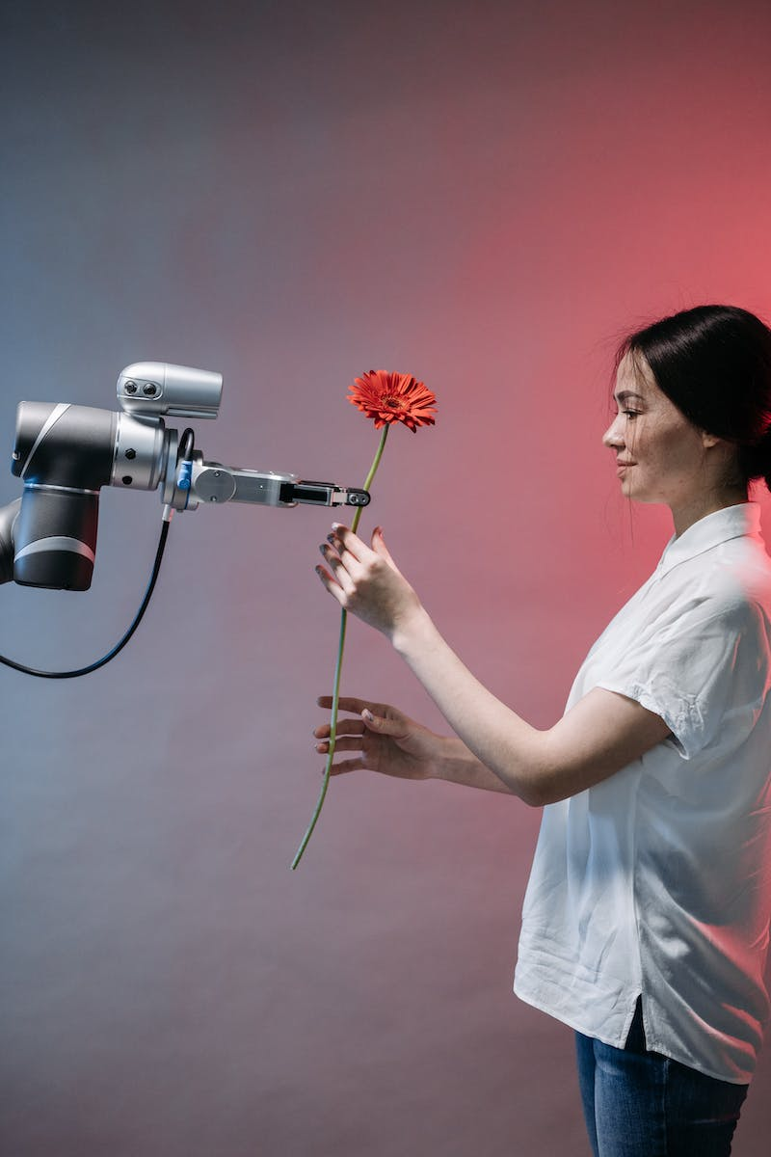
Meta's AI Updates for Social Networks
• Meta announced new updates for Facebook, Instagram, and WhatsApp
• Meta AI, based on the LLama 2 engine, enhances conversational capabilities
• Users can ask questions and customize messages using AI
• Integration of AI allows for personalized chat bots and niche specialization
Photo by Pexels

Slide 4
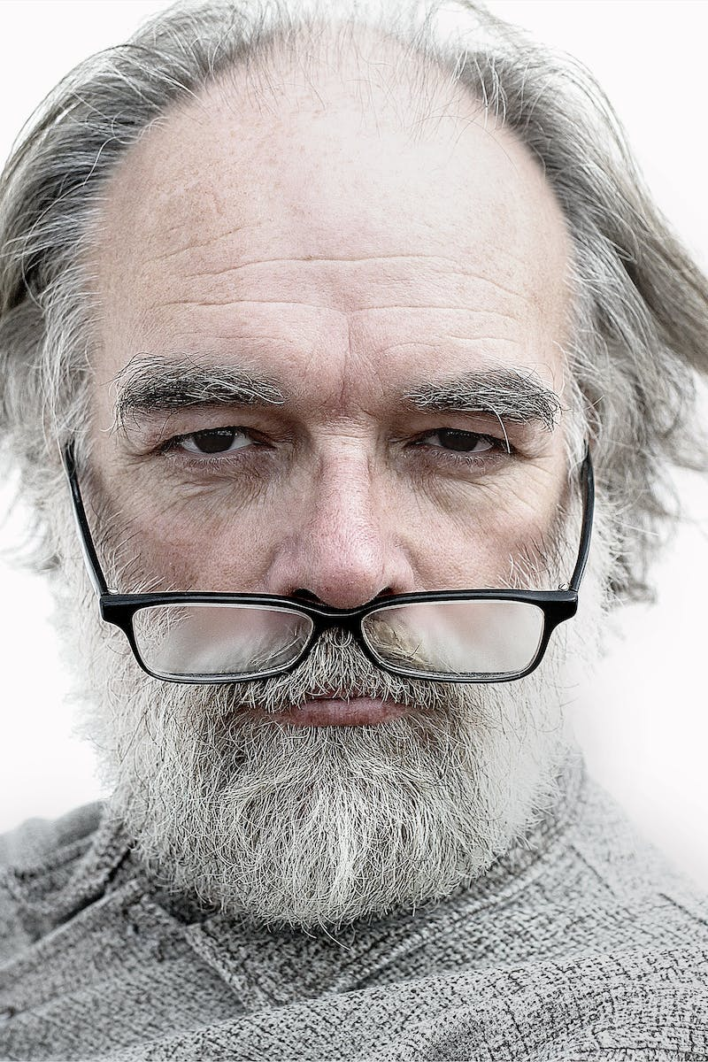
Meta's Glasses and Personalized Chat Bots
• Meta announces new smart glasses, Ray Ban Meta Smart Glasses
• Glasses integrate AI for various functionalities, including video recording and broadcasting
• AI enables object recognition and interactive communication
• Personalized chat bots based on individuals' expertise and knowledge
Photo by Pexels

Slide 5
AI Studio: Creating Your Own Artificial Intelligence
• AI Studio is a platform for creating and training AI
• Allows users to create personalized AI without programming skills
• Users can train their AI and control its behavior
• Offers opportunities for professional development and AI competency
Photo by Pexels

Slide 6
Windows Introduces AI Integration
• Windows 11 now embeds AI functionality into computers
• AI capabilities include generating content and assisting with tasks
• Enables control of computer functions through AI commands
• Reduces reliance on third-party programs
Photo by Pexels

Slide 7
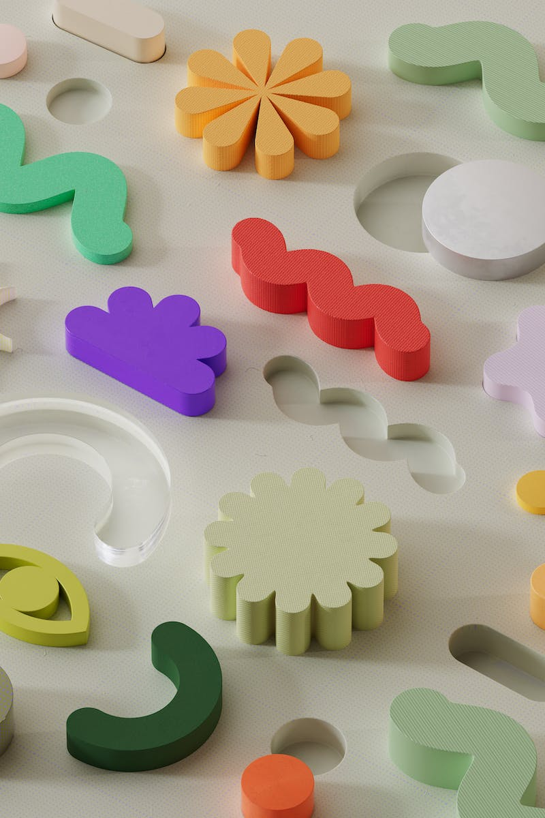
Google's AI Integration in Daily Life
• Google integrates AI into Gmail, Docs, Workspace, and Calendar
• AI assists in managing tasks, finding information, and creating lists
• AI becomes an integral part of Google applications
• The future implications of widespread AI integration
Photo by Pexels

Slide 8
AI in Design: Canva's Rapid Adoption
• Canva incorporates AI for background removal and content creation
• AI enables picture and video generation within Canva
• Canva's commitment to leveraging AI for enhanced design capabilities
• The expanding role of AI in creative industries
Photo by Pexels

Slide 9
AI Integration in Physical Products
• Companies like Rewind introduce AI in physical accessories
• Rewind's accessory records and analyzes daily conversations
• AI-powered accessories enable advanced data analysis and insights
• The implications of AI-integrated physical products
Photo by Pexels

Slide 10
Spotify's Voice Cloning for Podcasts
• Spotify introduces voice cloning for podcasts
• Allows podcast listeners to enjoy content in different languages
• Enables translation of podcasts into multiple languages
• Expanding the accessibility and reach of podcasts
Photo by Pexels

Slide 11
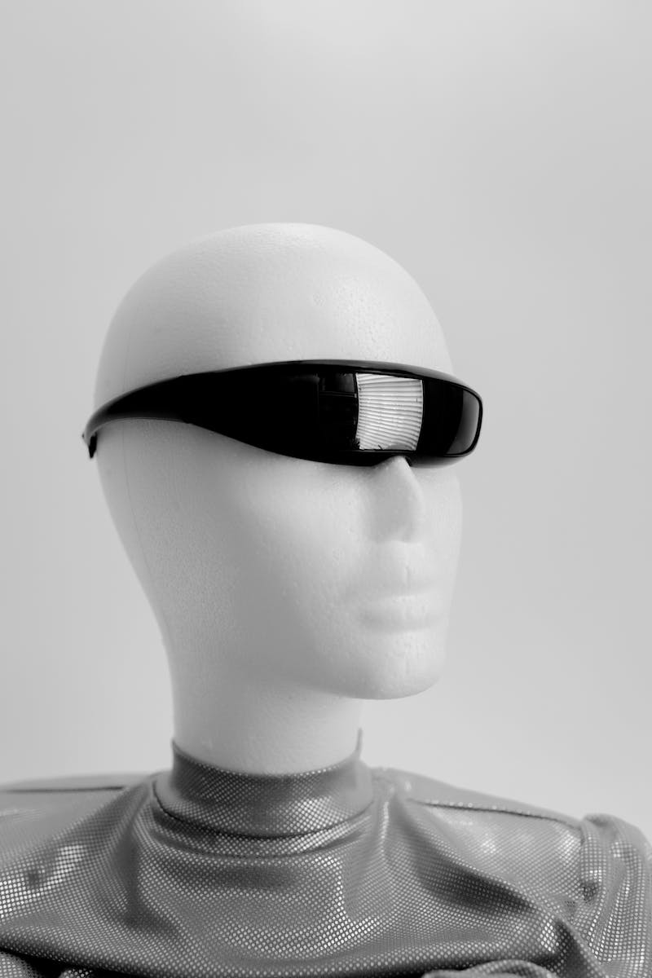
Conclusion: Reflections on AI's Impact
• AI's widespread integration transforms our daily lives
• Major companies shape the AI landscape
• Anticipate further integration and improvements
• Considering the implications and possibilities of AI
Photo by Pexels

