Slide 1
The Rise and Fall of the Inca Empire
From humble beginnings to a tragic end

Slide 2
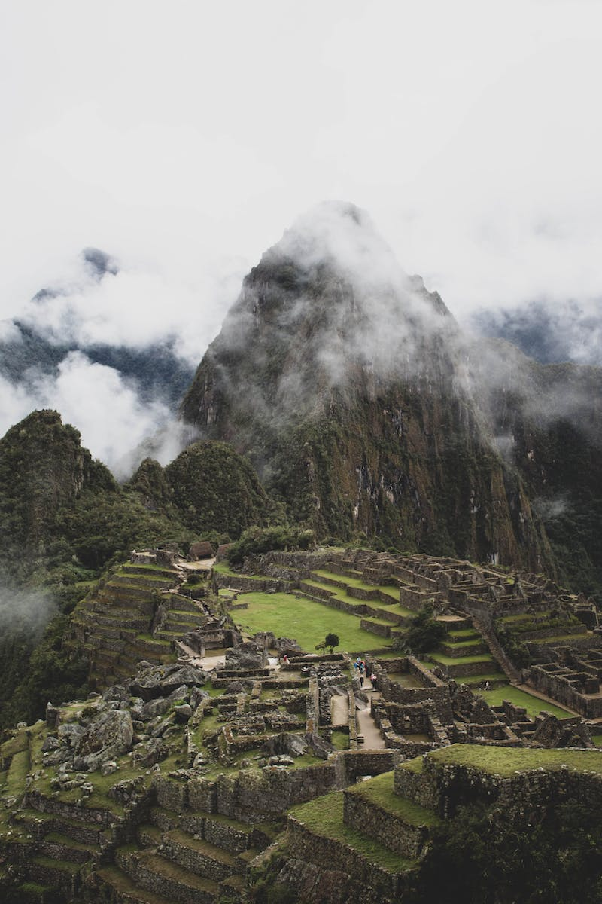
Introduction
• Western Hemisphere's largest empire
• Population of nearly ten million subjects
• Massive administrative centers, temples, and road systems
• No wheels, horses, or written language
Photo by Pexels

Slide 3
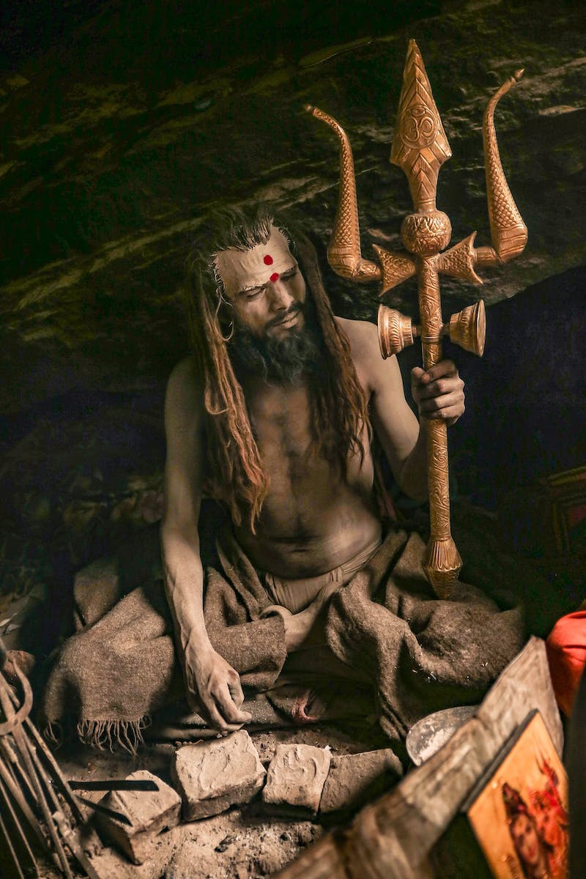
Legend and Origins
• Ancestors of Inca rulers created by the sun god Inti
• Emergence from a cave called Tomb Taco
• Aya Manco led four brothers and four sisters
• Aya Manco became the first Sapa Inca
Photo by Pexels

Slide 4
Expansion and Reforms
• Inca first settled in the K Valley around 1200 CE
• King Viracocha faced threats from the neighboring Shanka tribe
• Son Pachacuti successfully defended the capital and became the ninth Sapa Inca
• Implemented extensive reforms and expanded Inca rule
Photo by Pexels

Slide 5
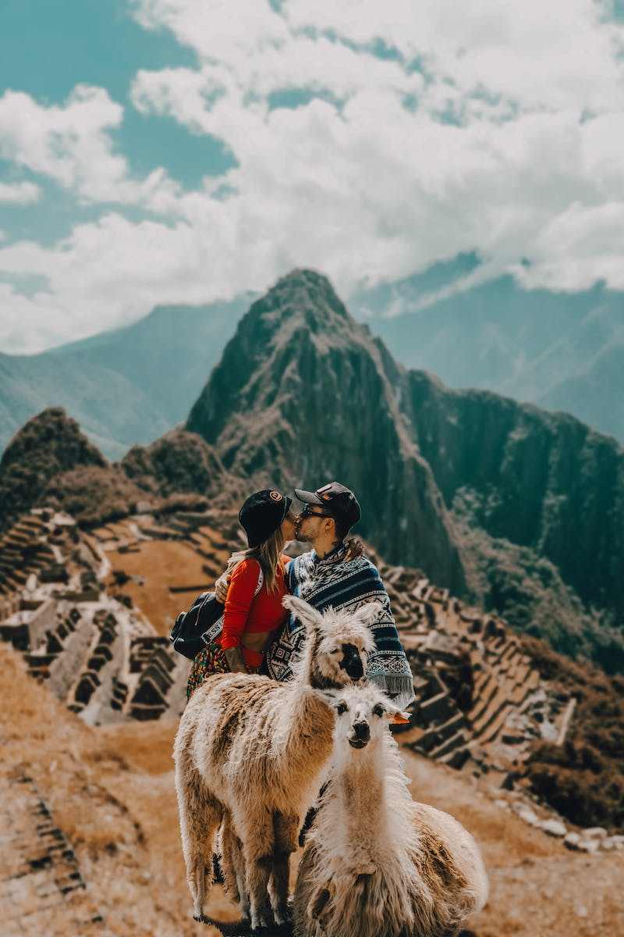
Machu Picchu and Cultural Legacy
• Construction of Machu Picchu during Pachacuti's reign
• Continued military expansion under Topa Inca
• Spanish conquest and devastating impact of diseases
• Surviving Inca resistance at Vilcabamba
Photo by Pexels

Slide 6
Final Collapse and Conquest
• Succession crisis and civil war among surviving brothers
• Atahualpa emerges victorious, but weakened
• Encounter with Spanish conquistadors
• Fall of the Inca Empire and destruction of cultural legacy
Photo by Pexels

Slide 7
Conclusion
• Rapid rise and even faster fall of the Inca Empire
• Legacy of Inca achievements and cultural heritage
• Importance of studying and preserving their history
Photo by Pexels

