Slide 1
Dolly 3: The Next Evolution in Image Generation
Explore the Features and Benefits of Dolly 3

Slide 2
Introduction to Dolly 3
• Dolly 3 is a revolutionary image generation tool
• Features include mid journey and stable diffusion
• A game changer in the AI landscape
• Provides competition to existing platforms
Photo by Pexels

Slide 3
Discovering Dolly 3
• Access to Dolly 3 through Bing.com
• Possible requirement of logging into Microsoft account
• Use of Microsoft Bing's Image Creator
• Comparison with Dolly 2
Photo by Pexels

Slide 4
Validating Dolly 3
• Comparing generated images with Dolly 3 blog post examples
• Using predefined prompts for consistent testing
• Assessing image quality and similarity
• Confirmation of Dolly 3 utilization
Photo by Pexels

Slide 5
Dolly 3 in Action
• Free usage within Bing Chat and Bing Image Creator
• Enhanced image generation capabilities
• Testing different prompts and assessing output
• Potential integration with Chat GPT
Photo by Pexels

Slide 6
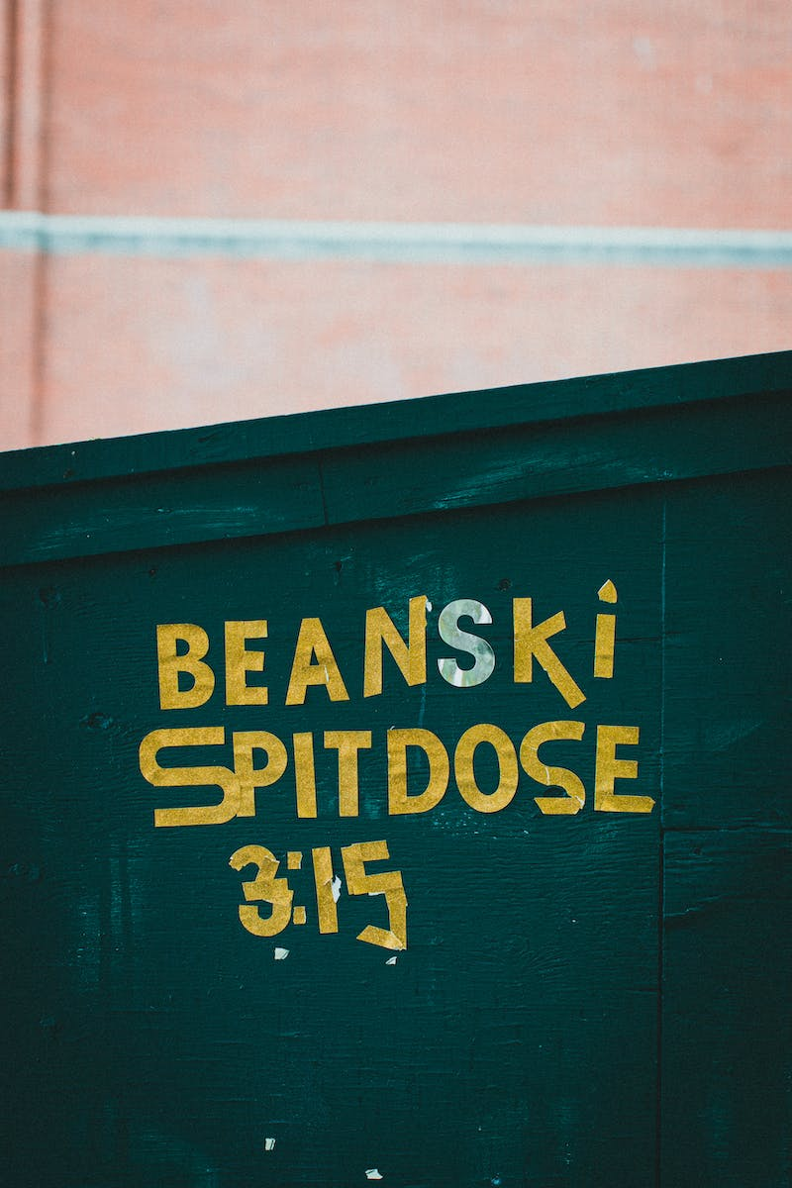
Exploring Text-Image Fusion
• Dolly 3's ability to add text into images
• Examples of successful text-image fusion
• Comparison with GPT-2 for text generation
• Potential for creative image generation applications
Photo by Pexels

Slide 7
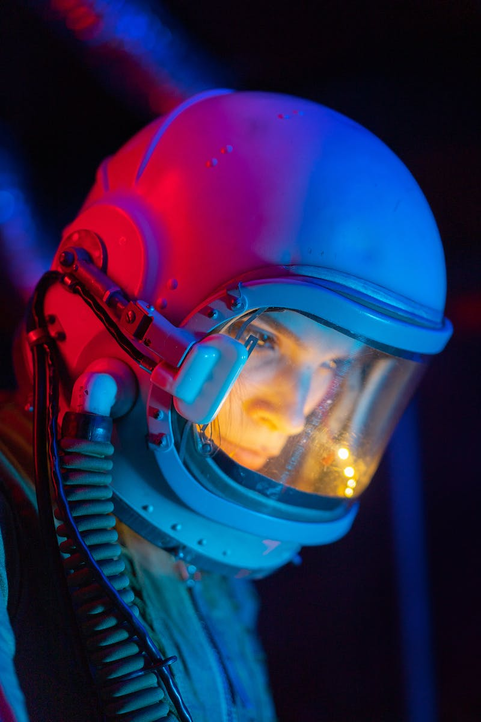
The Future of Dolly 3
• Potential integration with Chat GPT
• Combined vision and image generation capabilities
• Increased creative possibilities and applications
• Expanding the AI-generated imagery market
Photo by Pexels

