Slide 1
Abrasive Flow Machining: The Future of Surface Finishing
Unlocking the Power of Advanced Finishing Processes

Slide 2
Introduction
• Learning should never stop, even in difficult times
• Micron nano machining: A key area of focus
• The importance of surface finish in component wear resistance
• Traditional finishing processes vs. advanced finishing processes
Photo by Pexels

Slide 3
Abrasive Flow Machine (AFM)
• AFM as an advanced finishing process
• Capable of achieving surface finish up to fifteen nanometers
• Suitable for finishing internal and external surfaces
• Significance of precise dimensions and surface smoothness
Photo by Pexels

Slide 4
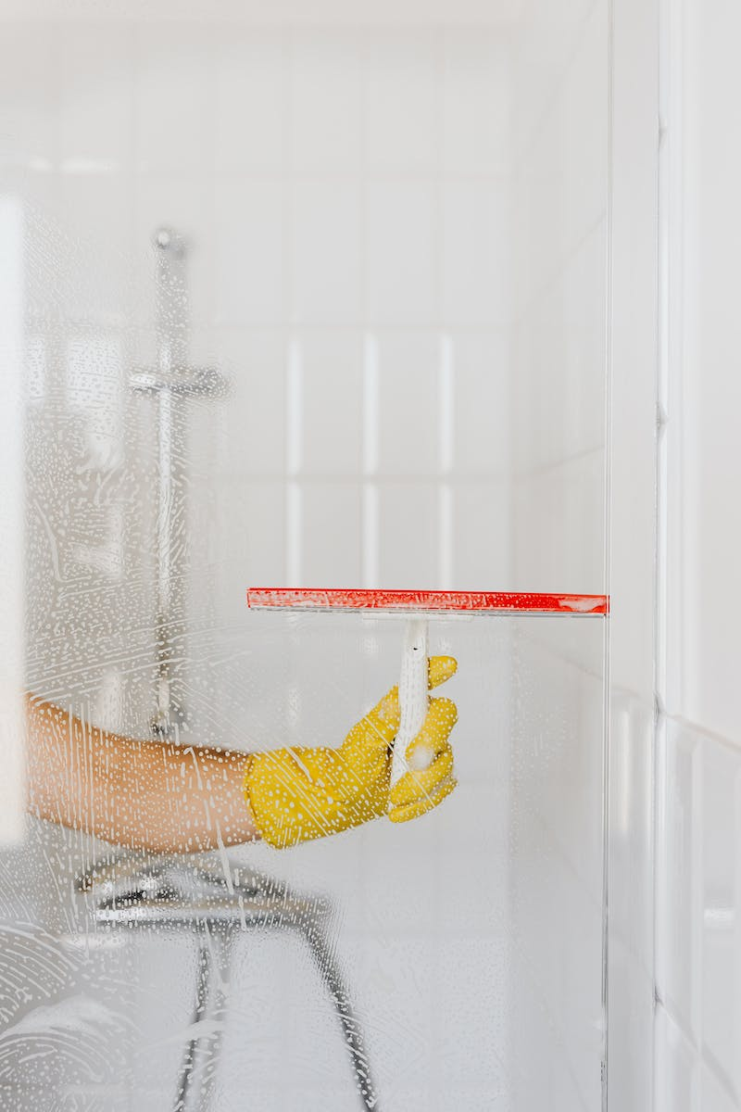
Characteristics of AFM
• Deeper polishing and refinement of difficult-to-reach surfaces
• Significant reduction in surface roughness compared to traditional methods
• Simultaneous processing of multiple parts or areas
• Economic and efficient finishing of inaccessible areas and complex internal passages
Photo by Pexels

Slide 5
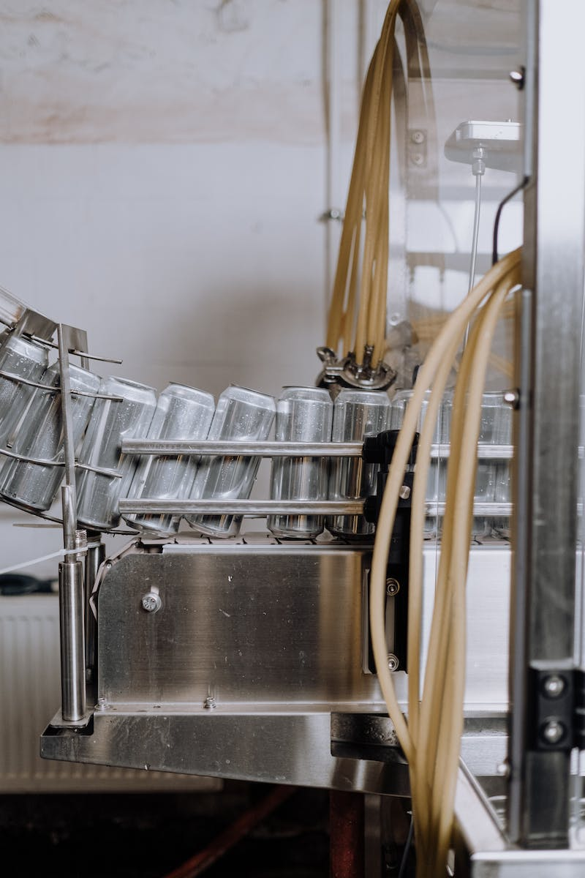
Controlling the AFM Process
• Integration of AFM in automatic manufacturing environments
• Significant time and labor savings compared to manual finishing
• Flexible control of intensity and location of surface preparation
• Adjustment of process parameters and abrasive medium for desired results
Photo by Pexels

Slide 6
Mechanism of Material Removal
• Composition of the medium used in AFM
• Role of soft base polymer, additives, and fine abrasive particles
• Generation of radial force and axial force for material removal
• Microchipping and material removal through sharing action
Photo by Pexels

Slide 7
Types of AFM Processes
• One-Way AFM: Extrusion of vis elastic medium uni-directionally
• Two-Way AFM: Reciprocal flow of medium through restricted passages
• Orbital Layer AFM: Low amplitude oscillation of vis finishing medium
Photo by Pexels

Slide 8
One-Way AFM
• Hydraulic act and rotating piston extrude medium uni-directionally
• Used for components with complex internal passages
• Ensures controlled flow of medium for precise finishing
• Advantages: faster processing, easy cleanup, and simple tooling
Photo by Pexels

Slide 9
Two-Way AFM
• Upper and lower medium cylinders guide medium flow
• Reciprocal movement of medium between the cylinders
• Ideal for finishing simple to complex components
• Capability to finish knee joint implants with ease
Photo by Pexels

Slide 10
Orbital Layer AFM
• Rapid low-amplitude oscillations in two or three dimensions
• Vis-elastic medium with slow flowing pad
• Finishing by translational medium motion and circular eccentric orbit
• Precise and controlled finishing of different workpiece areas
Photo by Pexels

Slide 11
Conclusion
• AFM as the future of surface finishing
• Unlocking the potential for precise and efficient component finishing
• Advantages over traditional methods and other advanced processes
• Continuous improvements and research in AFM technology
Photo by Pexels

