Slide 1

Comprehensive Course on Generative Artificial Intelligence
Exploring the Transformative Technology Reshaping Industries

Slide 2

Table of Contents
01
Generative AI Introduction
02
Technological Milestones Timeline
03
Evolution of Generative AI
04
Practical Applications in Industries: Real-world use cases and implementation strategies
05
Module One: Foundational Knowledge
06
Module Two: Essential Concepts
07
Module Three: Real-world Use Cases
08
Module Four

Slide 3
Table of Contents
09
Evolution of Generative AI
10
Enhancing Learning Through Pedagogy

Slide 4


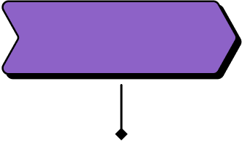
Generative AI Introduction
Emergence of GANs
StyleGAN
In 2010, Generative Adversarial Networks (GANs) were introduced, revolutionizing generative AI by pitting two neural networks against each other to...
NVIDIA's StyleGAN was released in 2018, setting a new standard in generative AI for generating high-quality and diverse images with...
2010
2014
2018
2021
DeepDream
GPT-3
Google introduced DeepDream in 2014, a neural network visualization tool that showcased the power of generative AI in creating mesmerizing...
OpenAI unveiled GPT-3 in 2021, a language model that demonstrated the capabilities of generative AI in natural language processing, enabling...

Slide 5
Technological Milestones Timeline
Industrial Revolution Begins
Birth of the Internet
The Industrial Revolution marks the transition to new manufacturing processes, leading to significant societal and economic changes, including the introduction...
The creation of the Internet connects computers worldwide, transforming communication, information sharing, and commerce on a global scale, shaping the...
1760
1947
1973
2014
Invention of Transistor
Rise of Generative AI
The invention of the transistor revolutionizes electronics, enabling the development of smaller, more efficient electronic devices and laying the foundation...
Generative AI emerges as a powerful technology capable of creating content, art, and music autonomously, revolutionizing industries like design, entertainment,...

Slide 6
Evolution of Generative AI
Deep Learning Boom
Industry Integration
In 2014, deep learning models like GANs gained prominence, laying the foundation for generative AI's creative potential in art and...
By 2020, generative AI had penetrated various industries, from fashion to gaming, transforming production processes and customer experiences.
2014
2018
2020
2022
Artistic Style Transfer
AI-Generated Content
2018 marked the rise of artistic style transfer algorithms, enabling generative AI to mimic artistic styles and revolutionize digital art...
In 2022, AI-generated content became mainstream, reshaping content creation by automating tasks and enhancing creative workflows.

Slide 7




Practical Applications in Industries: Real-world use cases and implementation strategies
1.
Manufacturing Automation
Implementing robotics and AI for efficient production processes in manufacturing industries.
2.
Smart Agriculture
Utilizing IoT sensors and data analytics to optimize crop yield and resource management.
3.
Healthcare Innovations
Applying telemedicine and wearable devices for remote patient monitoring and personalized healthcare.

Slide 8
Practical Applications in Industries: Real-world use cases and implementation strategies
4.
Supply Chain Optimization
Integrating blockchain and AI to enhance transparency and efficiency in supply chain logistics.
5.
Smart Cities Development
Implementing IoT infrastructure and smart technologies for sustainable urban planning and management.

Slide 9
Module One: Foundational Knowledge
AI Emergence
Deep Learning Boom
In 1956, the term 'Artificial Intelligence' was coined, marking the birth of AI as a field of study, focusing on...
The year 2014 witnessed a significant advancement in AI with the Deep Learning boom, leading to breakthroughs in image and...
1956
1980
2014
2020
Expert Systems
GPT-3 Release
The 1980s saw the rise of Expert Systems, AI programs designed to mimic human decision-making processes, revolutionizing problem-solving in various...
In 2020, OpenAI released GPT-3, a language model capable of generating human-like text, showcasing the power of Generative AI in...

Slide 10
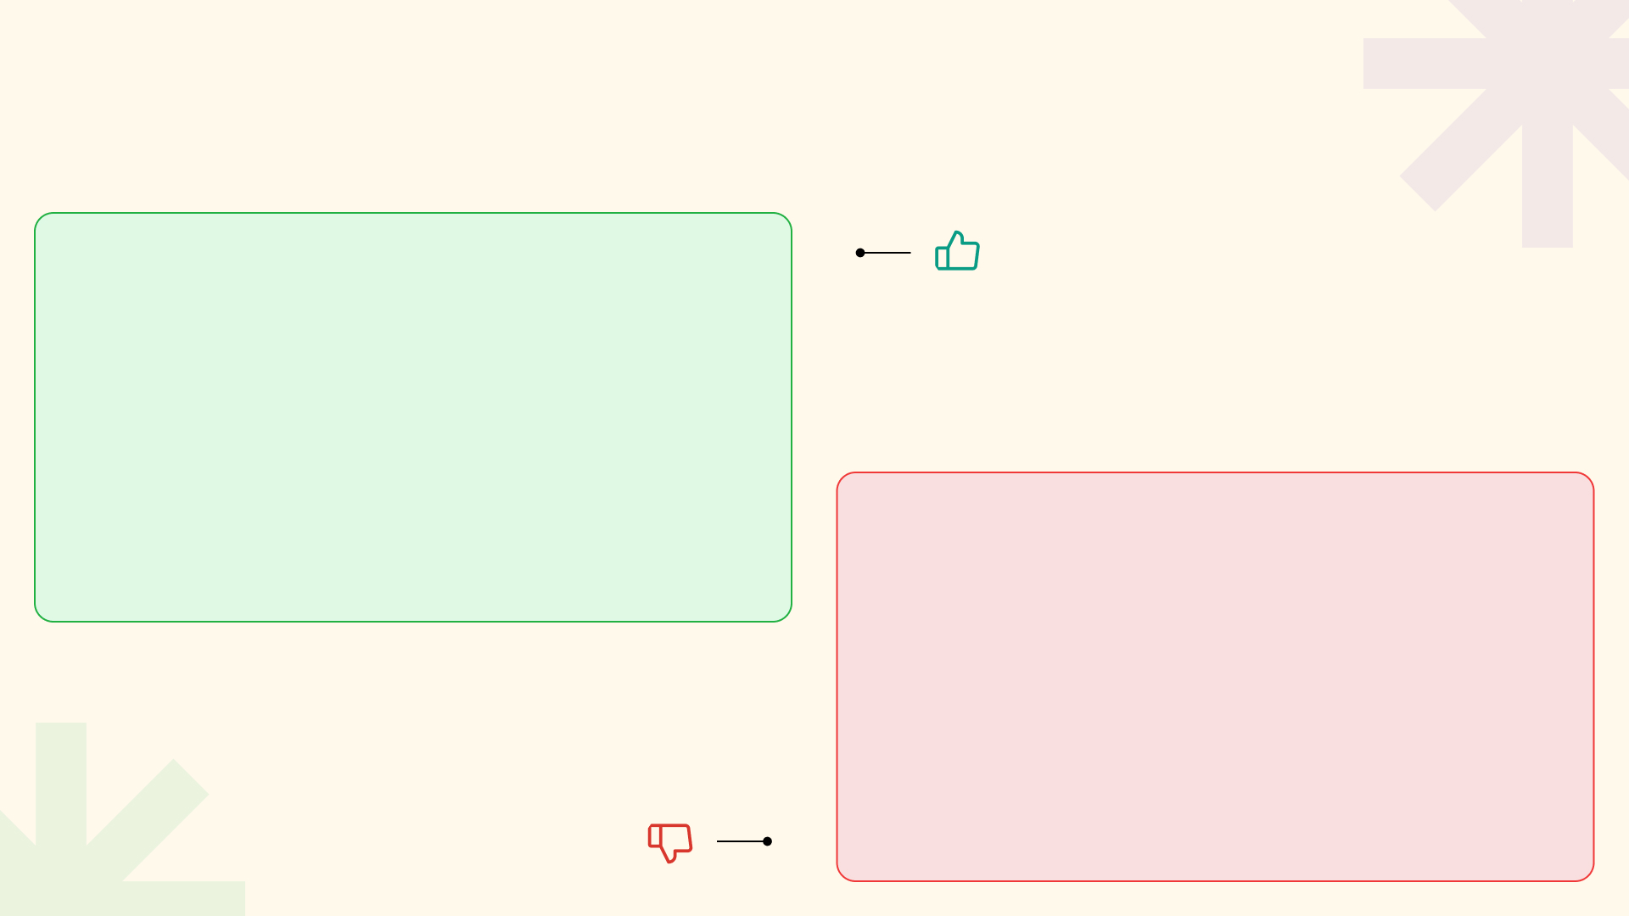


Module Two: Essential Concepts
Cutting-edge technology advancements in language models
Innovative Concepts
Enhanced understanding of embeddings and their applications
Opportunities for fine-tuning models for specific tasks
Complexity in implementing and managing large language models
Resource-intensive training and computation requirements
Risk of bias and ethical considerations in model development
Challenges Ahead

Slide 11
Module Two: Essential Concepts
Potential for breakthroughs in natural language processing
Innovative Concepts
Challenges in interpreting and explaining model decisions
imageSearch
Large Language Models
Challenges Ahead

Slide 12
Module Three: Real-world Use Cases
Digital Transformation
Blockchain Adoption
The rise of digital transformation reshapes industries, integrating technology into all aspects of business operations, enhancing efficiency and customer experiences.
Blockchain technology gains traction, offering secure and transparent transactions, disrupting financial services, supply chain management, and data security.
2010
2015
2018
2021
AI Revolution
IoT Expansion
Artificial Intelligence revolutionizes industries, automating processes, enabling predictive analytics, and transforming decision-making with machine learning algorithms.
The Internet of Things expands rapidly, connecting devices and systems, enabling real-time data monitoring, and driving innovation in smart cities...

Slide 13

Module Four
1.
Introduction
Overview of chatbot systems and their importance in modern applications
2.
Chatbot Development
Steps involved in building a chatbot system from scratch using ChatGPT API
3.
Integration
How to seamlessly integrate ChatGPT API into the chatbot system for enhanced functionality
Photo by Pexels

Slide 14
Module Four
4.
Testing and Debugging
Best practices for testing and debugging the chatbot system to ensure optimal performance
5.
Deployment
Guidelines for deploying the chatbot system in real-world scenarios
Photo by Google

Slide 15
Evolution of Generative AI
Rapid Advancements
Ethical Debates Arise
In 2020, Generative AI saw rapid advancements in natural language processing, image generation, and creativity, setting the stage for transformative...
In 2025, ethical debates surrounding Generative AI intensified, focusing on issues of bias, privacy, and accountability, prompting regulatory frameworks and...
2020
2022
2025
2030
Mainstream Adoption
Workforce Transformation
By 2022, Generative AI became mainstream, with businesses integrating AI-generated content in marketing, design, and decision-making processes, reshaping consumer experiences...
By 2030, Generative AI had a profound impact on the workforce, leading to the emergence of new job roles, reskilling...

Slide 16





Enhancing Learning Through Pedagogy
Focus on deep understanding and practical application in education
3k
90%
Engagement
Comprehension
85%
4.5
Retention
Feedback
4
5
Application
Skill Development

