Slide 1
The First Fully Electric AMG by Mercedes: EQS 53
A Closer Look at the Performance and Design of this Futuristic Electric Car

Slide 2
Introduction
• Welcome to the POV review of the Mercedes EQS 53, the first fully electric AMG by Mercedes
• Impressive performance and driving experience
• Initial reservations about the styling, but now appreciating its uniqueness
• Features sleek and futuristic design with distinctive 34-spoke wheels
Photo by Pexels

Slide 3
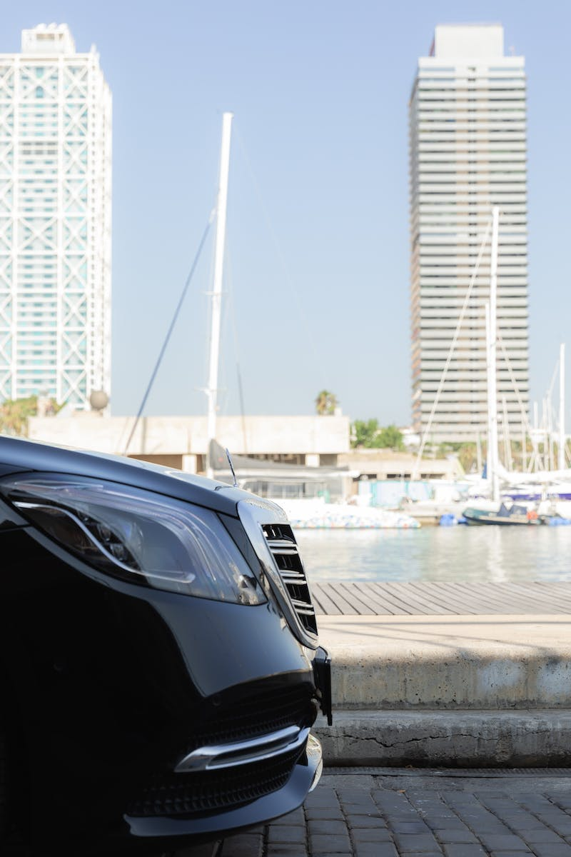
Exterior Design
• AMG-specific design cues with black chrome details and closed intakes
• Panamericana grille design with AMG badge
• LED bar running across the front end for clever lighting
• Stylish AMG wheels and gray Magno matte color
Photo by Pexels

Slide 4
Performance Features
• Surprising feature: Ceramic brakes for superior stopping power
• Melin Pilot Sport EV tires and adjusted air suspension for smooth handling
• Dual wishbones at the front and five-link suspension at the rear
• Powerful electric motors and rear-wheel steering for agility
Photo by Pexels

Slide 5
Interior Design
• Sporty and luxurious interior with carbon fiber and Alcantara
• Floating center stack with hyper screen and additional screen for the passenger
• Premium materials and comfortable seating
• Ample passenger space and a large boot for practicality
Photo by Pexels

Slide 6
Driving Experience
• Quiet and comfortable in Comfort mode, with responsive power
• Sport Plus mode for enhanced performance and aggressive power delivery
• Adjustable recuperation for personalized driving experience
• Excellent handling and maneuverability with rear-wheel steering
Photo by Pexels

Slide 7
Power and Efficiency
• Impressive power with up to 658 horsepower and 950 newton-meters of torque
• Option for Dynamic Plus package with even more power
• 0 to 100 km/h in 3.8 seconds, with excellent acceleration
• 107.8 kWh battery for estimated range of up to 566 kilometers
Photo by Pexels

Slide 8
Conclusion
• Overall impression: AMG successfully combines luxury and futuristic design
• Impressive performance and handling for an electric car
• Comfortable and quiet driving experience
• Highly recommended option for those seeking a unique and powerful electric vehicle
Photo by Pexels

