Slide 1
Exploring the Magic of Music and Shapes
Unleash your creativity with the power of music and shapes

Slide 2
Introduction
• Welcome to an immersive presentation on the magic of music and shapes
• Discover how music and shapes can inspire and ignite creativity
• Learn how to combine music and shapes to create engaging experiences
• Unleash your imagination and dive into a world of endless possibilities
Photo by Pexels

Slide 3
Children's Songs
• Introduce children's songs as a powerful tool for learning and entertainment
• Explore songs about shapes, colors, and different objects
• Engage children with interactive songs and activities
• Foster creativity and cognitive development through music and shapes
Photo by Pexels

Slide 4
Music and Shapes for All Ages
• Extend the application of music and shapes beyond children
• Explore how music and shapes can enhance relaxation and mood
• Discover the therapeutic effects of music and shapes
• Engage individuals of all ages in a multisensory experience
Photo by Pexels

Slide 5
The Power of Visuals
• Visualize music and shapes through animations and multimedia
• Explore the impact of visuals on audience engagement
• Create visually captivating experiences using music and shapes
• Harness the power of visuals to enhance storytelling
Photo by Pexels

Slide 6
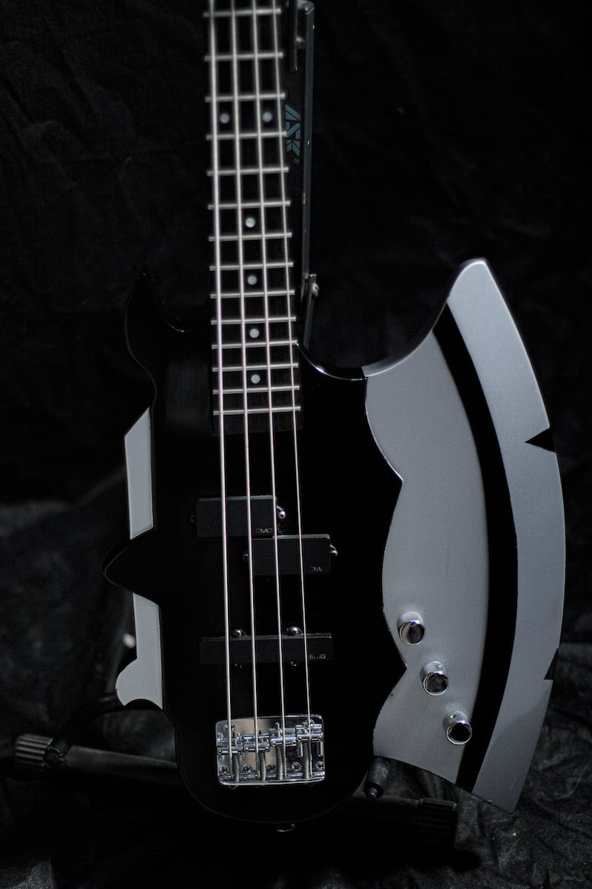
Unlocking Creativity
• Discover how music and shapes can unlock creativity
• Break free from traditional barriers and explore new possibilities
• Combine music and abstract shapes to inspire unique creations
• Encourage experimentation and innovation through music and shapes
Photo by Pexels

Slide 7
Conclusion
• Reflect on the transformative power of music and shapes
• Encourage the audience to incorporate music and shapes in their daily lives
• Highlight the endless possibilities and joy that music and shapes can bring
• Inspire the audience to continue exploring the magic of music and shapes
Photo by Pexels

