Slide 1
Following Childhood Dreams: Stories of Daisy and Herman
How dreams can become reality and lead to a fulfilling life

Slide 2
Introduction
• BBC Learning English presents Six Minute English
• Meet Daisy from New Zealand and Herman from Argentina
• Discussing childhood dreams and the adult world
• Exploring the concept of utopia and changing oneself
Photo by Pexels

Slide 3
Childhood Dreams
• Daisy dreamt of a utopia where everyone is happy
• Herman dreamt of traveling the world with his family
• Many childhood dreams get lost in adult responsibilities
Photo by Pexels

Slide 4
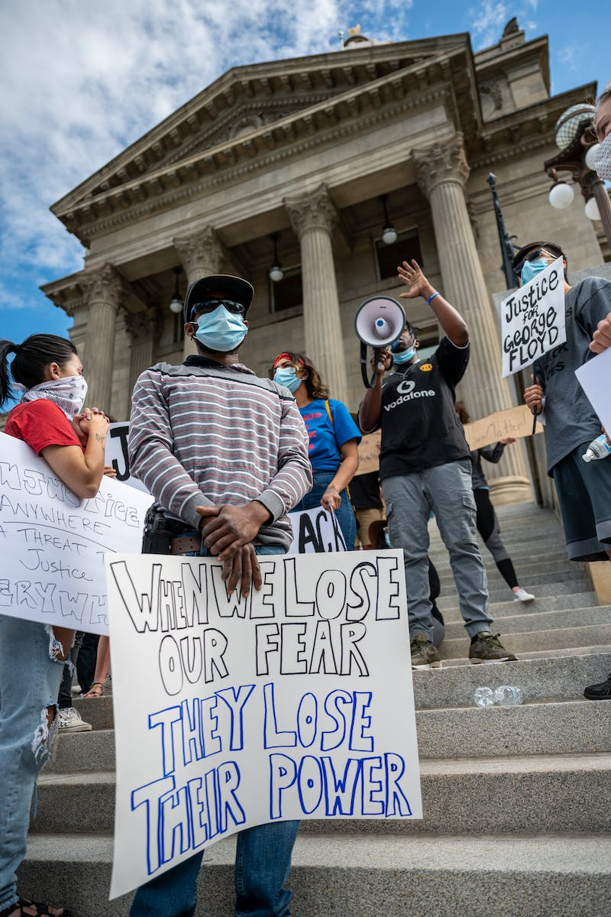
Daisy and Riverside
• Daisy joined Riverside, a sharing community in New Zealand
• She believes in the advantages of resource sharing
• Local people struggle with the idea of everything being shared
Photo by Pexels

Slide 5
Herman and His Journey
• Herman and Can app traveled the world with their family
• Started with less than $350 and visited over 100 countries
• Meeting diverse people and having life-changing experiences
Photo by Pexels

Slide 6
Lessons from Dreams
• Daisy and Herman found happiness by following their dreams
• Not by changing the world, but by changing themselves
• They serve as examples that dreams can come true
Photo by Pexels

Slide 7
Regrets and Dreams
• Not following dreams is a top regret of the dying
• Courage to pursue dreams is crucial for a fulfilled life
Photo by Pexels

Slide 8
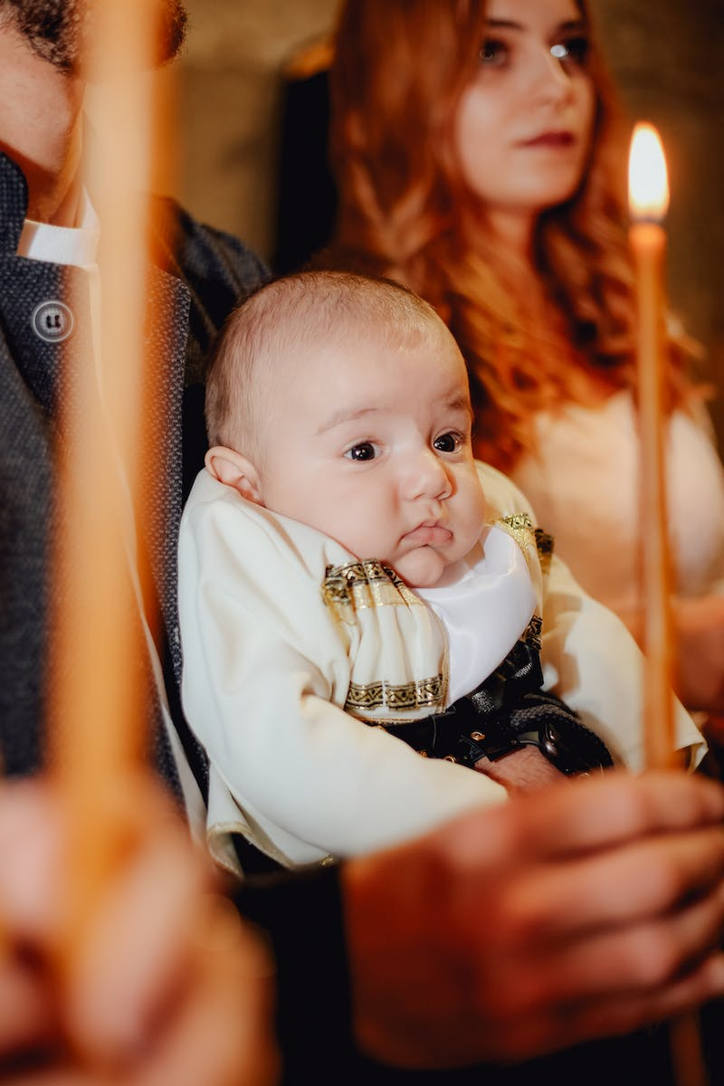
Vocabulary Recap
• Utopia: An ideal world where everyone is happy
• Struggling with an idea: Difficulty accepting or thinking about it
• Outlandish: Strange and unusual
• Conquer: Control by force
• Humble: Not proud or arrogant
• Grain of sand: Insignificant, yet important
Photo by Pexels

Slide 9
Conclusion
• Following dreams can lead to a fulfilling life without regret
• Daisy and Herman serve as inspirations for dreamers
• Thank you for joining Six Minute English
Photo by Pexels

