Slide 1
Amazing Wines under 3000 yen
Discover the Best Wines with Parker Points

Slide 2
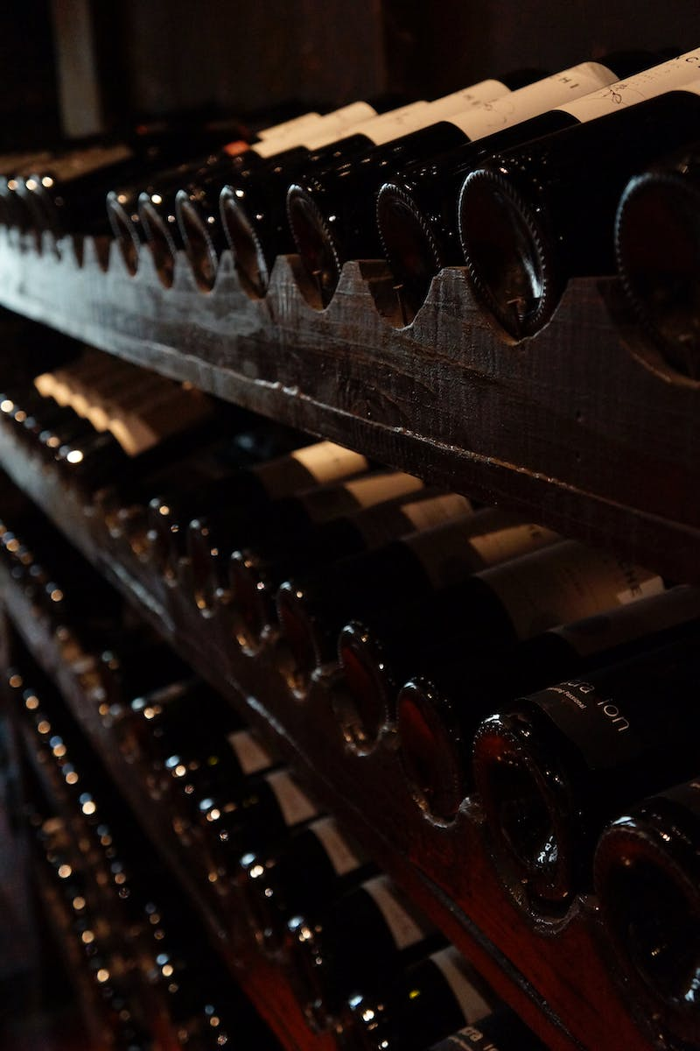
Introduction
• Parker Points - the trusted wine evaluation system
• High Parker Point wines are sought after
• Introducing 5 amazing wines under 3000 yen with Parker Points of 90+
Photo by Pexels

Slide 3
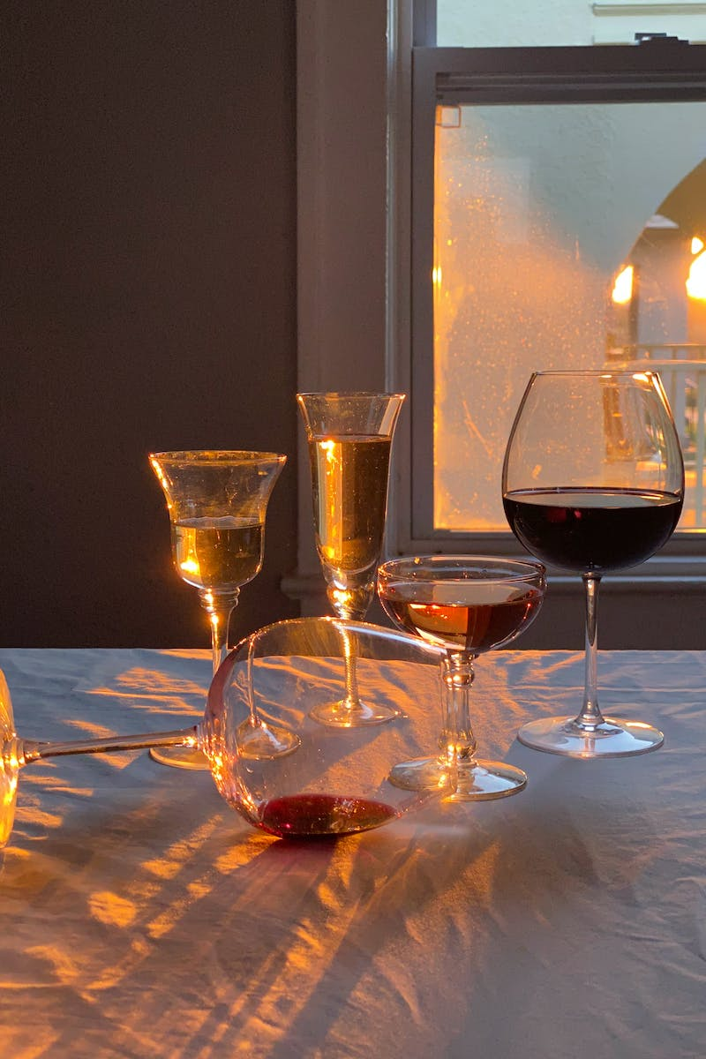
What are Parker Points?
• Robert Parker - the world-renowned wine critic
• Parker Points represent a wine's evaluation on Wine Advocate website
• Points range from 0 to 100, similar to WA points
• Parker Points hold significant authority and influence in the wine industry
Photo by Pexels

Slide 4
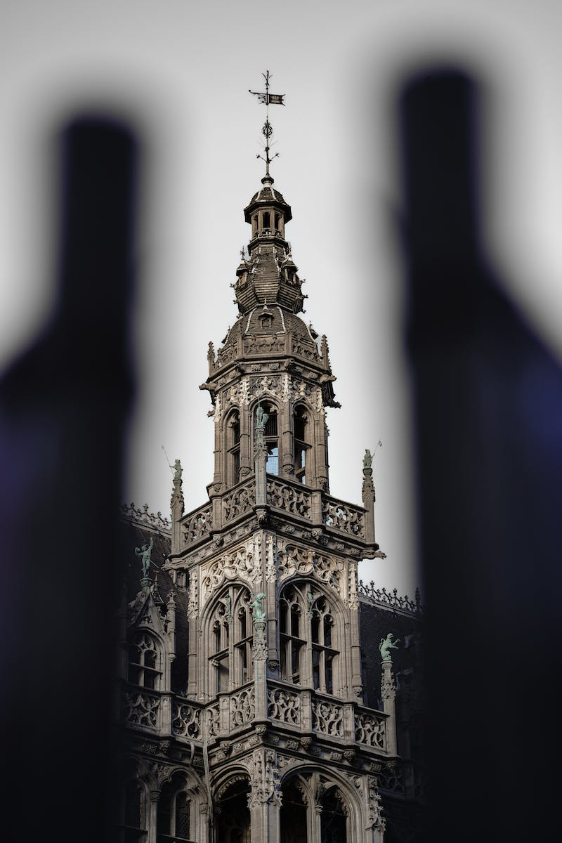
Parker Point Ratings
• Various wine evaluation systems exist (WS, JS)
• Parker Points have the highest credibility and dominance
• Parker Points greatly impact wine prices
• Example: Chateau Lafite Rothschild with different vintage and ratings
Photo by Pexels

Slide 5
Amazing White Wine - Chateau Monpeurlat Blanc
• Price: 2200 yen
• Parker Point: 91
• Region: Bordeaux, France
• Features: Sauternes-style white wine with a taste of sweetness, notes of white peach, green apple, and jasmine
Photo by Pexels

Slide 6
Recommended Red Wine - Slam Dunk Wines
• Price: 2500 yen
• Parker Point: 90
• Region: California, USA
• Produced by renowned winemakers David Greene and Myles Cosgrove
• Flavor profile: Black cherry, blackberry, spicy notes, and herbal nuances
Photo by Pexels

Slide 7
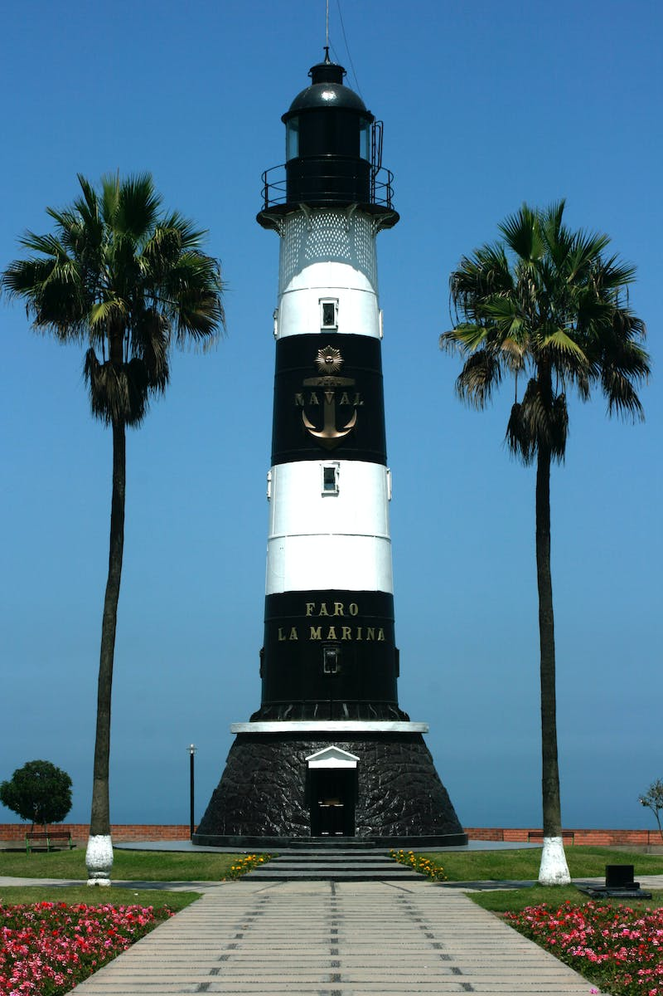
Delicious Rosé Wine - Domaine Lafarge Pasteur Miraflores
• Price: 1680 yen
• Parker Point: 92
• Region: Languedoc-Roussillon, France
• Produced by renowned winemaker Domaine Lafarge
• Flavor profile: Ripe cassis, blackberry, dried grass, rosemary, and herbal nuances
Photo by Pexels

Slide 8
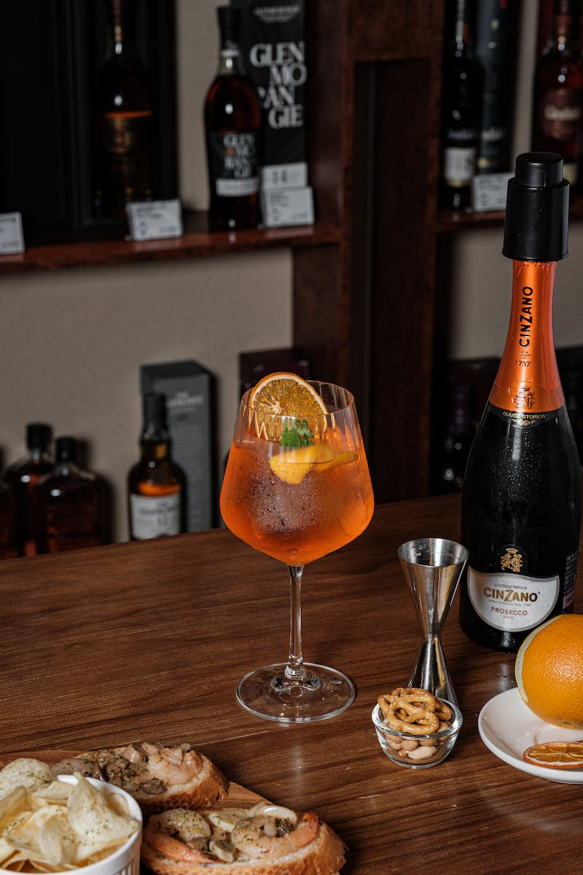
Value for Money Wine - Evodia
• Price: 1300 yen
• Parker Point: 90+ consistently
• Region: Calatayud, Spain
• Produced by Bodegas and Vinos Shaya
• Flavor profile: Intense blackberry jam flavors with hints of pepper, spices, and vanilla
Photo by Pexels

Slide 9
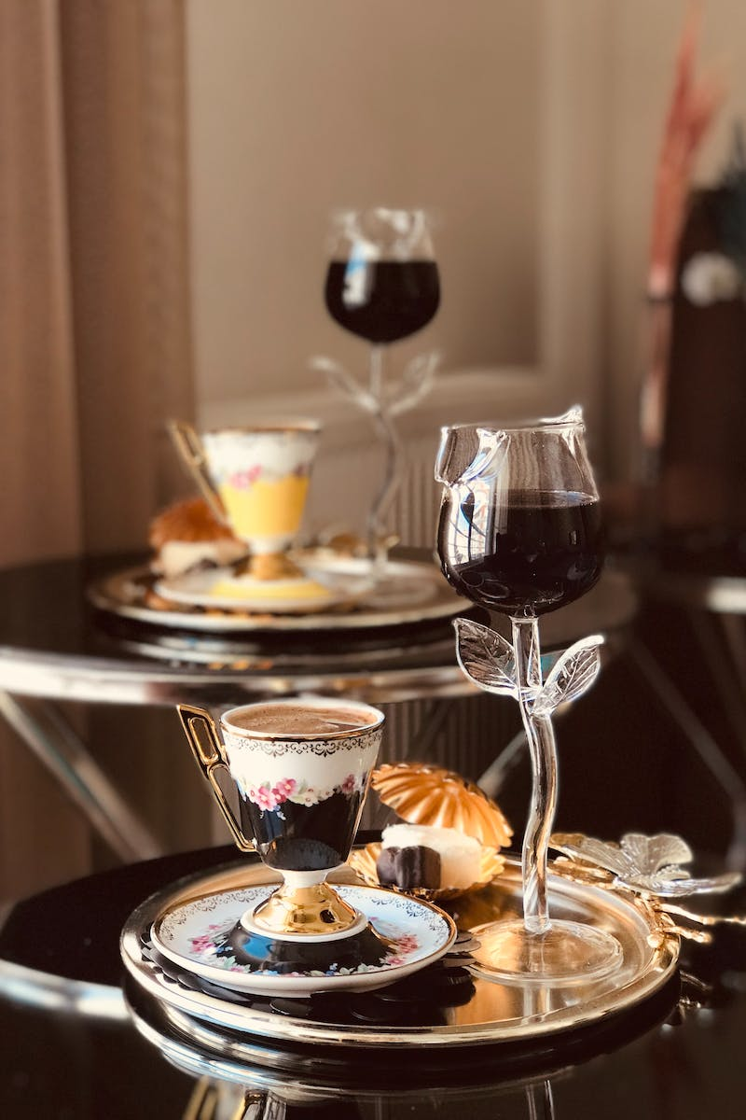
The Exceptional Wine - Peter Sisseck
• Price: 3900 yen
• Parker Point: 93-95 (recent vintage)
• Region: Ribera del Duero, Spain
• Produced by renowned winemaker Peter Sisseck
• Flavor profile: Rich flavors of blackberry, cassis, spices, and hints of vanilla, with silky smoothness
Photo by Pexels

Slide 10
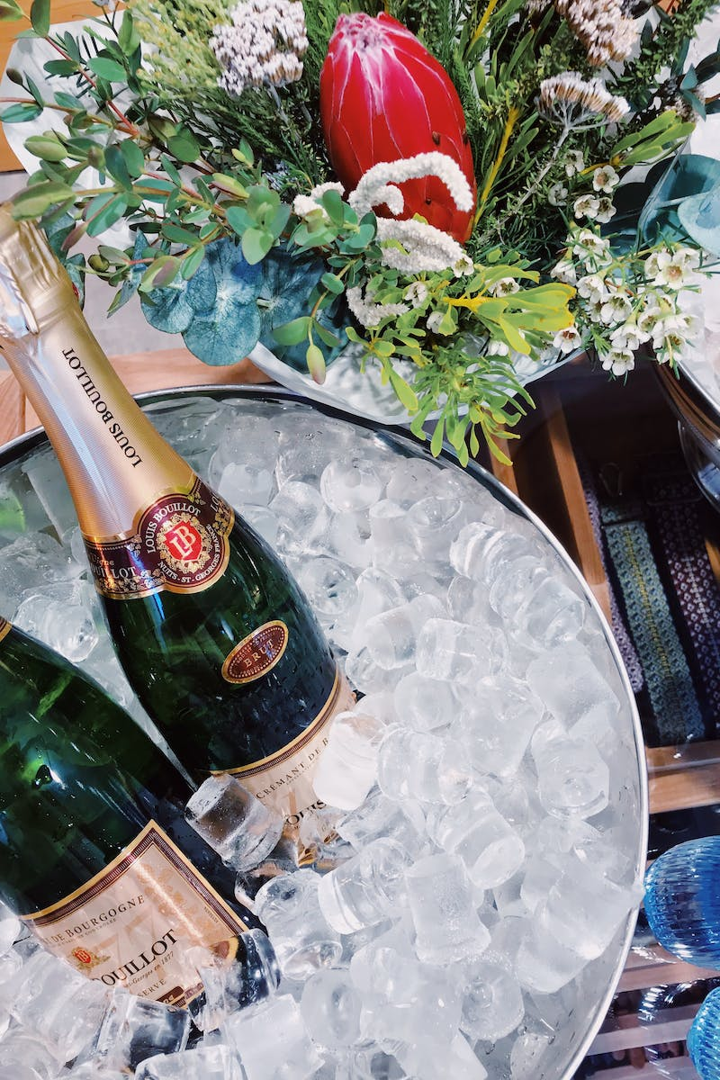
Conclusion
• Parker Points are a reliable indicator of wine quality
• High Parker Point wines can be affordable and delicious
• Explore the world of amazing wines with Parker Points
Photo by Pexels

