Slide 1
Exploring Norway: A Journey Through Land of Stunning Beauty
Discover the Enchanting Landscapes and Rich Cultural Heritage of Norway

Slide 2
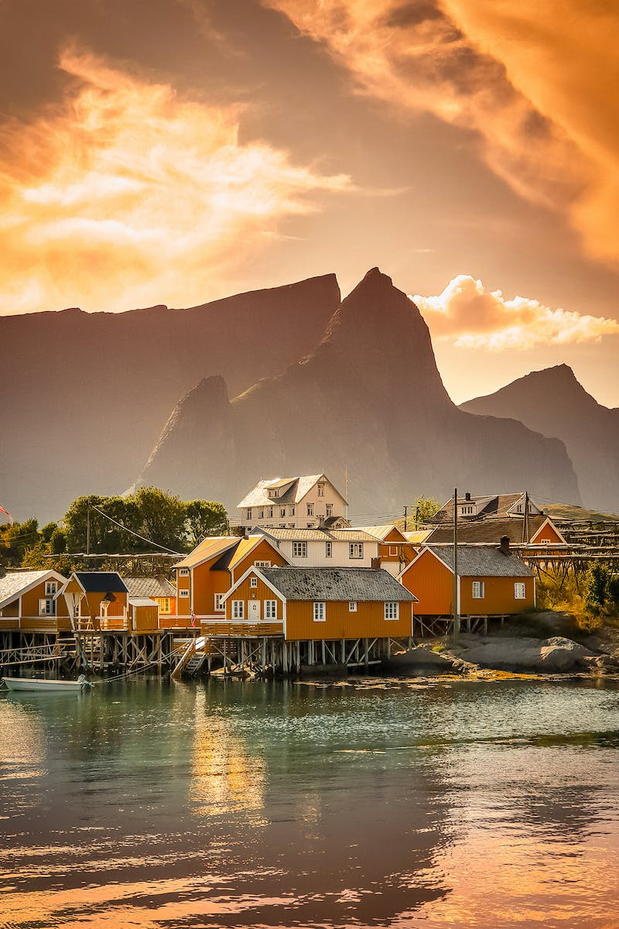
Introduction to Norway
• Located in Northern Europe
• Bordered by Sweden, Finland, and Russia
• Capital city: Oslo
• Population: Over 5 million
Photo by Pexels

Slide 3
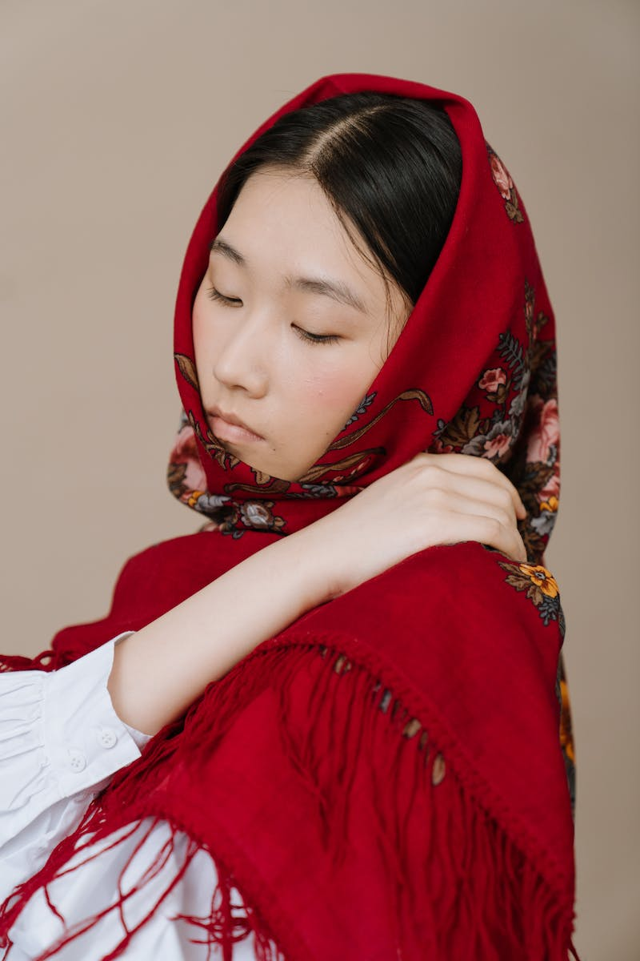
Norwegian Culture and Traditions
• Strong Norse heritage
• Unique language: Norwegian
• Folklore and mythology
• Distinctive national costumes
Photo by Pexels

Slide 4
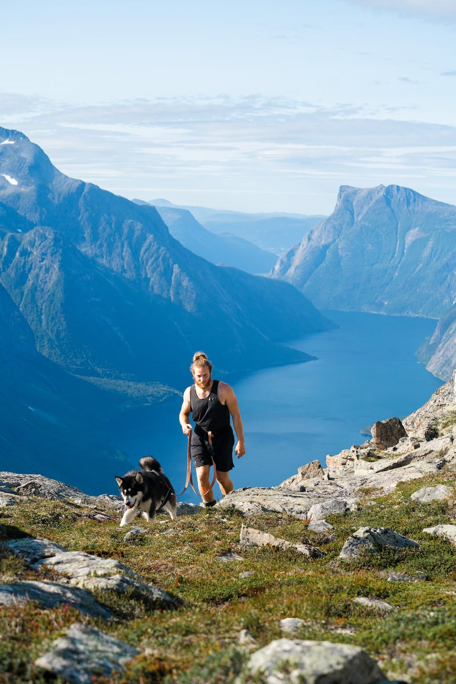
Norway's Natural Wonders
• Breathtaking fjords
• Majestic mountains
• Lush green forests
• Stunning waterfalls
Photo by Pexels

Slide 5
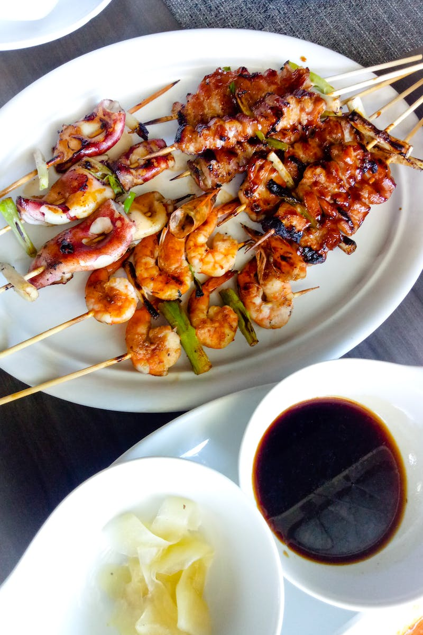
Exploring Norwegian Cuisine
• Fresh seafood
• Delicious dairy products
• Traditional dishes like lutefisk and rakfisk
• Scandinavian-inspired desserts
Photo by Pexels

Slide 6
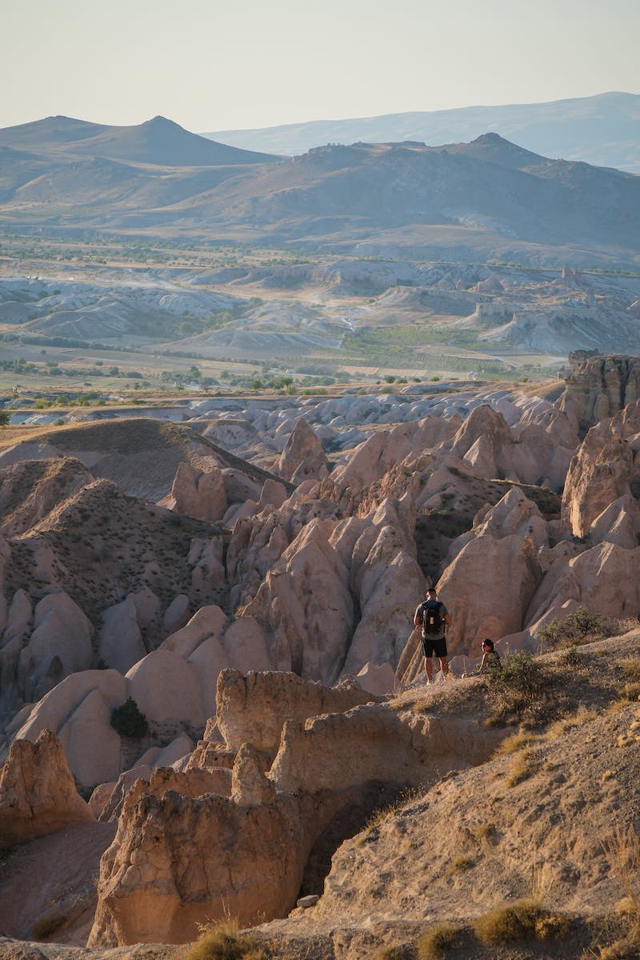
Norwegian Outdoor Activities
• Hiking in scenic landscapes
• Skiing in winter
• Fishing in pristine rivers and lakes
• Cycling and kayaking adventures
Photo by Pexels

Slide 7
Conclusion
• Norway offers unparalleled natural beauty
• Rich cultural heritage and traditions
• Endless opportunities for outdoor exploration
• A destination worth experiencing
Photo by Pexels

