Slide 1
Exploring the Carpathian Mountains
An Adventure in the Land of Tranquility

Slide 2
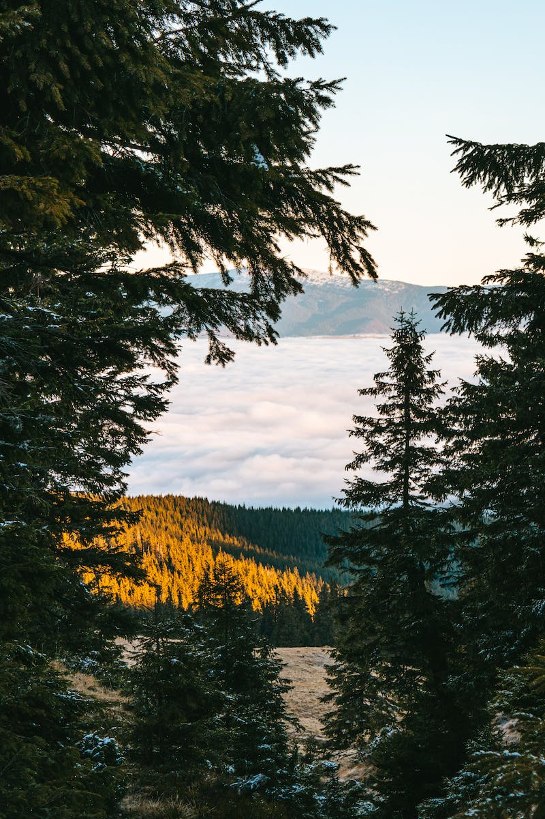
Introduction to the Carpathian Mountains
• The Carpathian Mountains are a beautiful mountain range in Central and Eastern Europe.
• They stretch across several countries, including Ukraine, Romania, and Poland.
• The Carpathians are known for their breathtaking landscapes, diverse wildlife, and rich cultural heritage.
• They offer countless opportunities for hiking, skiing, and exploring nature.
Photo by Pexels

Slide 3
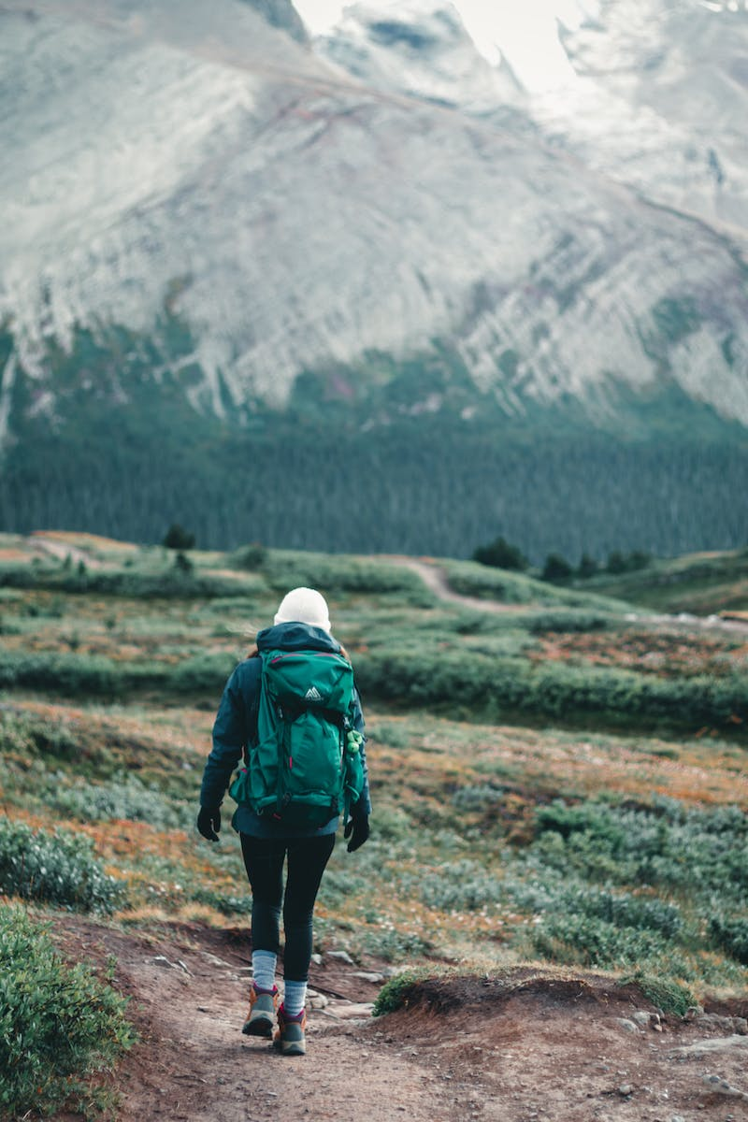
Outdoor Activities in the Carpathians
• Hiking trails that take you through picturesque forests, meadows, and mountain peaks.
• Ski resorts with well-groomed slopes and modern infrastructure.
• Opportunities for wildlife spotting, including bears, wolves, and lynxes.
• Exploring charming traditional villages and tasting local cuisine.
Photo by Pexels

Slide 4
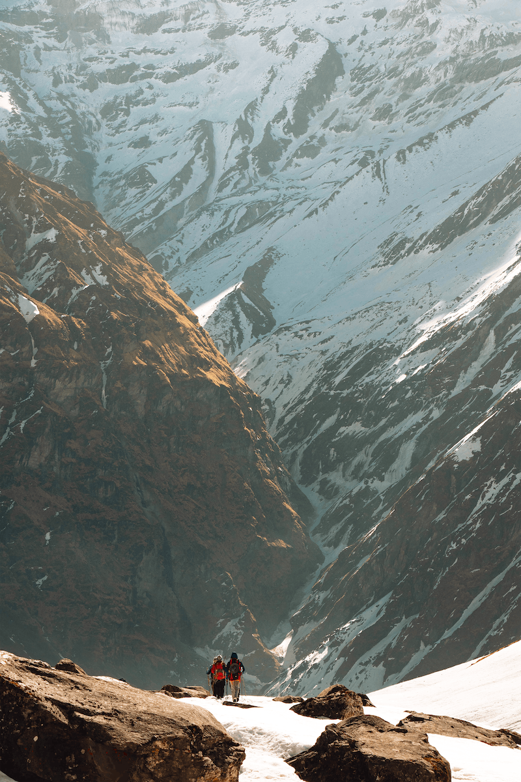
Preservation of Nature and Wildlife
• Conservation efforts to protect the Carpathian's unique ecosystem.
• Collaboration between national parks, NGOs, and local communities.
• Preservation of endangered species, such as the European bison.
• Promotion of sustainable tourism to minimize environmental impact.
Photo by Pexels

Slide 5
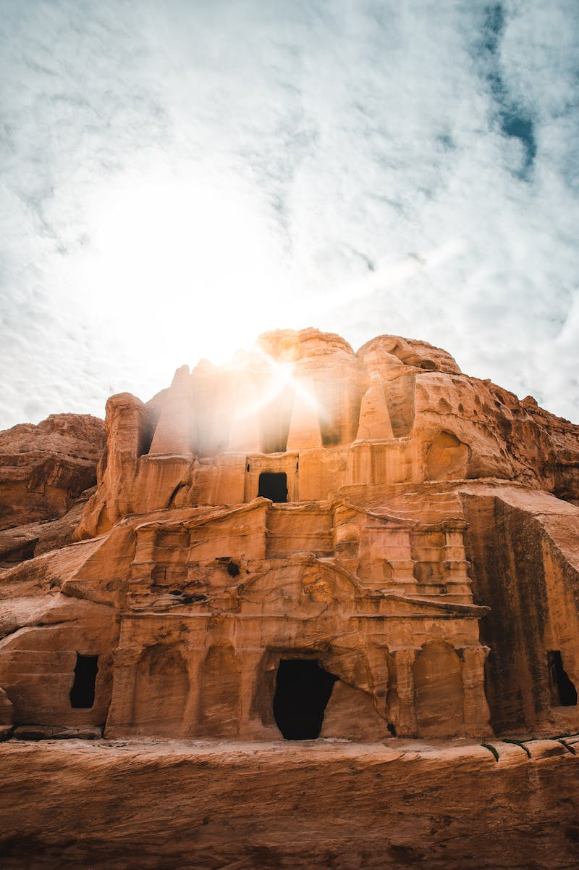
Cultural Heritage of the Carpathians
• Rich folklore and traditional customs preserved by local communities.
• Picturesque wooden churches and historic castles.
• Festivals celebrating local traditions, music, and cuisine.
• Craftsmanship and artisanal products, such as traditional embroidery.
Photo by Pexels

Slide 6
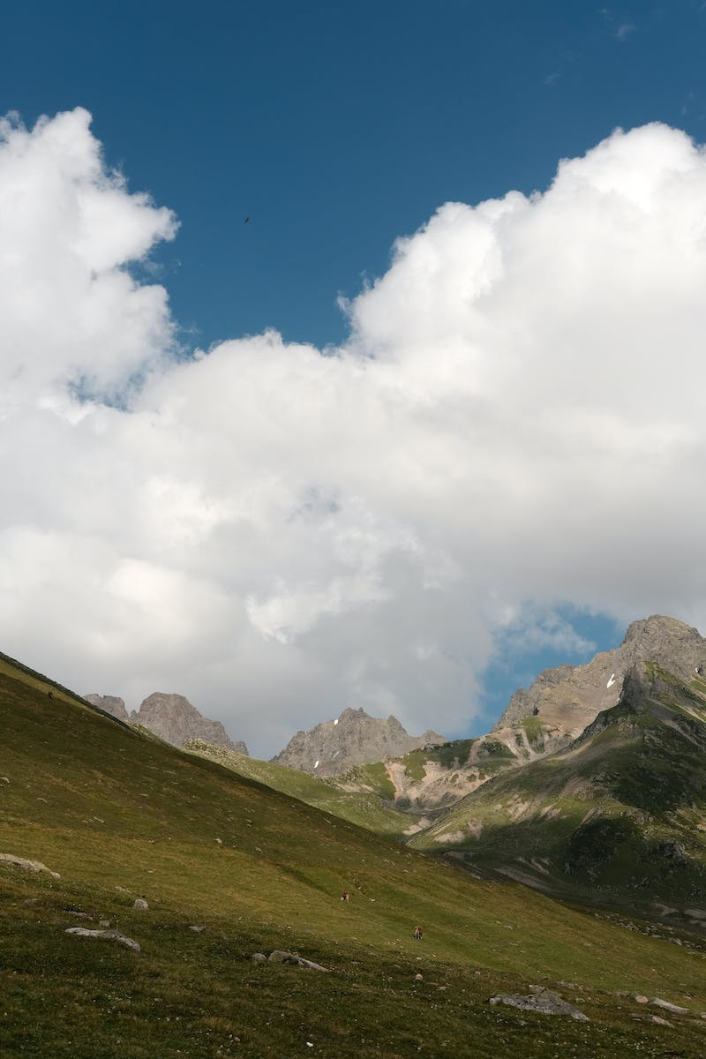
Conclusion
• The Carpathian Mountains offer a perfect blend of natural beauty and cultural richness.
• Whether you seek adventure or tranquility, the Carpathians have something to offer for everyone.
• Plan your next trip to the Carpathian Mountains and embark on an unforgettable journey!
Photo by Pexels

