Slide 1
The Impact of Climate Change on Coastal Communities
Adapting to a Changing World

Slide 2
Introduction
• Climate change poses significant challenges to coastal communities
• Rising sea levels, increased storm intensity, and coastal erosion are major concerns
• Adaptation strategies are necessary to protect communities and ecosystems
• This presentation will explore the impacts of climate change on coastal communities and discuss adaptation measures
Photo by Pexels

Slide 3
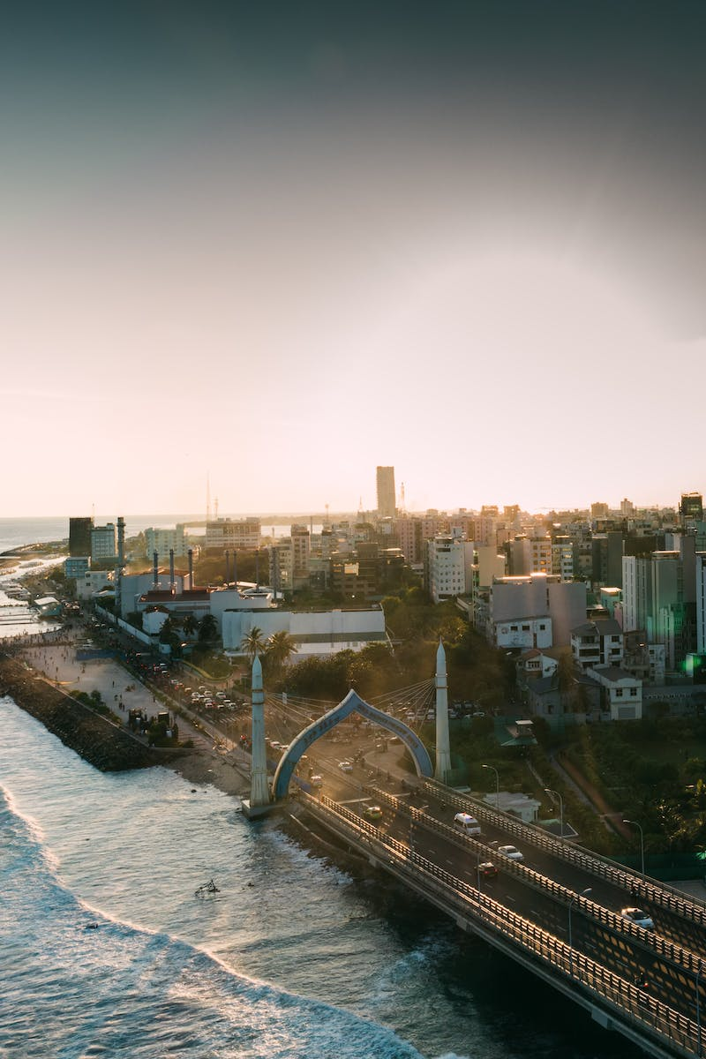
Sea Level Rise
• Sea levels have been rising due to global warming
• Coastal areas are particularly vulnerable to sea level rise
• Increased flooding, erosion, and saltwater intrusion are consequences of rising sea levels
• Adaptation measures include coastal defense infrastructure and managed retreat
Photo by Pexels

Slide 4
Extreme Weather Events
• Climate change intensifies extreme weather events
• Coastal communities are at high risk of hurricanes, storms, and surges
• Increased property damage, displacement, and health risks are associated with extreme weather
• Adaptation strategies include early warning systems, resilient infrastructure, and community preparedness
Photo by Pexels

Slide 5
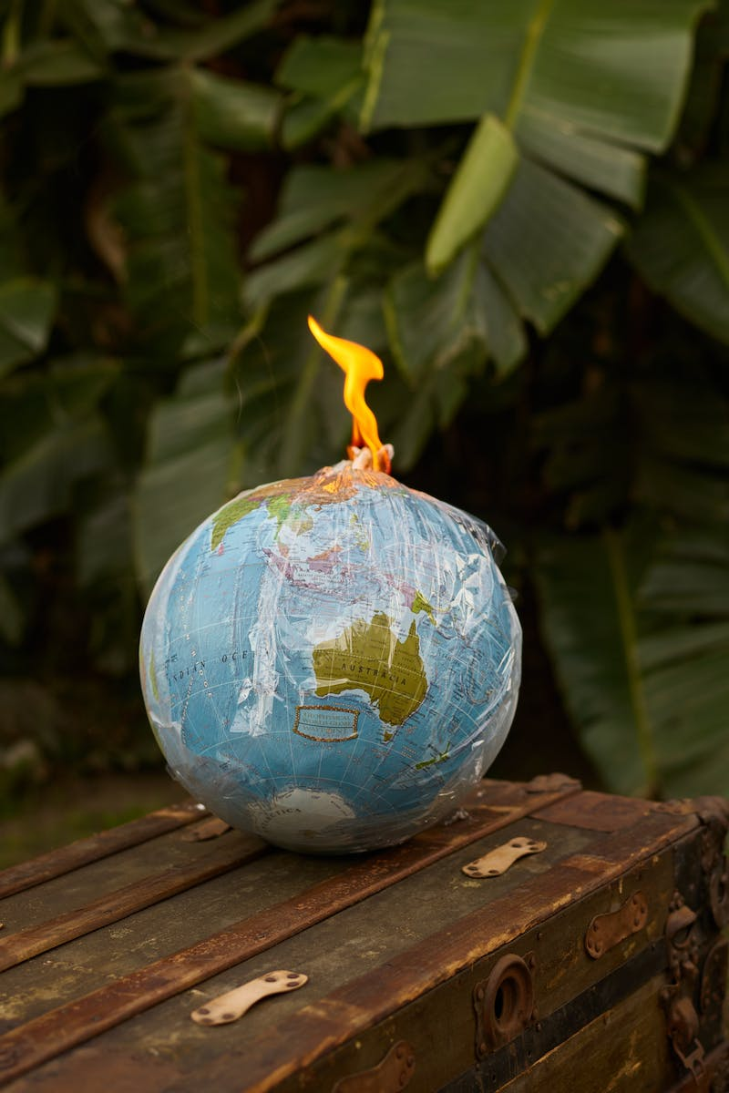
Coastal Ecosystems
• Coastal ecosystems provide numerous benefits to communities
• Climate change threatens the health and functioning of these ecosystems
• Loss of biodiversity, habitat destruction, and reduced natural defenses are consequences of ecosystem degradation
• Adaptation measures include habitat restoration, sustainable management, and protected areas
Photo by Pexels

Slide 6
Community Resilience
• Building resilience is key for coastal communities
• Social, economic, and environmental factors contribute to community resilience
• Collaboration, education, and resource management are essential for building resilience
• Adaptation measures include community engagement, diversification of economies, and disaster risk reduction
Photo by Pexels

