Slide 1
Building Your Dream Home
Step-by-step guide to preparing for construction

Slide 2
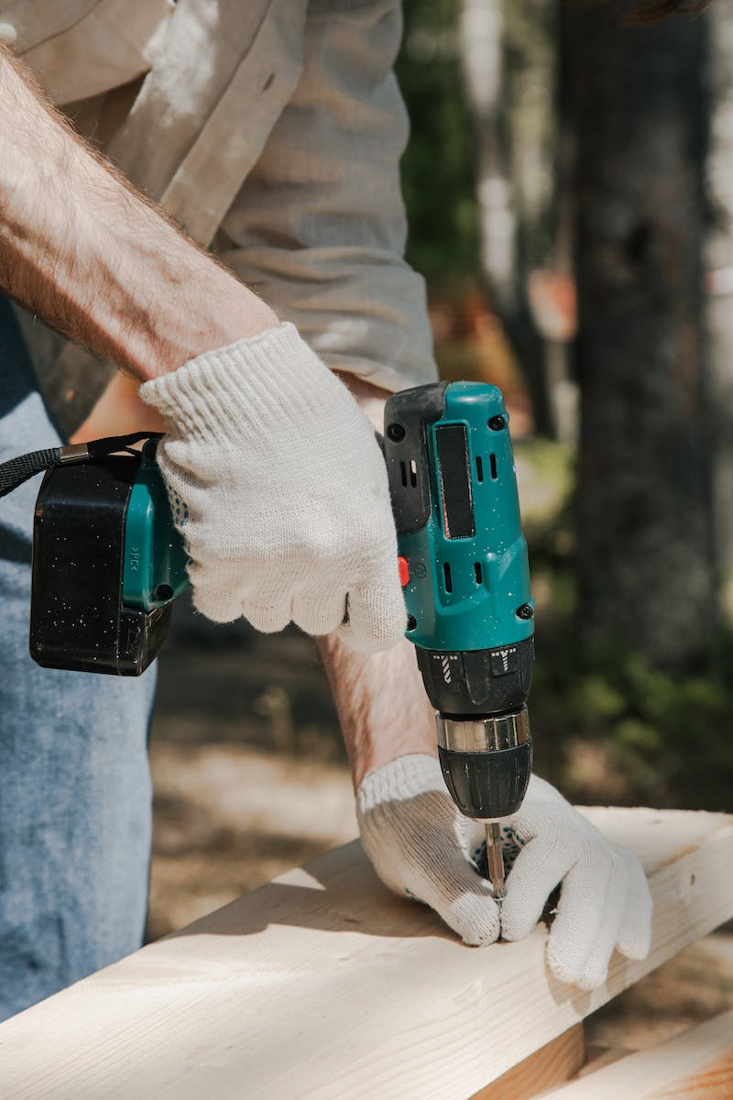
Introduction
• Welcome to the Portal Strogi channel
• Today we will discuss the essential steps to consider before starting construction
• First, let's talk about the importance of a general plan for your property
Photo by Pexels

Slide 3
General Plan
• A general plan outlines the restrictions and limitations for building on your property
• It includes the layout of your land, proposed structures, and additional amenities
• Having a general plan helps you understand the boundaries and obtain necessary permits
Photo by Pexels

Slide 4
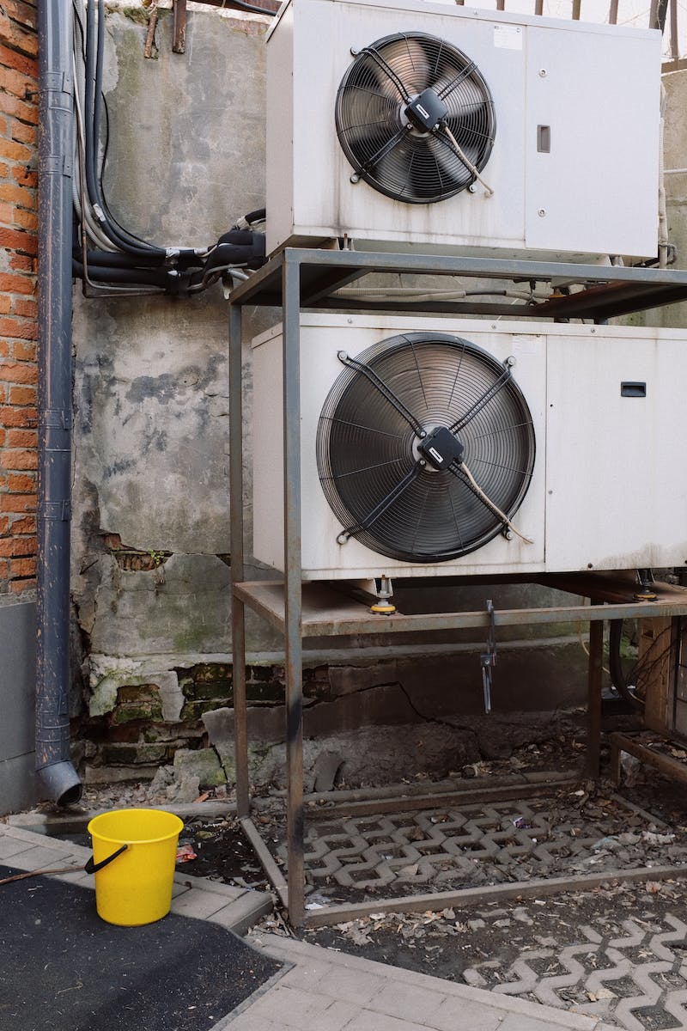
Outdoor Utilities
• Ensure the proper installation of external utilities like electricity, water, and sewage
• These utilities should be planned and laid out before construction begins
• By doing so, you save time, money, and avoid digging up your property multiple times
Photo by Pexels

Slide 5
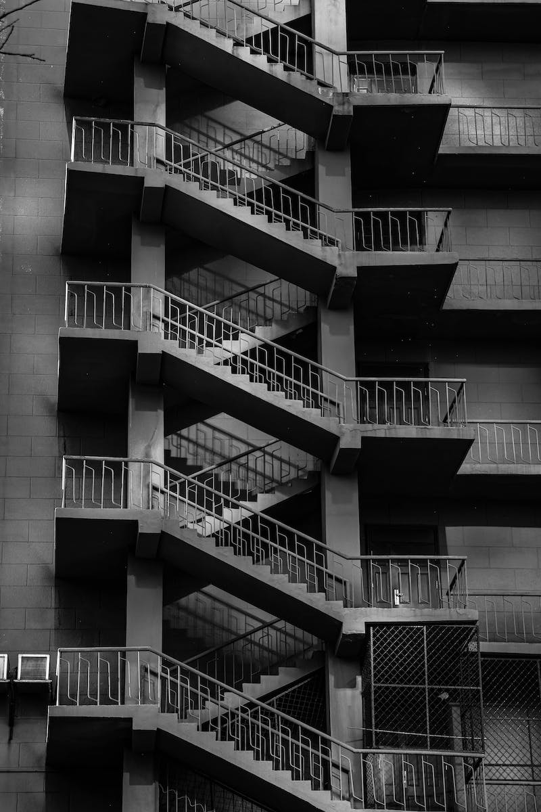
Foundation Preparation
• Prepare the foundation and excavation for your future home
• This includes digging trenches and laying the foundation for the building
• Simultaneously, install all necessary outdoor utilities and drainage systems
Photo by Pexels

