Slide 1
Creating a Tetris Game with Python
A step-by-step guide to building and playing Tetris

Slide 2
Introduction
• Overview of the Tetris game
• Importance of Tetris in gaming history
• Using Python and Pi game library
• Objective of the presentation
Photo by Pexels

Slide 3
Setting Up the Game
• Importing necessary libraries
• Creating a window with specified resolution
• Main game loop
• Using a settings file for convenience
Photo by Pexels

Slide 4
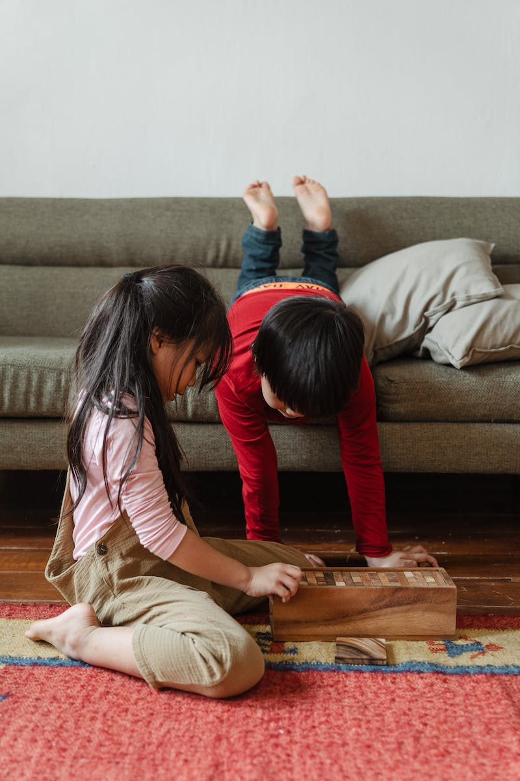
Building the Game Structure
• Creating classes for blocks and tetra
• Managing tetra and block instances
• Implementing flexible and scalable structure
• Using sprite for improved graphics
Photo by Pexels

Slide 5
Implementing Tetra Rotation
• Theory of rotating points around a pivot
• Calculating new rotated positions
• Checking for collisions after rotation
• Updating block positions accordingly
Photo by Pexels

Slide 6
Scoring and Game Mechanics
• Tracking points and full lines
• Accruing points based on line count
• Implementing speed-up mechanism
• Checking for game over condition
Photo by Pexels

Slide 7
Adding Visual Effects
• Implementing special effects for line clearing
• Creating transparent block images
• Animating block scattering and rotation
• Removing blocks after special effects
Photo by Pexels

Slide 8
Finalizing the Game
• Adding text inscriptions
• Displaying next tetra and score
• Implementing endgame condition
• Reviewing the completed game
Photo by Pexels

