Slide 1
The Importance of Safety Attitude
Protecting Yourself and Your Loved Ones

Slide 2
Introduction
• Building a safety culture
• Why safety matters
• Understanding personal passion
• Reflecting on past experiences
Photo by Pexels

Slide 3
My Life-Changing Experience
• Surviving Vietnam as a young marine
• Stationed in beautiful Okinawa
• Necessity of personal protective equipment (PPE)
• A life-threatening accident averted
Photo by Pexels

Slide 4
The Value of Safety Gear
• Worth of safety gear compared to its cost
• Helmet, boots, leather jacket, and gloves
• Preventing severe injuries and fatalities
• Importance of prioritizing safety equipment
Photo by Pexels

Slide 5
Safety Around the World
• Cultural differences in safety practices
• Eye protection in India
• Sponge hats for head protection
• Safety implications of alternative practices
Photo by Pexels

Slide 6
The Dangers of Complacency
• Recognizing the hazard of complacency
• Driving on autopilot
• Lack of attention leading to accidents
• The importance of remaining vigilant

Slide 7
Managing Anger in the Workplace
• Impact of anger on safety
• Anger carrying over to workplace
• Reduced focus and increased risk
• Promoting a positive work environment
Photo by Pexels

Slide 8
The Hazards of Fatigue
• Effects of fatigue on safety
• Reduced focus and decision-making
• Increased likelihood of shortcuts
• Importance of rest and proper sleep
Photo by Pexels

Slide 9
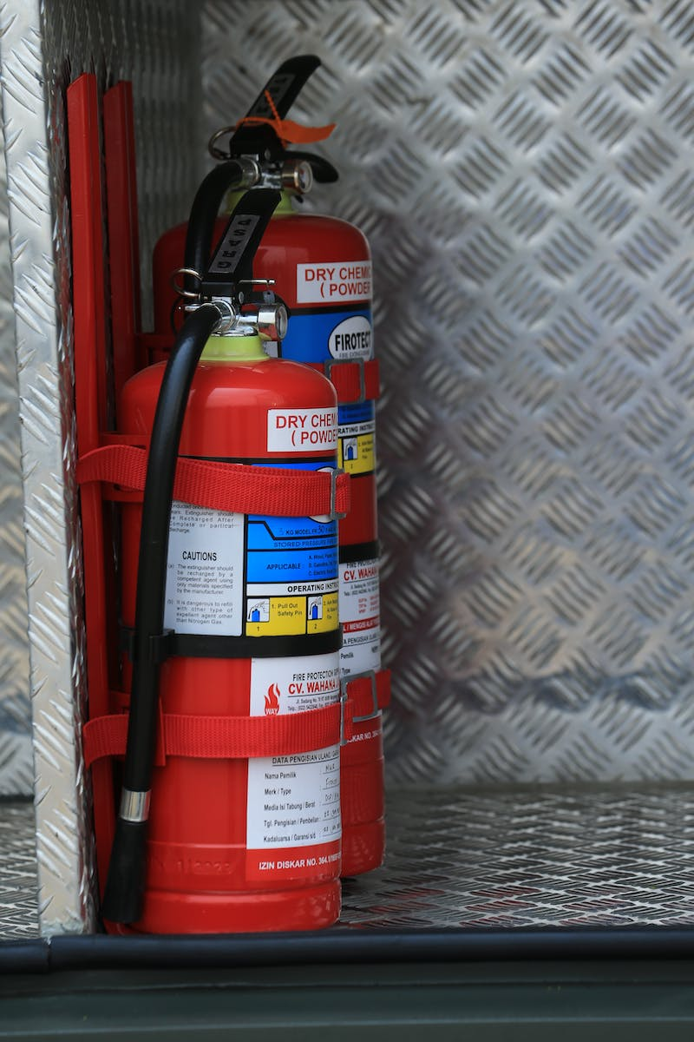
Developing a Safety Attitude
• Understanding the value of safety
• Being aware of potential risks
• Protecting oneself and loved ones
• Adopting a proactive approach
Photo by Pexels

