Slide 1
Guess the Food by Emoji
A Fun Quiz for Food Lovers

Slide 2
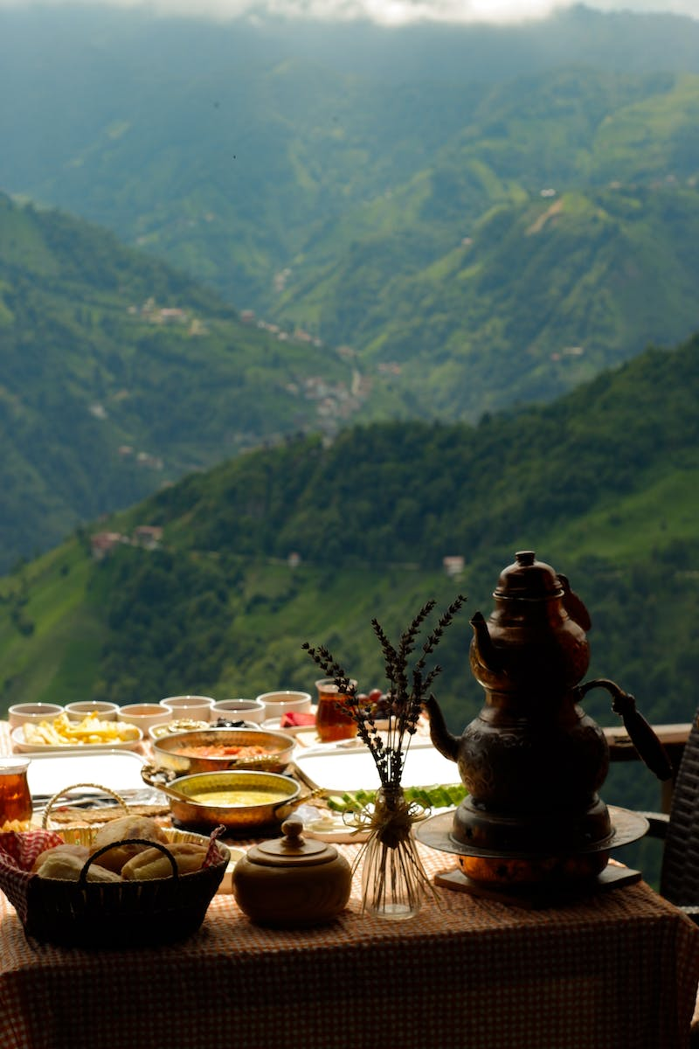
Welcome Back!
• Get ready for a fun challenge: Guess the food by the emoji!
• Subscribe to our channel for more quizzes like this.
• Let's play!
• 🎵 Music
• 🎂 Cake
• 🐶 Dog
• 🍪 Cookie
Photo by Pexels

Slide 3
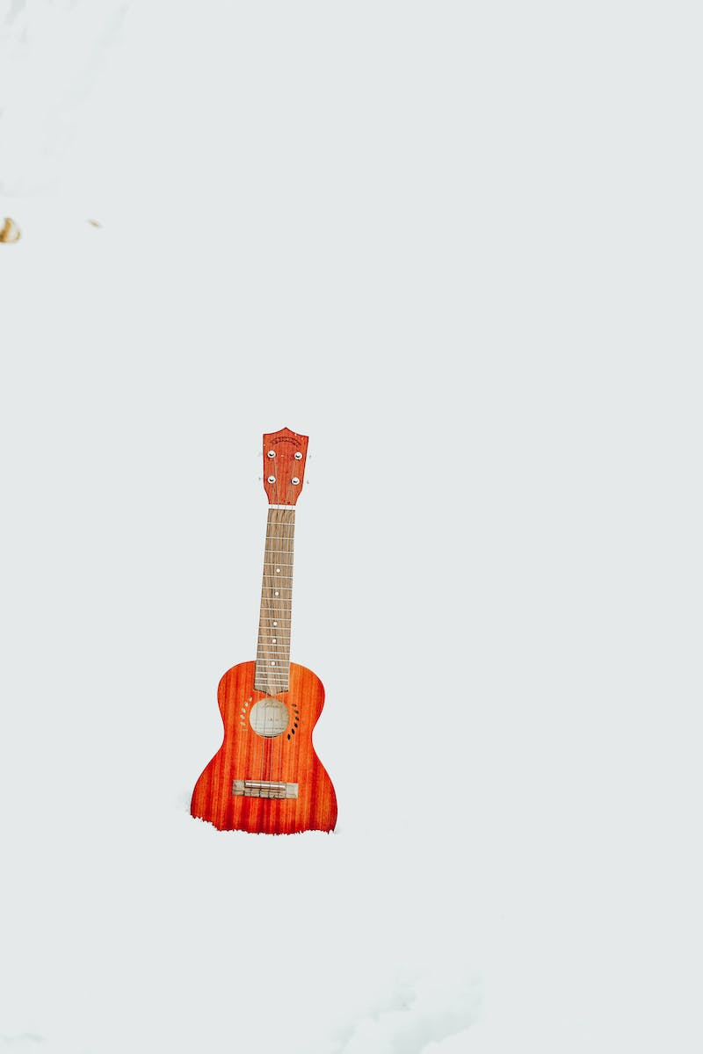
First Set of Emojis
• 🎵 Music
• 🍔 Hamburger
• 🍦 Ice Cream
• 🇫🇷 Foreign
• 🖐️ Balls
• 🌜 Moon Pie
• 🌰 Walnut
Photo by Pexels

Slide 4
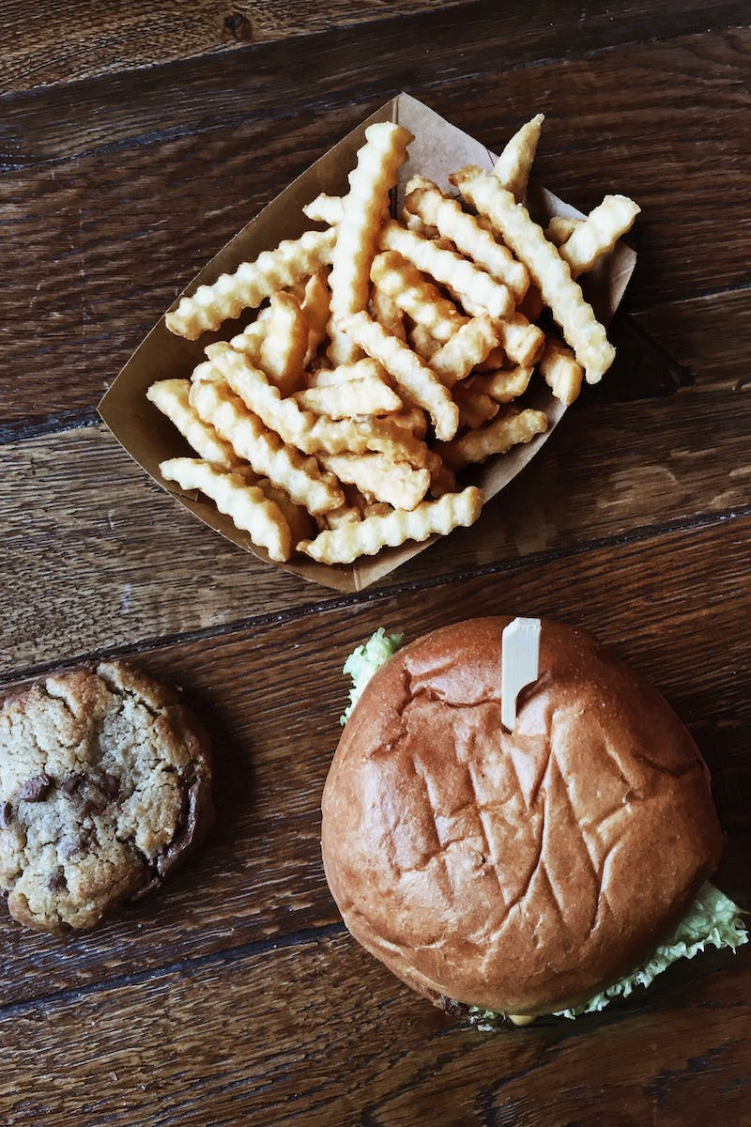
Second Set of Emojis
• 🍪 Cookie
• 📺 Popcorn
• 🇬🇧 Foreign
• 🎶 Music
• 🍟 French Fries
• 🐠 Goldfish
• 🧅 Onion Ring
Photo by Pexels

Slide 5
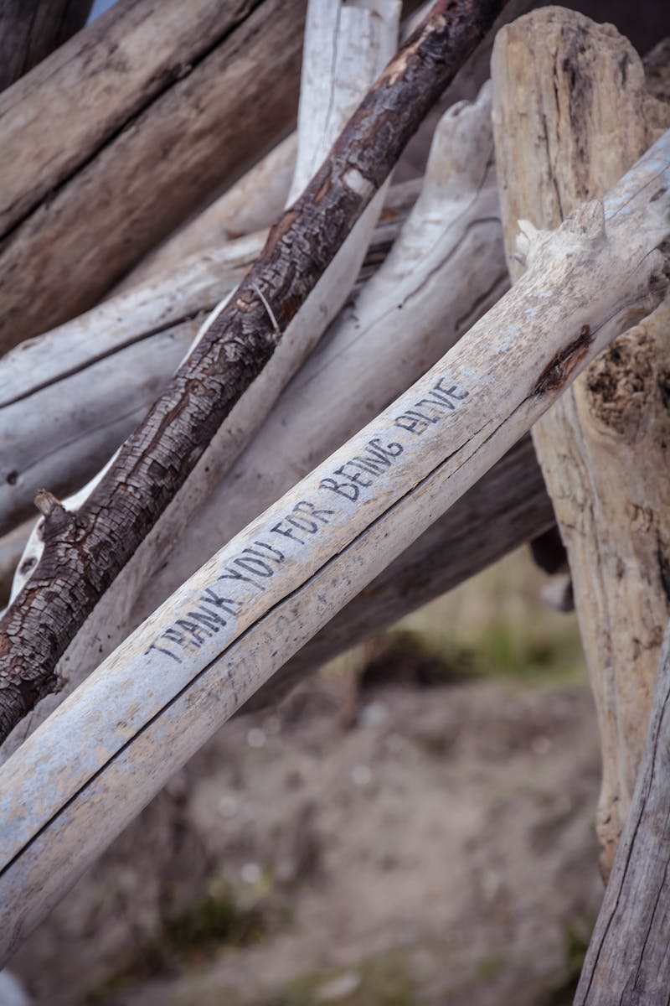
Conclusion
• Thank you for watching this video!
• Stay tuned for more fun quizzes.
• See you in the next video!
Photo by Pexels

