Slide 1
The Verb to Be: Present Tense
Mastering the Irregular Forms

Slide 2
Introduction to the Verb to Be
• The verb to be is commonly used in various contexts
• It is highly irregular and has different forms to learn
• The present tense forms are: I am, you are, he/she/it is, we are, they are
• Examples: He is Mark. She is thirteen years old. They are happy.
• The verb changes to match the subject
Photo by Pexels

Slide 3
Activity: Complete the Sentences
• Complete the following sentences with the correct form of the verb to be
• Pause here while you work
• Example sentences: I am fine. He is in the house. You are talking.
• They are at the university. The bus is at the school. We are friends.
Photo by Pexels

Slide 4
Forming Questions with the Verb to Be
• The verb to be can also form questions
• The verb must be conjugated to match the subject
• Examples: How are you? Am I right? Is he happy? Are they in Paris?
• Notice the subject-verb order change in questions
Photo by Pexels

Slide 5
Activity: Complete Questions
• Complete the following sentences with the correct form of the verb to be
• This time without the conjugation chart
• Pause here while you work
• Example sentences: Tom and Tina are tired. Are you coming over?
• The dog is sleeping. Fiona and I are friends.
Photo by Pexels

Slide 6
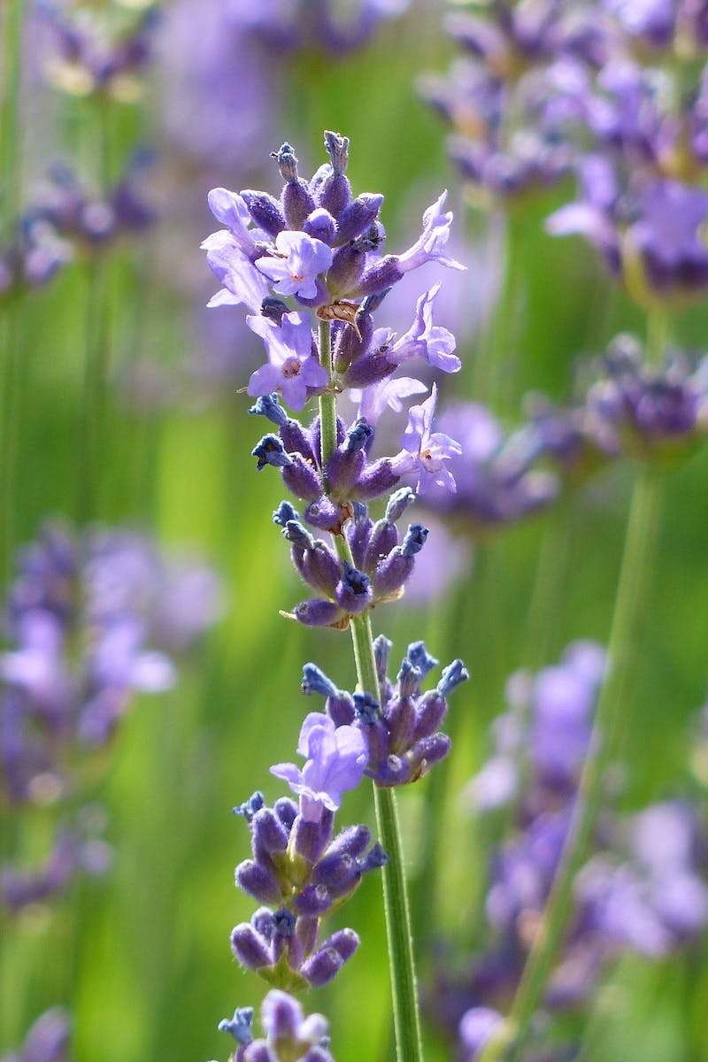
Review and Conclusion
• Recap the usage of the verb to be in the present tense
• Remind the audience that it can be used to talk about names, age, feelings, professions, and nationality
• Encourage the audience to write four sentences using the verb to be
• Provide an opportunity to share sentences in the comments
Photo by Pexels

