Slide 1
The Power of Coding and Information
Unlocking the Mysteries of Language and Data

Slide 2
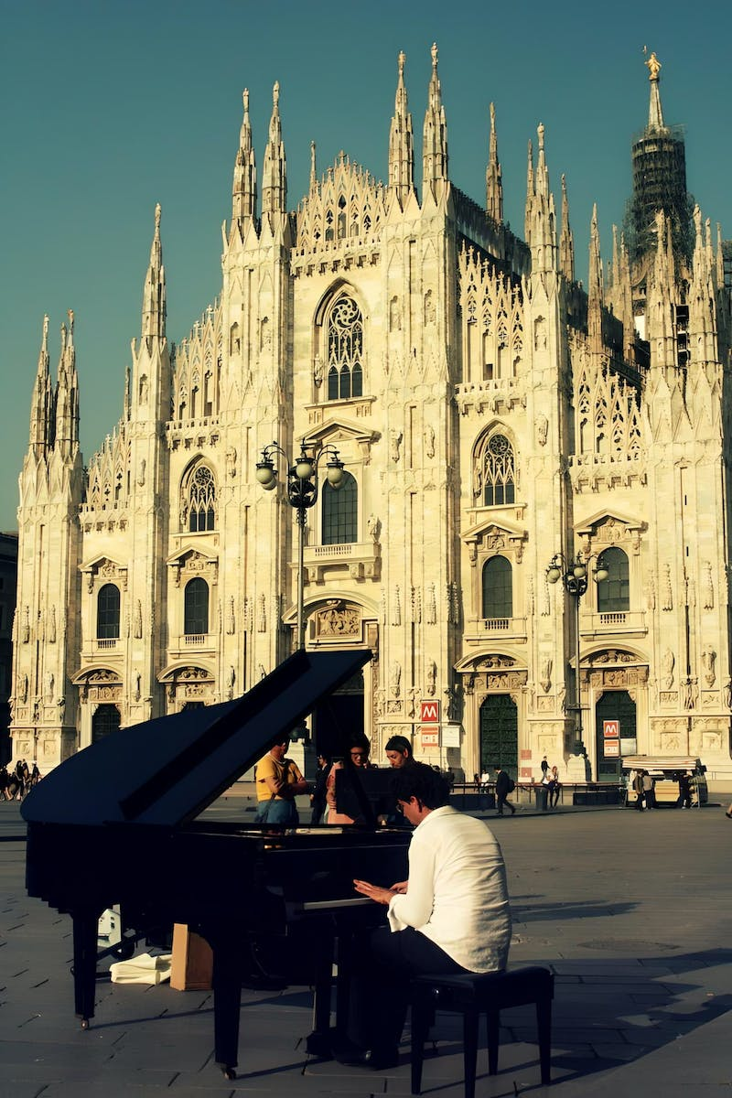
The Language of Music
• Music connects and communicates emotions
• Natural languages like Belarusian and Russian are used for communication
• Alphabets form the basis of natural languages
• Artificial languages like mathematical or chemical formulas are also used for communication
Photo by Pexels

Slide 3
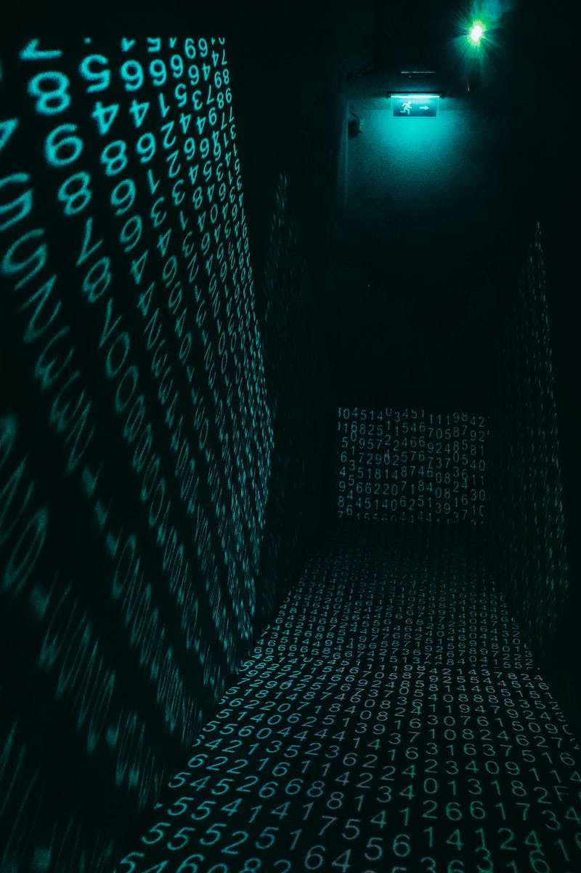
The Art of Encoding
• Codes are a collection of symbols assigned with specific meanings
• Encoding is the process of transforming information using codes
• Historical example: Julius Caesar's cipher for secret messages
• Modern examples: Barcodes, QR codes for quick information retrieval
Photo by Pexels

Slide 4
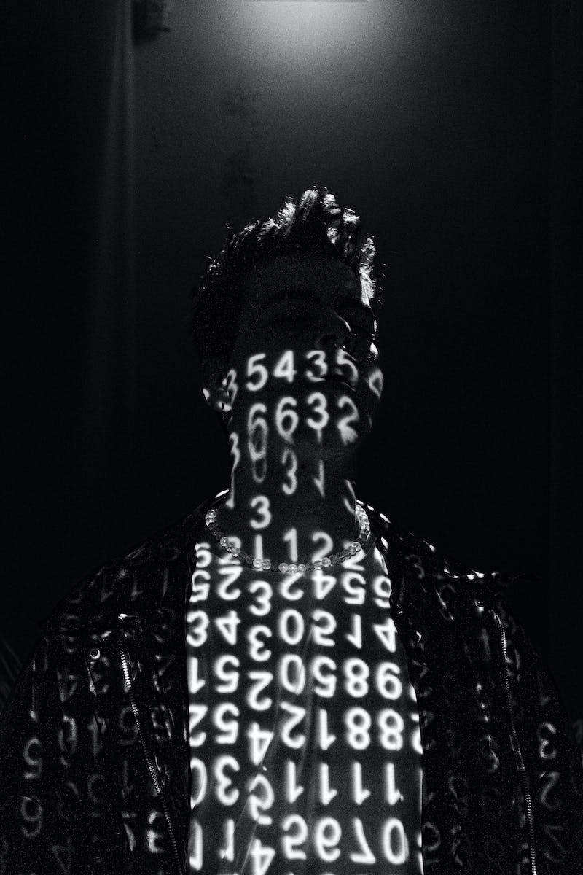
Binary Code: The Language of Computers
• Computers process information in digital format
• Binary code represents information using '0' and '1'
• Advantages of binary code: simplicity and compatibility
• Computers use binary code to handle numerical, textual, graphical, and audio information
Photo by Pexels

Slide 5
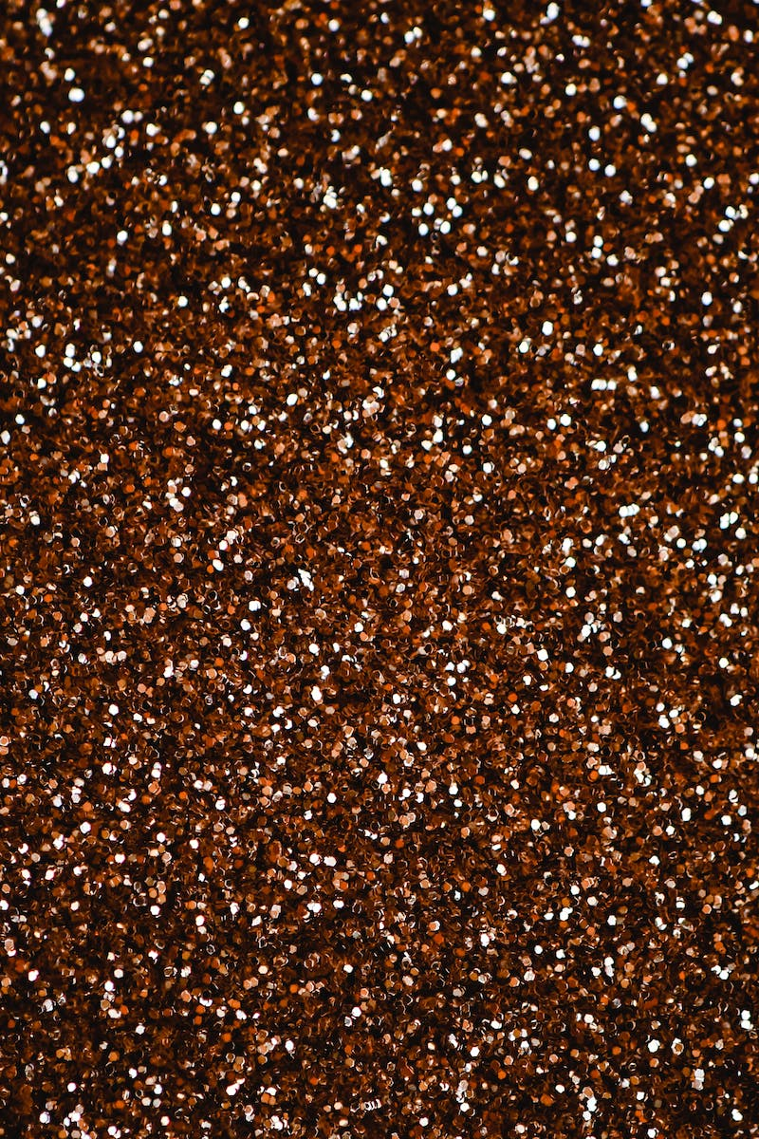
From Bits to Bytes
• Bit is the smallest unit of information, representing '0' or '1'
• Byte is a unit of information consisting of 8 bits
• Kilobytes, megabytes, and gigabytes represent larger volumes of information
• Different units of measurement for time, distance, and information
Photo by Pexels

