Slide 1
The Power of Yeast: Unlocking its Untapped Potential
Exploring the diverse applications and benefits of yeast in various industries

Slide 2
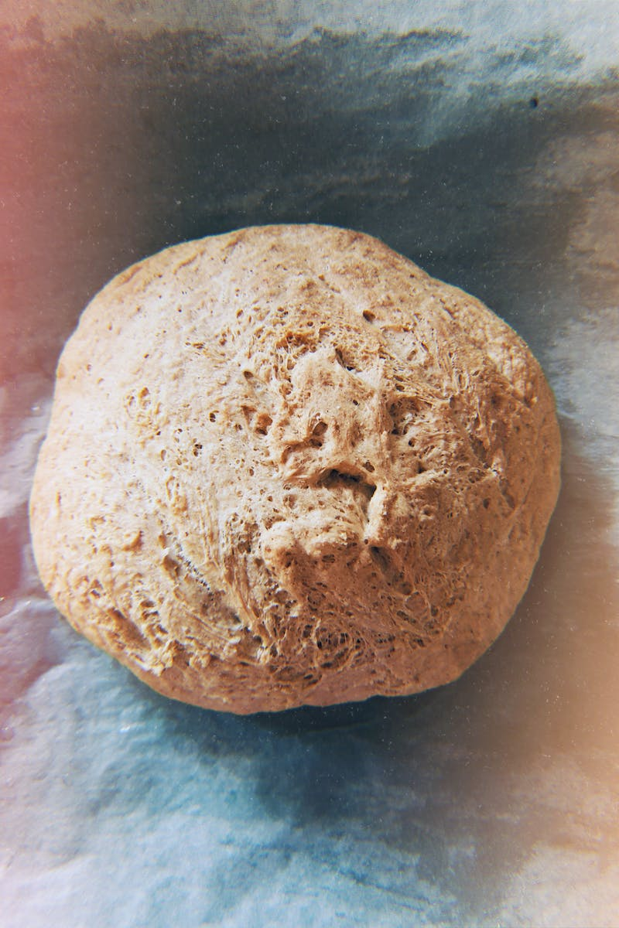
Introduction to Yeast
• Single-celled microorganisms
• Part of the fungus kingdom
• Wide range of species and strains
• Used in baking, brewing, and biofuel production
Photo by Pexels

Slide 3
Yeast in Baking
• Leavening agent in bread and pastries
• Fermentation releases carbon dioxide
• Creates a fluffy texture and improves flavor
• Different strains produce unique flavors
Photo by Pexels

Slide 4
Yeast in Brewing
• Essential for beer and wine production
• Fermentation converts sugars into alcohol and carbon dioxide
• Different yeast strains produce distinct flavors and aromas
• Temperature control is crucial for optimal fermentation
Photo by Pexels

Slide 5
Yeast in Biofuel Production
• Potential alternative to fossil fuels
• Yeast converts sugars into ethanol through fermentation
• Used in the production of bioethanol
• Renewable and environmentally friendly energy source
Photo by Pexels

Slide 6
Yeast in Biotechnology
• Used in the production of pharmaceuticals and enzymes
• Expression of recombinant proteins
• Facilitates genetic engineering applications
• Important tool in medical research
Photo by Pexels

Slide 7
Conclusion
• Yeast is a versatile microorganism with numerous applications
• Crucial in the food and beverage industry
• Emerging potential in energy and biotechnology sectors
• Ongoing research to unlock further possibilities
Photo by Pexels

