Slide 1
Introduction to K-Nearest Neighbors Algorithm
Exploring the fundamentals of KNN and its application in classification problems.

Slide 2
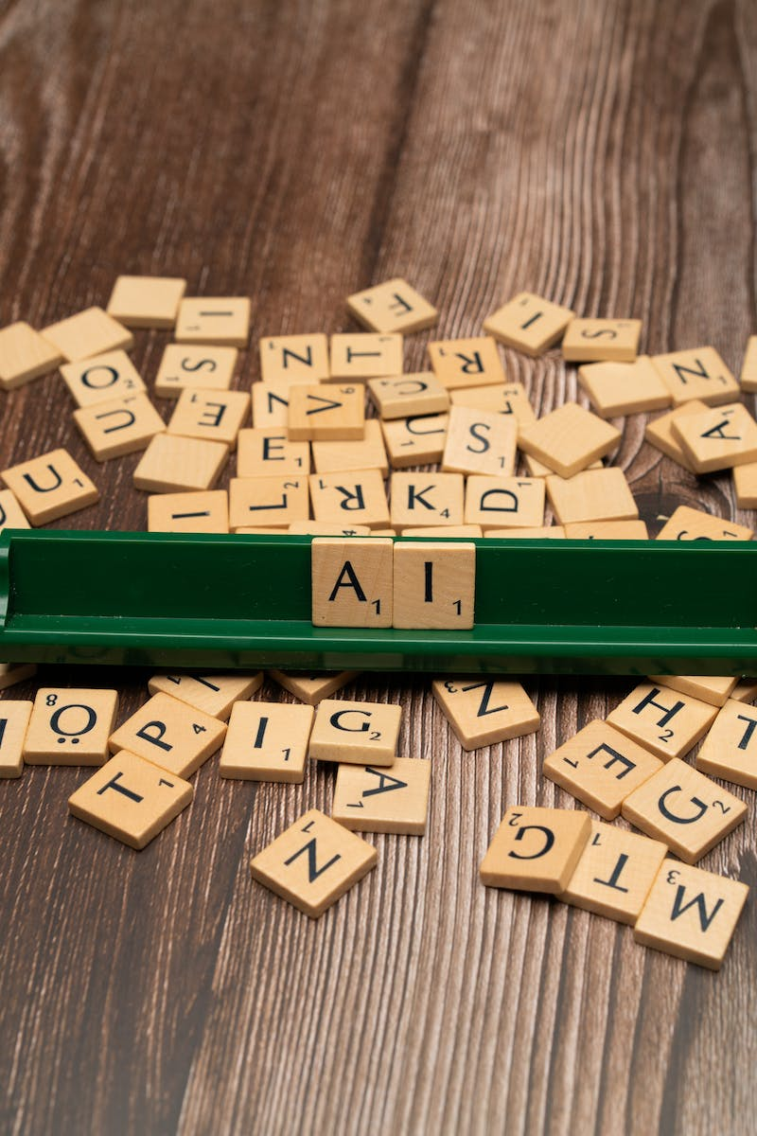
Music Music hello everyone welcome to my channel
• In this presentation, we will discuss the K-Nearest Neighbors (KNN) algorithm and its implementation in Python.
• We will use a dataset containing Indian level patient data to demonstrate the KNN algorithm.
• We will also explore the process of reading a CSV file and understand the data structure in Python using the 'pd.read_csv' method.
• By the end of this presentation, you will have a better understanding of KNN and how it can be used for classification problems.
Photo by Pexels

Slide 3
Understanding the Dataset
• The dataset we will be using is called 'indian_level_patient.csv'.
• It contains information about Indian patients at a national level.
• By reading the CSV file using 'pd.read_csv', we can access and analyze the data in Python.
• Understanding the dataset is an essential step before applying any machine learning algorithm.
Photo by Pexels

Slide 4
K-Nearest Neighbors Algorithm
• The KNN algorithm is a simple yet powerful classification algorithm.
• It classifies new data points based on their proximity to the existing data points in a dataset.
• The 'k' in KNN refers to the number of nearest neighbors used for classification.
• The algorithm calculates the distances between the new data point and all other data points, and assigns it to the majority class of its 'k' nearest neighbors.
Photo by Pexels

Slide 5
Model Evaluation Metrics
• When evaluating a model's performance, we need to consider various metrics.
• In the context of classification problems, some commonly used metrics are: true positives, false positives, true negatives, and false negatives.
• These metrics help us assess how well the model is performing in terms of correctly classifying data points.
• Accuracy score is another important metric that measures the overall accuracy of the model's predictions.
Photo by Pexels

Slide 6
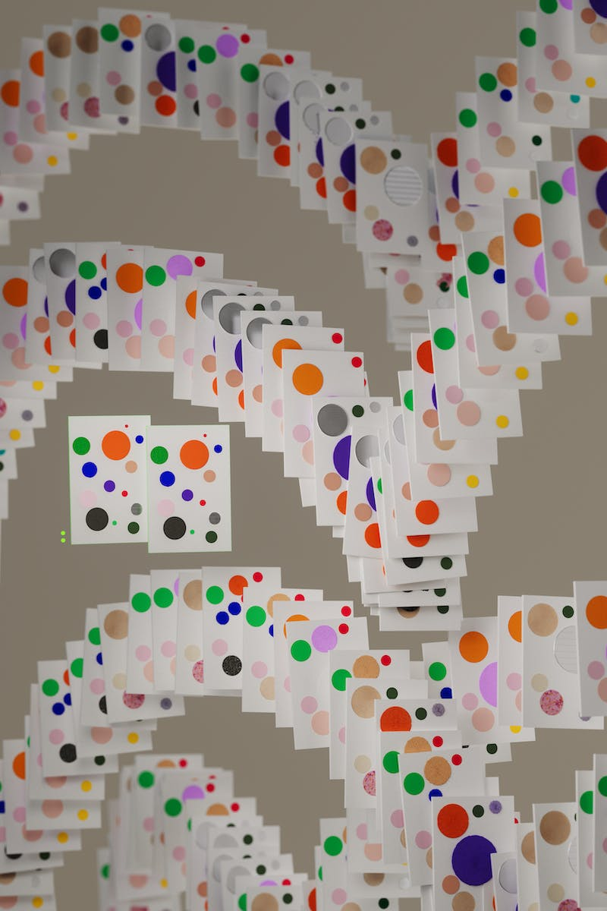
Initializing Neural Network
• To implement the KNN algorithm, we need to initialize a neural network.
• We can achieve this using the Sequential module from Keras.
• The Sequential module allows us to build neural networks by stacking layers sequentially.
• We can also implement regularization methodologies like dropout to improve the model's generalization ability.
Photo by Pexels

Slide 7
Conclusion
• In conclusion, the K-Nearest Neighbors (KNN) algorithm is a simple yet effective classification algorithm.
• It assigns data points to classes based on their proximity to the existing data points in a dataset.
• Understanding the dataset, evaluating the model's performance using relevant metrics, and initializing a neural network are crucial steps in implementing the KNN algorithm.
• Thank you for watching this presentation. Feel free to explore more about KNN and its applications in the field of machine learning.
Photo by Pexels

