Slide 1
Mastering Smartphone Filmmaking
Unlocking the Potential of Your Smartphone Camera

Slide 2
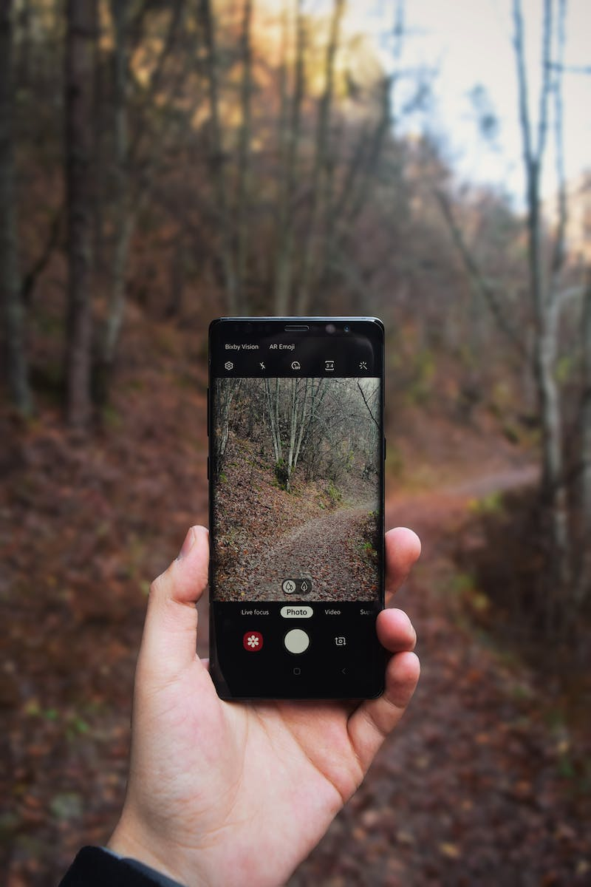
Introduction
• Smartphones have reached a point where they can rival high-end camera gear
• No excuse to delay your content creation journey
• Skills and knowledge to take your smartphone content to the next level
• Applies to youtubers, social media creators, hobbyists, and freelancers
Photo by Pexels

Slide 3
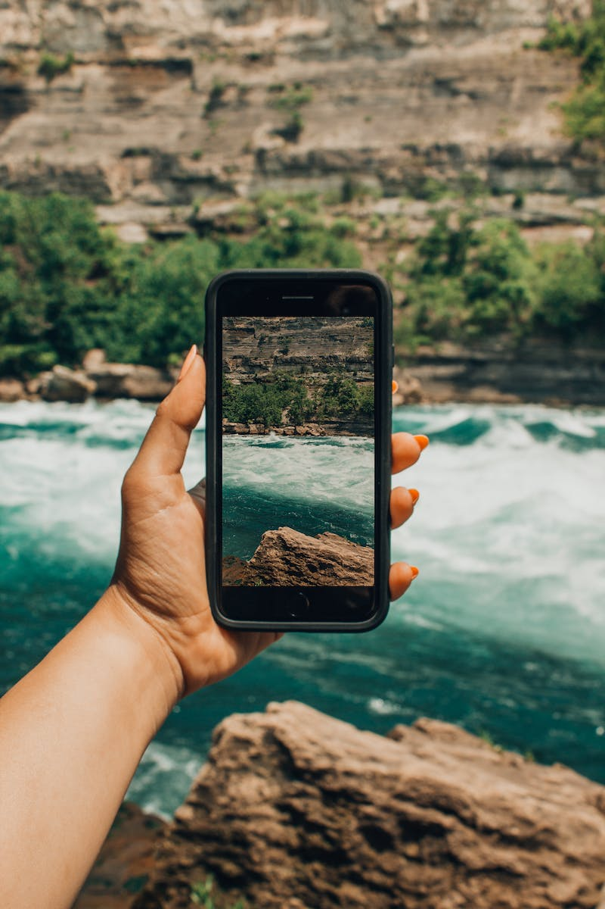
Choosing the Right Smartphone
• Major smartphone manufacturers like Apple, Samsung, and Google offer excellent camera performance
• Consider your preferred ecosystem (Apple vs. Android)
• Recommended options: iPhone 13 Pro or Samsung S22 Ultra
• Focus on camera quality rather than resolution (e.g., iPhone 13 Pro vs. S22 Ultra's 8K capabilities)
Photo by Pexels

Slide 4
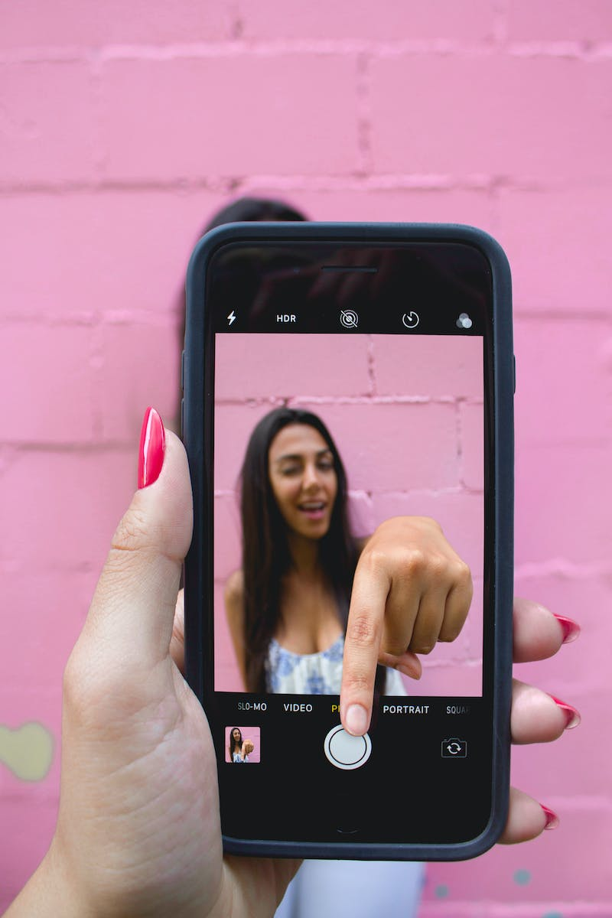
Utilizing Third-Party Camera Apps
• Native camera apps often lack manual control over settings
• Third-party apps like Filmic Pro, Moment Pro, and DJI Memo provide more control
• Manual control helps avoid exposure shifts and ensures consistent video quality
• Pro tip: Lock exposure and focus even in native camera apps by tapping and holding on the subject
Photo by Pexels

Slide 5
Mastering Camera Settings
• Resolution: Maximize it, usually at 4K
• Frame rate: Use 24 frames per second for regular speed content, increase for slow motion
• Shutter speed: Set it two times your frame rate, maintain motion blur
• ISO: Keep it as low as possible to avoid digital noise
• White balance: Ensure natural colors by adjusting to scene's color temperature
• Camera selection: Main camera is usually the best in terms of image quality
• Maintain depth: Add foreground and background layers to create immersive footage
Photo by Pexels

Slide 6
Achieving Perfect Lighting
• Lighting is essential for quality content
• Invest in budget-friendly lights like Yongnuo YN300 or Godox SL60
• Use diffusion panels or natural light through windows for softening the light
• Avoid harsh overhead lights, aim for soft and flattering light
• Consider golden hours for outdoor shooting, avoid midday sunlight
Photo by Pexels

Slide 7
Mastering Composition and Movement
• Be deliberate in your shot selection and composition
• Follow the rule of thirds for balanced and visually pleasing shots
• Create depth in your shots by adding foreground and background layers
• Deliberate movements like push-ins, pull-outs, trucks, and jibs enhance storytelling
• Plan shots that highlight specific subjects rather than randomly filming
Photo by Pexels

Slide 8
Capturing Clean Audio
• Invest in a quality lav mic for dialogue-heavy content
• Pop Voice Pro Lavalier Mic is an affordable option for clear audio
• Use the voice record app or sync external audio for situations where the mic cannot be attached to the camera
• Consider capturing ambient sounds using on-camera microphones or download sound effects
Photo by Pexels

Slide 9
Editing Your Footage
• Shoot well with a plan to make editing easier
• Use video editing apps like VN Video Editor or LumaFusion
• Organize footage and follow a logical progression in your editing
• Focus on pacing, transitions, and storytelling to create a polished final product
Photo by Pexels

