Slide 1
The Power of Artificial Intelligence
Unlocking the Potential of AI in the Digital Age

Slide 2
Introduction to Artificial Intelligence
• AI is the simulation of human intelligence in machines.
• It enables machines to perform tasks that normally require human intelligence.
• AI has the potential to revolutionize industries and transform societies.
• Key applications include machine learning, natural language processing, and robotics.
Photo by Pexels

Slide 3
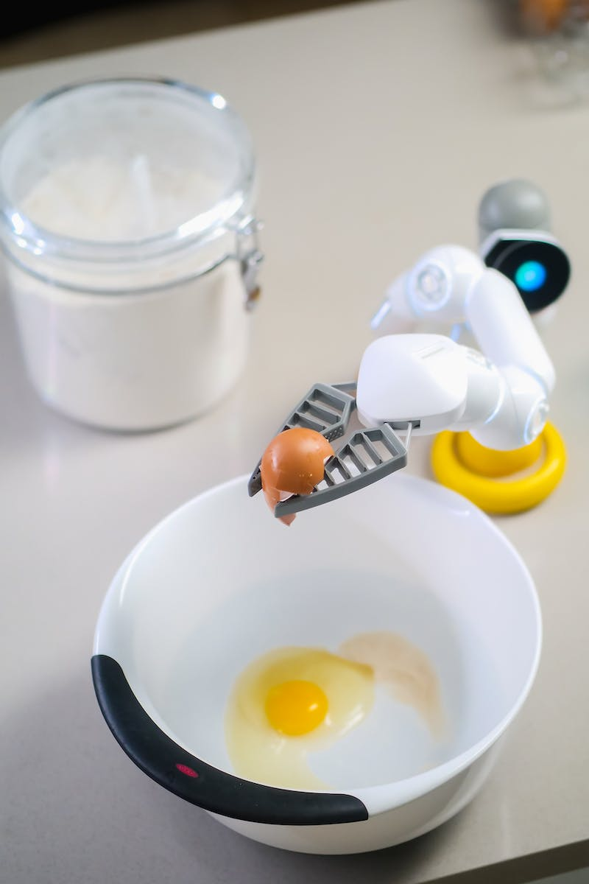
Machine Learning for Data Analysis
• Machine learning is a subfield of AI that enables computers to learn and make predictions from data.
• It uses algorithms and statistical models to analyze large datasets and identify patterns.
• Machine learning is widely used in fields such as finance, healthcare, and marketing.
• It empowers organizations to make data-driven decisions and gain a competitive edge.
Photo by Pexels

Slide 4
Natural Language Processing and Chatbots
• Natural Language Processing (NLP) enables computers to understand and interpret human language.
• Chatbots are AI applications that use NLP to interact with users and provide automated responses.
• They are utilized in customer service, virtual assistants, and information retrieval systems.
• Chatbots enhance user experience and streamline business operations.
Photo by Pexels

Slide 5
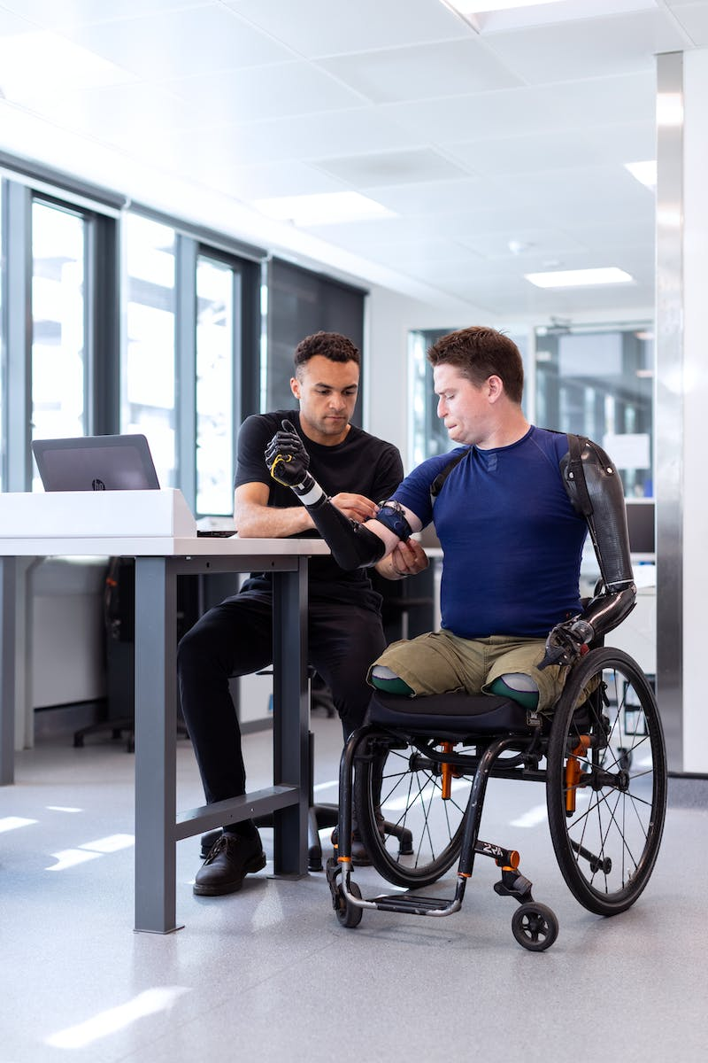
Robotics and Automation
• Robotics involves the design, creation, and operation of robots.
• Robots are becoming increasingly sophisticated and are capable of performing complex tasks.
• They are used in industries such as manufacturing, healthcare, and agriculture.
• Robots improve efficiency, precision, and safety in various sectors.
Photo by Pexels

Slide 6
Ethical Considerations and AI Bias
• AI raises ethical concerns related to privacy, security, and job displacement.
• There is a risk of bias in AI systems due to biased datasets and algorithmic decision-making.
• Efforts are being made to address bias and ensure fairness in AI applications.
• Ethical guidelines and regulations are being developed to govern the use and development of AI.
Photo by Pexels

Slide 7
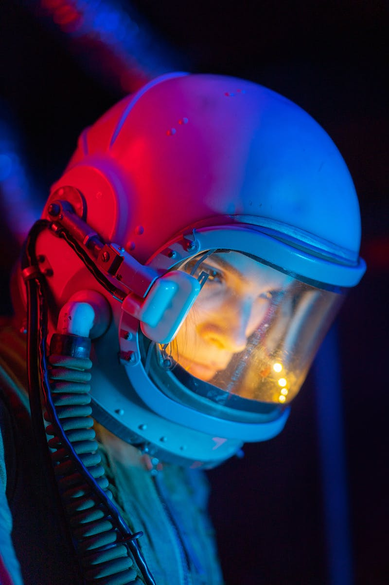
Future Trends and Opportunities
• AI is expected to continue advancing rapidly, opening up new possibilities.
• Emerging technologies such as autonomous vehicles and medical diagnosis systems will be enhanced by AI.
• AI will create new job opportunities and transform existing industries.
• It will influence our daily lives, from personalized recommendations to smart homes.
Photo by Pexels

