Slide 1
The Future of Artificial Intelligence
Exploring the Evolution, Impact, and Challenges

Slide 2
Introduction to Artificial Intelligence
• AI refers to the simulation of human intelligence in machines.
• It enables machines to learn, reason, and perform tasks like humans.
• AI has limitless potential and is revolutionizing various industries.
• AI technologies include machine learning, natural language processing, and computer vision.
Photo by Pexels

Slide 3
Applications of AI
• AI is being used in healthcare to improve diagnostics and treatment.
• In finance, AI is employed for fraud detection and algorithmic trading.
• AI-powered virtual assistants like Siri and Alexa have become part of our daily lives.
• Self-driving cars leverage AI to navigate and make decisions on the road.
Photo by Pexels

Slide 4
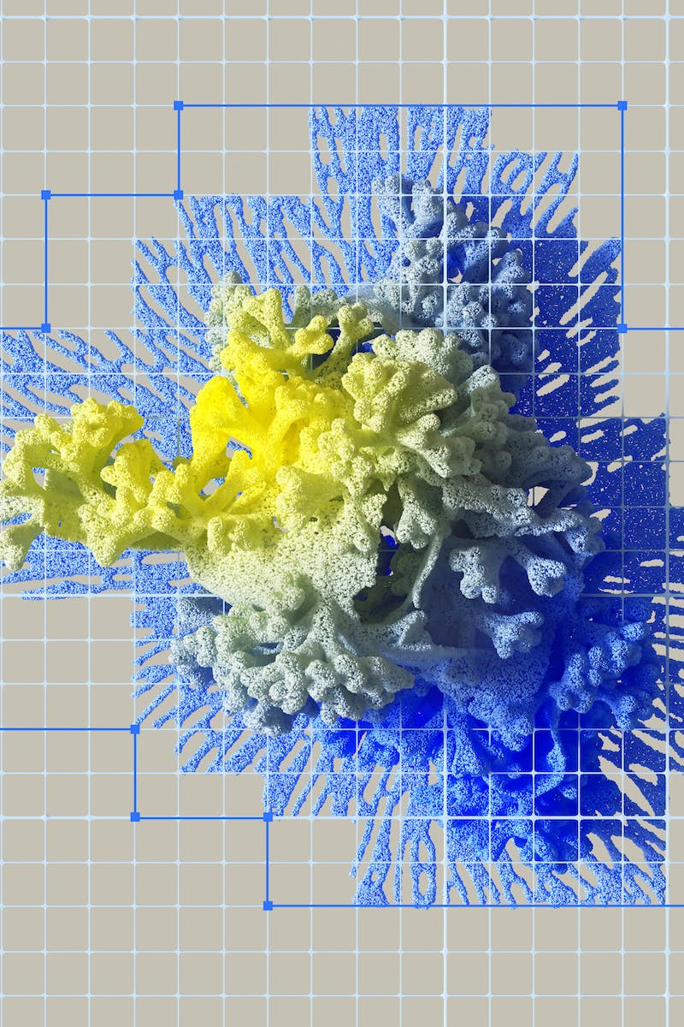
Ethical Considerations
• AI raises ethical concerns around privacy and data protection.
• Bias and discrimination can be perpetuated by AI algorithms.
• Automation might lead to job displacement and socioeconomic inequality.
• Ensuring responsible AI development and deployment is crucial.
Photo by Pexels

Slide 5
Future of AI
• AI is expected to continue advancing, driving technological innovation.
• The integration of AI with other emerging technologies like IoT and blockchain holds immense potential.
• Robots and autonomous systems powered by AI will become more prevalent.
• AI's impact on industries and society will continue to evolve.
Photo by Pexels

