Slide 1
The New Wave of Russian Rap
Exploring the latest releases and trends

Slide 2
Welcome
• Introduction to the presentation
• Overview of the topics to be covered
Photo by Pexels

Slide 3
Upcoming Releases
• Announcement of AA Lage 2 release
• Album update from Oblandat
• Expectations for Pleer KBA
Photo by Pexels

Slide 4
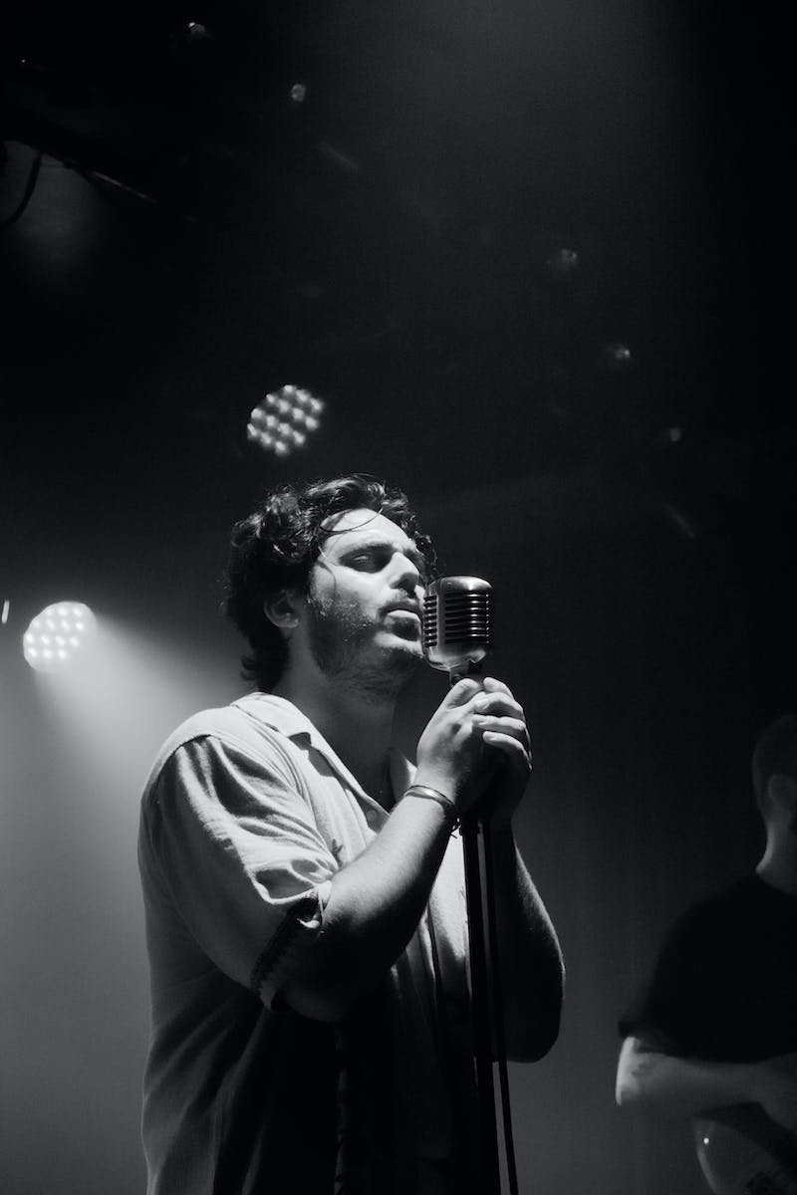
Hottest News and Controversies
• Recent nail art controversy by Lil Buddha
• Threats and hate towards Lil Buddha
• Controversy surrounding Caspian Cruise's music video
• Reaction to the alleged plagiarism
Photo by Pexels

Slide 5
Legendary Comebacks
• Return of Gonflad
• New album announcement by Lil Skvad
• Mala's latest release
Photo by Pexels

Slide 6
Surprising New Releases
• New track from Ernest
• Impressive releases from Van and Tom Mraza
• Unexpected release from Ken Carson
• New single by The Baby
Photo by Pexels

Slide 7
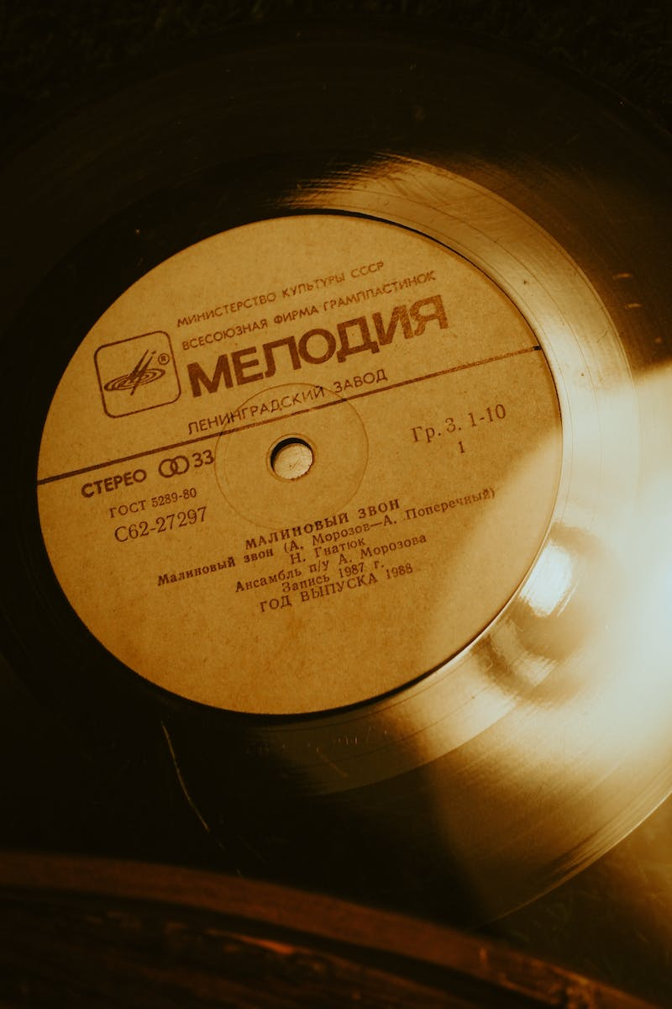
Album Highlights
• Great Chaos by L'One
• Morgenshtern's latest work
• Nava's comeback
• Opium Opium by Obe Kartin
Photo by Pexels

Slide 8
The Future of Russian Rap
• Exploring the evolving sound of Navell
• The unique style of White
• Moskit's compelling artistry
• Maslo Minato's dark music
Photo by Pexels

