Slide 1
Extraction of Metals with Low Reactivity
The Process of Roasting and Reduction

Slide 2
Introduction
• Metals with low reactivity can be extracted from their ores.
• Copper and mercury are examples of metals with low reactivity.
• Copper exists in the form of copper glance (copper one sulphide).
• Mercury exists in the form of s (mercury sulphide).
Photo by Pexels

Slide 3
Extraction of Mercury
• Mercury sulphide can be heated in the presence of oxygen.
• It converts to mercury oxide, releasing sulfur dioxide gases.
• Mercury oxide is further heated in the absence of oxygen, forming mercury and releasing oxygen.
• The process of converting a sulphide ore to an oxide is called roasting.
• The second process, removing oxygen from mercury oxide, is reduction.
Photo by Pexels

Slide 4
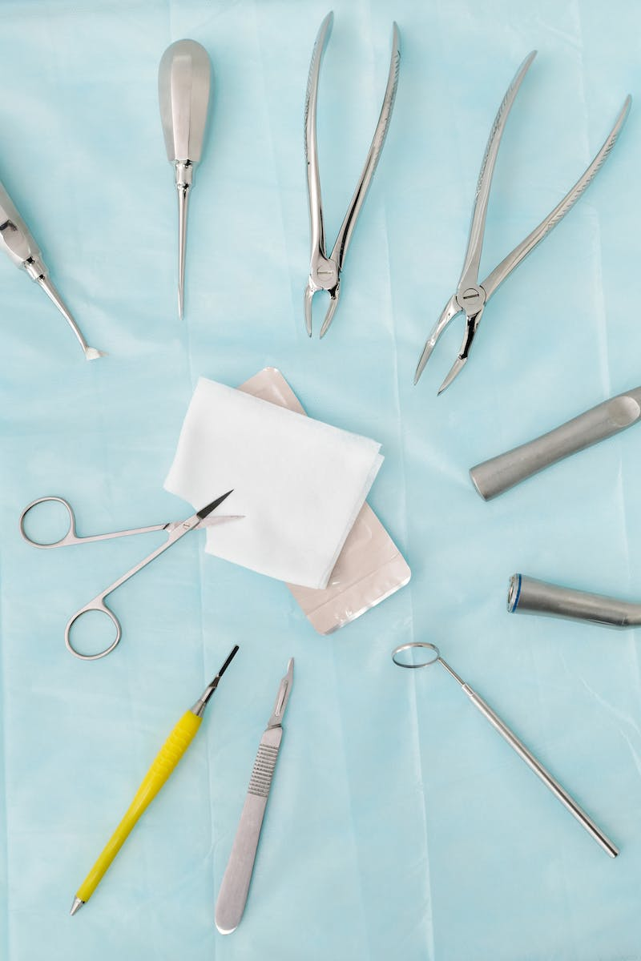
Extraction of Copper
• Copper glance (copper one sulphide) is heated in the presence of oxygen.
• It converts to copper one oxide, releasing sulfur dioxide.
• Not all the copper one sulphide is converted.
• Copper one oxide is further heated in the absence of oxygen, reacting with the remaining copper one sulphide to form copper and sulfur dioxide.
• The process of converting copper glance to copper one oxide is called roasting.
Photo by Pexels

