Slide 1
The Impact of Canals on Agriculture
Exploring the benefits and challenges of canal irrigation

Slide 2
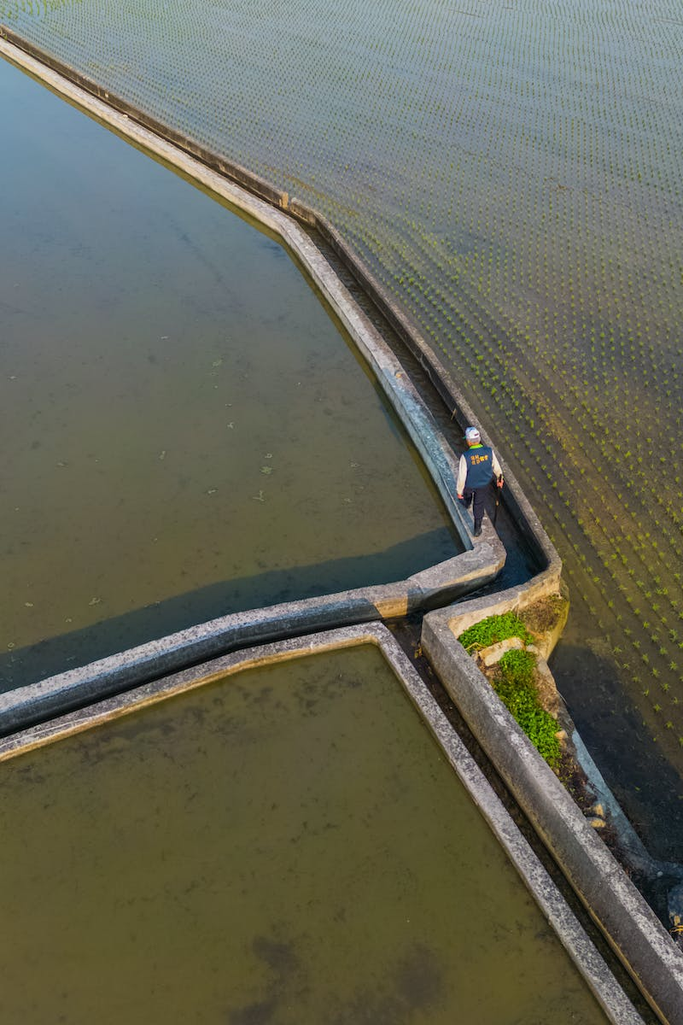
Introducing Canals
• Canals are artificial waterways used for irrigation
• They have been crucial in supporting agriculture for centuries
• Canals provide a reliable water supply for crops
• Canal systems require regular maintenance and management
Photo by Pexels

Slide 3
The Impact on Farmers
• Canals benefit farmers by improving access to water resources
• Farmers can efficiently irrigate their fields using canal water
• Canal irrigation can lead to increased agricultural productivity
• However, farmers may face challenges in maintaining canal infrastructure
Photo by Pexels

Slide 4
Formula for Success
• Efficient canal management is key to maximizing benefits
• Adopting proper maintenance practices ensures optimal functionality
• Regular inspections and repairs help prevent major breakdowns
• Collaboration between farmers and authorities fosters canal sustainability
Photo by Pexels

Slide 5
The Challenges Ahead
• Canal systems require ongoing investment and financial support
• Water scarcity and climate change pose threats to canal irrigation
• Balancing water distribution and equity among farmers is essential
• Innovation and technological advancements offer solutions for improving canal efficiency
Photo by Pexels

Slide 6
Conclusion
• Canals have been instrumental in supporting agriculture
• Efficient management and cooperation are vital for sustainable canal systems
• Continued investment in canal infrastructure is necessary
• Technological innovations can enhance canal efficiency and resilience
Photo by Pexels

