Slide 1
Bridging Local and Shutter BB Systems
Enhancing Performance and Resource Utilization

Slide 2
Introduction
• Collaboration between Cci Qing and the National Shipping Center Wu
• Focus on bus system deployment and engineering and social problems
• Growing demands of Hp applications
• Proposed buffer solutions for resource management
• Deployment of Ssds for improved local disk access
Photo by Pexels

Slide 3
Challenges in Building a Flexible Architecture
• Different applications have different requirements
• Relaxing protection remains a challenge
• Low performance of Bb without data management
• Data migration challenges between Bb and global system
• Need for dynamic management during application running
Photo by Pexels

Slide 4
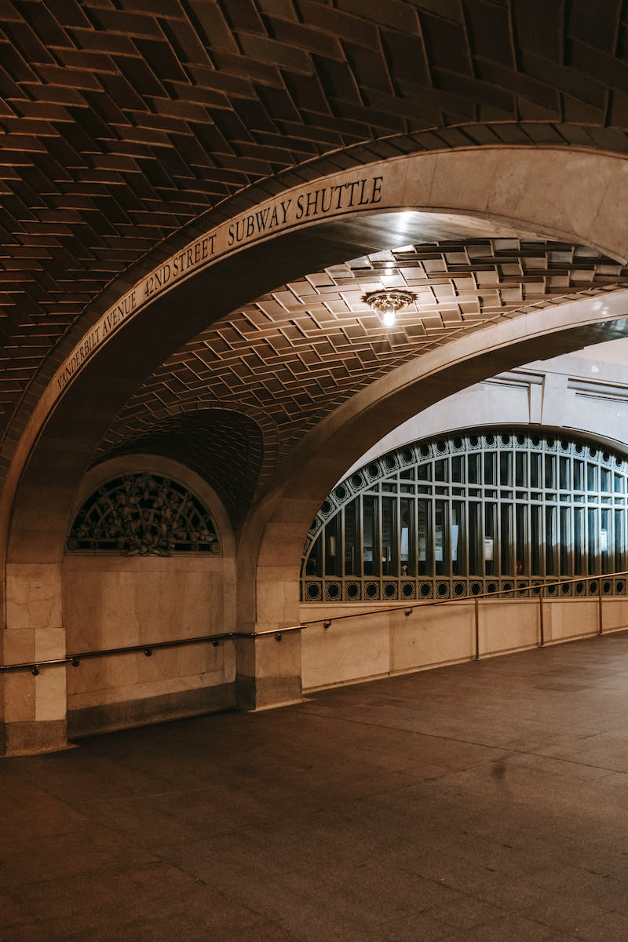
Subway Node Architecture
• Over one hundred cabinets with GPU nodes
• Storage nodes for object storage
• Aisle forwarding nodes for connectivity
• Integration of fast system with local and shutter platforms
• Overview of the architecture
Photo by Pexels

Slide 5
Data Management and Migration
• Four-pass indexing approach for metadata
• Local metadata database for fast information access
• Global metadata database for broader file management
• Methods to improve data migration efficiency
• Example of Hud's IO control and data flow
Photo by Pexels

Slide 6
Evaluation and Performance
• Evaluation of latency and duration with different block sizes
• Impact of data forty ratio on bandwidth
• Comparison of performance with other file systems
• Demonstration of performance advantages on shared files
Photo by Pexels

Slide 7
Conclusion and Future Work
• Relaunch of power system named Hud
• Bridge local and shutter BB systems
• Utilize Baby resources effectively
• Development of an automatic tool for common users
• Contact for questions: [email protected]
Photo by Pexels

