Slide 1
The Ancient Civilization of Harappa in Ancient India
An exploration of the Harappan civilization and its cultural achievements

Slide 2
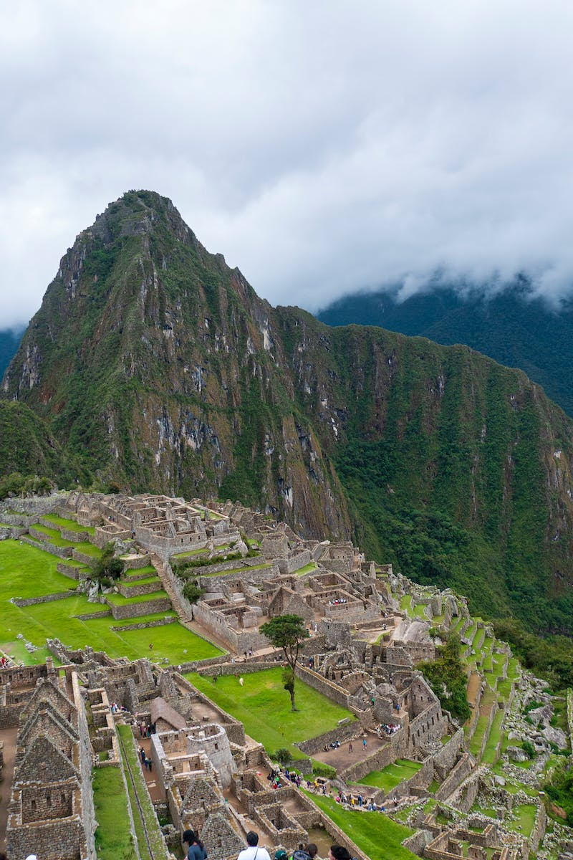
Introduction
• Harappan civilization flourished around the mid-3rd millennium BCE in the Indus and Ganges river valleys.
• Comparable to developments in Egypt and Mesopotamia.
• Impressive cities with monumental architecture and sophisticated drain systems.
• Artistic achievements in pottery, sculpture, and seal tablets.
Photo by Pexels

Slide 3
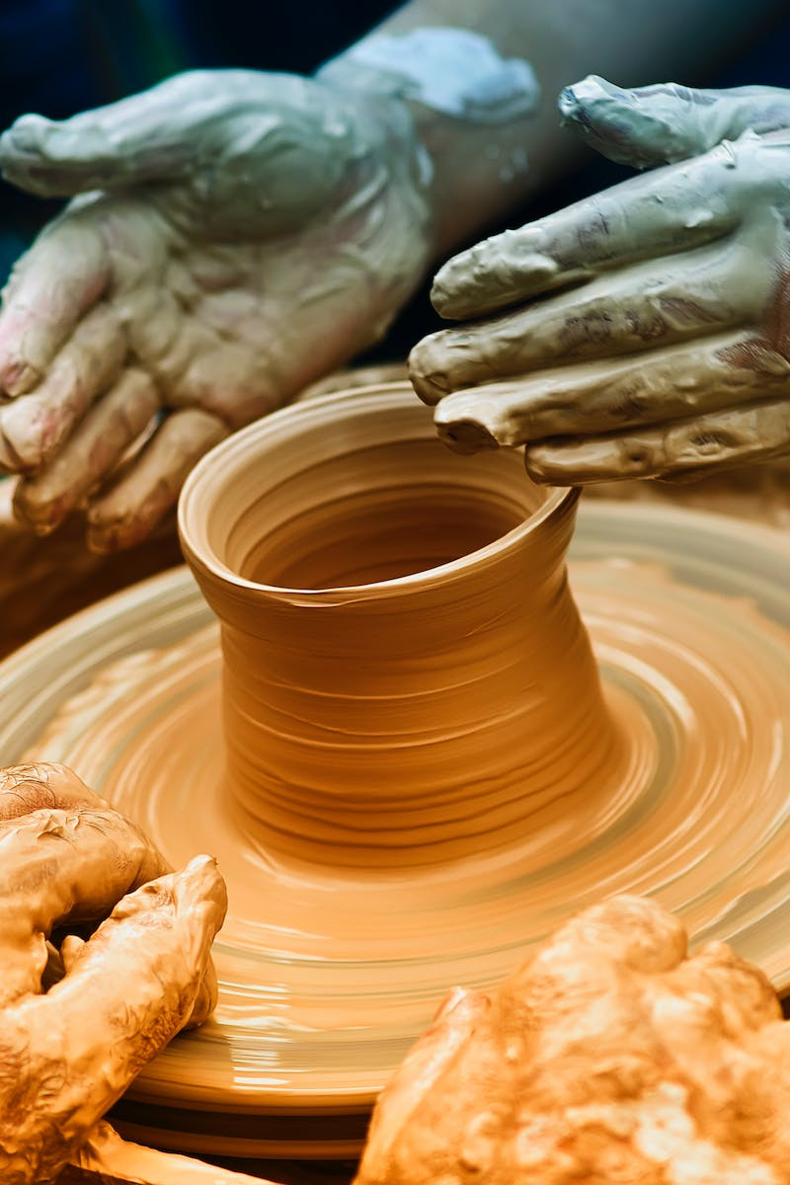
Art and Craftsmanship
• Harappan ceramics exhibited diverse forms and intricate animal and plant motifs.
• Black paint on red background was a common decorative style.
• Figurines of priests and dancers were common, showing unique characteristics.
• Ceramic objects from Mohenjo-daro showcased variety and elaborate ornamentation.
Photo by Pexels

Slide 4
Decline and Legacy
• Harappa's decline in the mid-2nd millennium BCE, possibly due to Aryan invasions, floods, or epidemics.
• Surviving inhabitants of Harappa believed in reincarnation and worshiped animals like elephants and cows.
• Formation of three major religions: Brahmanism, Buddhism, and Jainism.
• Mauryan dynasty continued the cultural legacy, leaving remarkable architectural structures.
Photo by Pexels

Slide 5
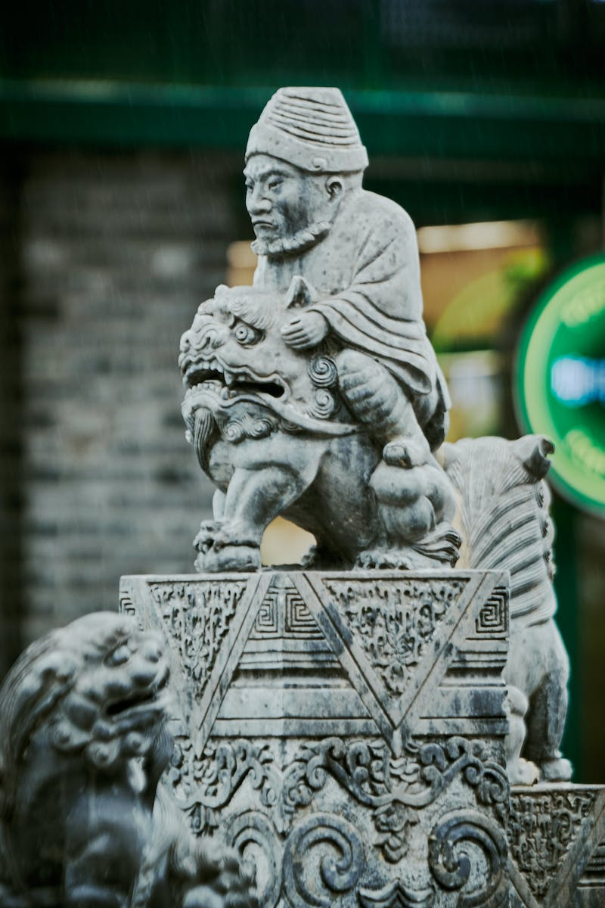
Development of Sculpture
• Different sculpture schools emerged: Gandhara, Mathura, and Amaravati.
• Early sculptures depicted traditional iconographic features of Buddha.
• Gandhara sculptures showed influence from Roman and Hellenistic styles.
• Mathura sculptures emphasized a softer interpretation of religious themes.
Photo by Pexels

Slide 6
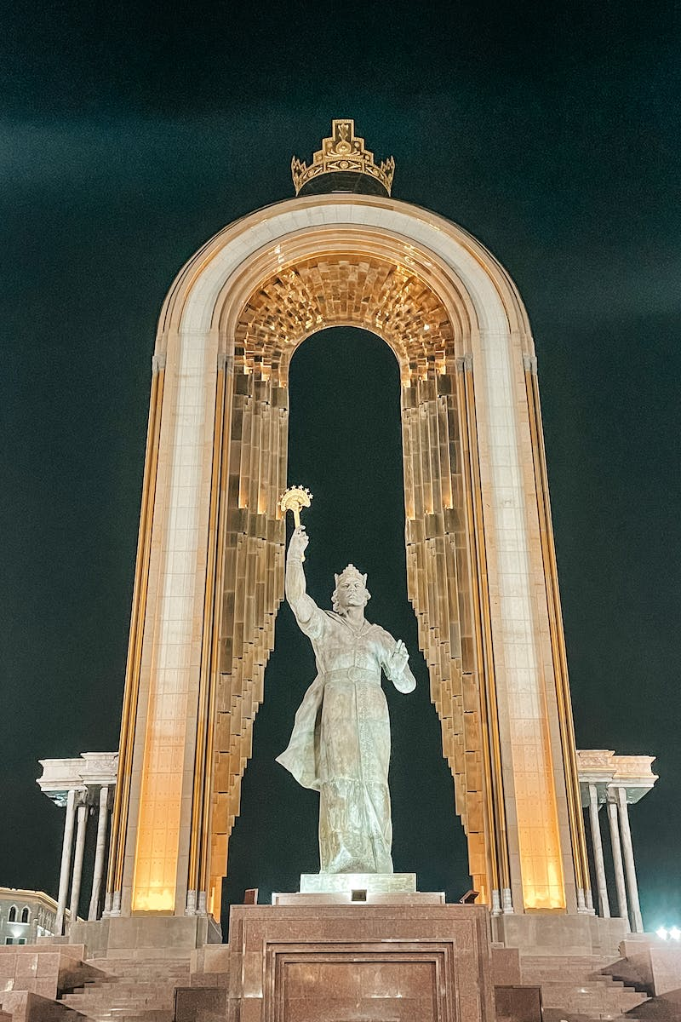
Gupta Dynasty and Literary Works
• Rise of the Gupta dynasty in the 3rd century CE marked an economic and cultural revival.
• Ancient Indian theater developed, influenced by Greek traditions.
• Epic literary works like the Mahabharata and Ramayana were composed.
• Bronze statues of Buddha showcased advanced technological processes.
Photo by Pexels

Slide 7
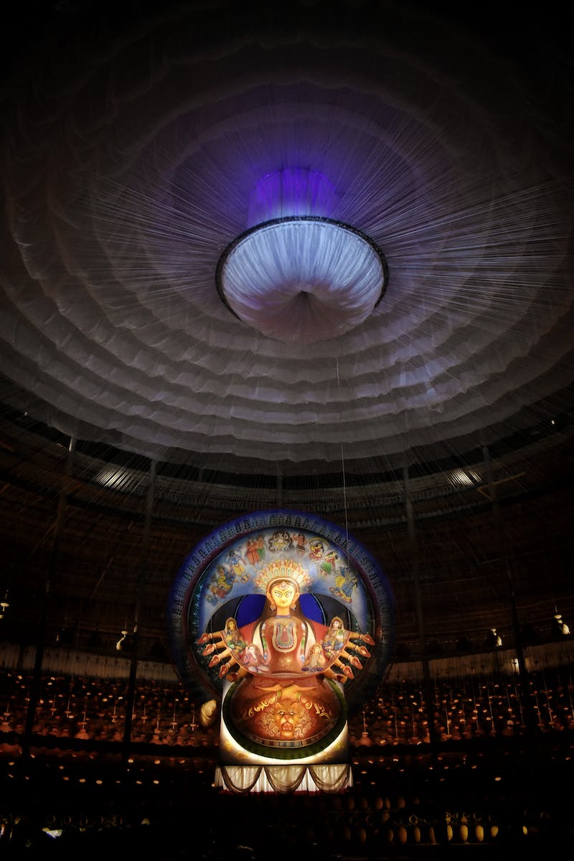
Conclusion
• Ancient Indian civilization witnessed remarkable cultural achievements and artistic expressions.
• Continuity in cave temple construction, evolving styles, and deep spiritual symbolism.
• Preservation of ancient cave frescoes depicting various aspects of life and mythology.
• An enduring legacy that has left an indelible mark on Indian art and culture.
Photo by Pexels

