Slide 1
Understanding Assembly Language and Machine Code
Exploring the Relationship and Applications

Slide 2
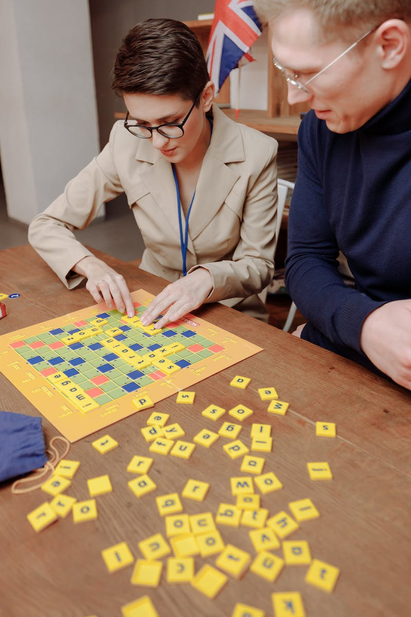
Introduction
• Focus on the relationship between assembly language and machine code
• Importance of assembly languages in creating programs
• Difference between hardware and instruction set
• Overview of different stages of assembly process
Photo by Pexels

Slide 3
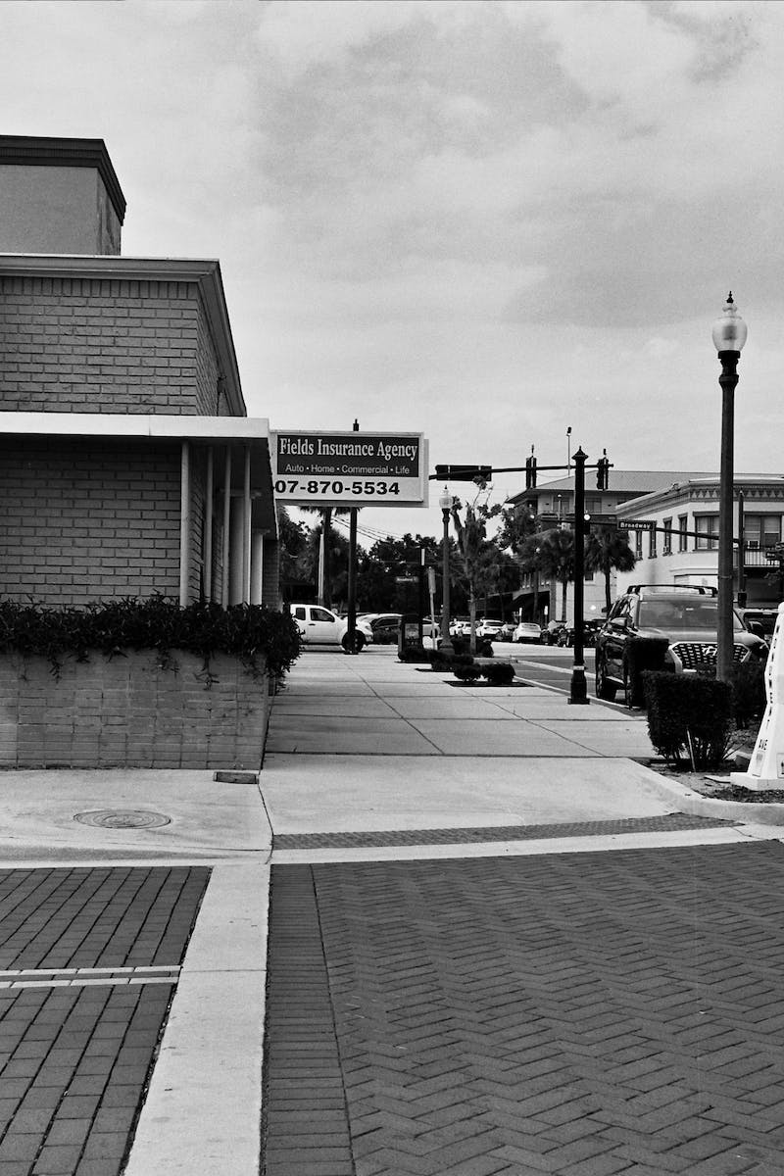
Neumann Architecture and Instruction Set
• Basic overview of the Neumann architecture
• Explanation of machine code as the programming language for the CPU
• Introduction to assembly language as a low-level programming language
• Difference between op code and opera end in machine code instructions
Photo by Pexels

Slide 4
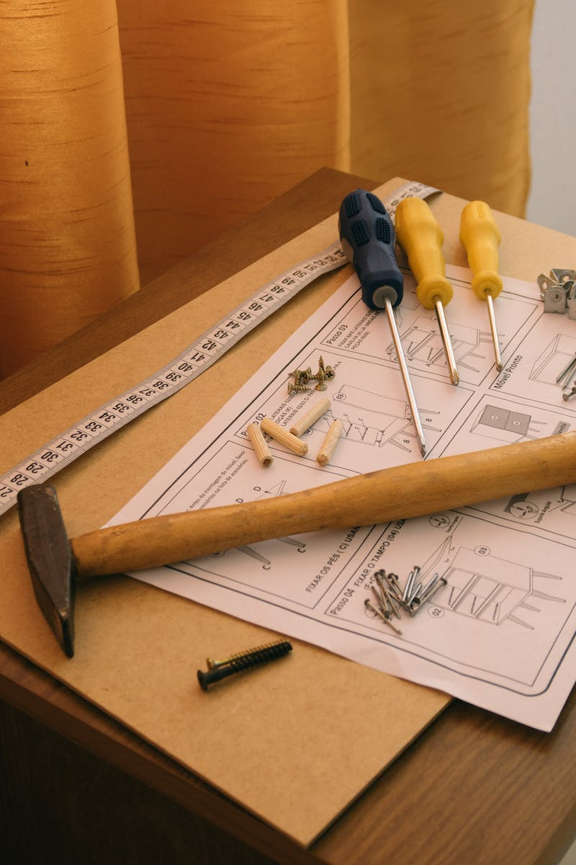
Assembly Language Instructions
• Overview of data movement instructions
• Explanation of input and output instructions
• Introduction to arithmetic operation instructions
• Overview of conditional and unconditional instructions
• Explanation of compare and logical instructions
Photo by Pexels

Slide 5
Modes of Addressing
• Explanation of absolute and direct addressing
• Introduction to indirect addressing
• Overview of index addressing
• Explanation of immediate and relative addressing
• Introduction to symbolic addressing
Photo by Pexels

Slide 6
Two Pass Assembler
• Explanation of single pass and two pass assemblers
• Overview of the first pass in a two pass assembler
• Explanation of the symbol table and its role in the first pass
• Overview of the second pass in a two pass assembler
• Discussion on labels and their translation to memory addresses
Photo by Pexels

Slide 7
Tracing Assembly Language Programs
• Explanation of trace tables
• Overview of how trace tables are used to trace assembly language programs
• Example of tracing a simple assembly language program
• Discussion on the use of labels in assembly language programming
Photo by Pexels

Slide 8
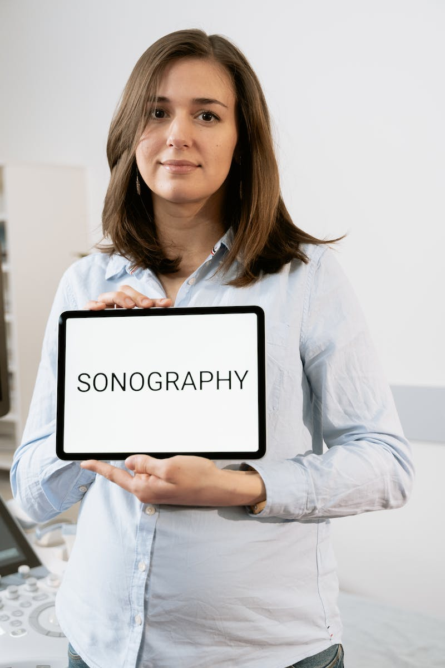
Conclusion
• Recap of the main points covered in the presentation
• Importance of assembly language in programming
• Understanding the relationship between assembly language and machine code
Photo by Pexels

