Slide 1
Raising a Successful Child in Sims 4
Discover the strategies and challenges of guiding our main character's upbringing

Slide 2
Introduction
• Focus on raising our main character responsibly from childhood
• Overcome challenges and complete various interesting tasks
• Introduce a new character named Mint 2
• Transition from the previous generation to the new one
Photo by Pexels

Slide 3
Building a Strong Foundation
• Custody transferred to the guardianship
• Addressing the neglect issue from the previous generation
• Introduce a new character, Rose 2
• Create a nurturing environment for the child
Photo by Pexels

Slide 4
Guiding the Child's Development
• Tips for developing the child's skills and making them perfect
• Advantages of living in a small house and taking advantage of the Child's Play lot trait
• Utilizing the Parenting interactions to boost skill leveling
• Exploring the child's traits and the impact on their development
Photo by Pexels

Slide 5
Creating a Memorable Childhood
• Celebrating the child's birthday with a memorable party
• Planning a special birthday event with a bartender and entertainer
• Introducing Mint's transformation to adulthood
• Exploring the options for skill development beyond childhood
Photo by Pexels

Slide 6
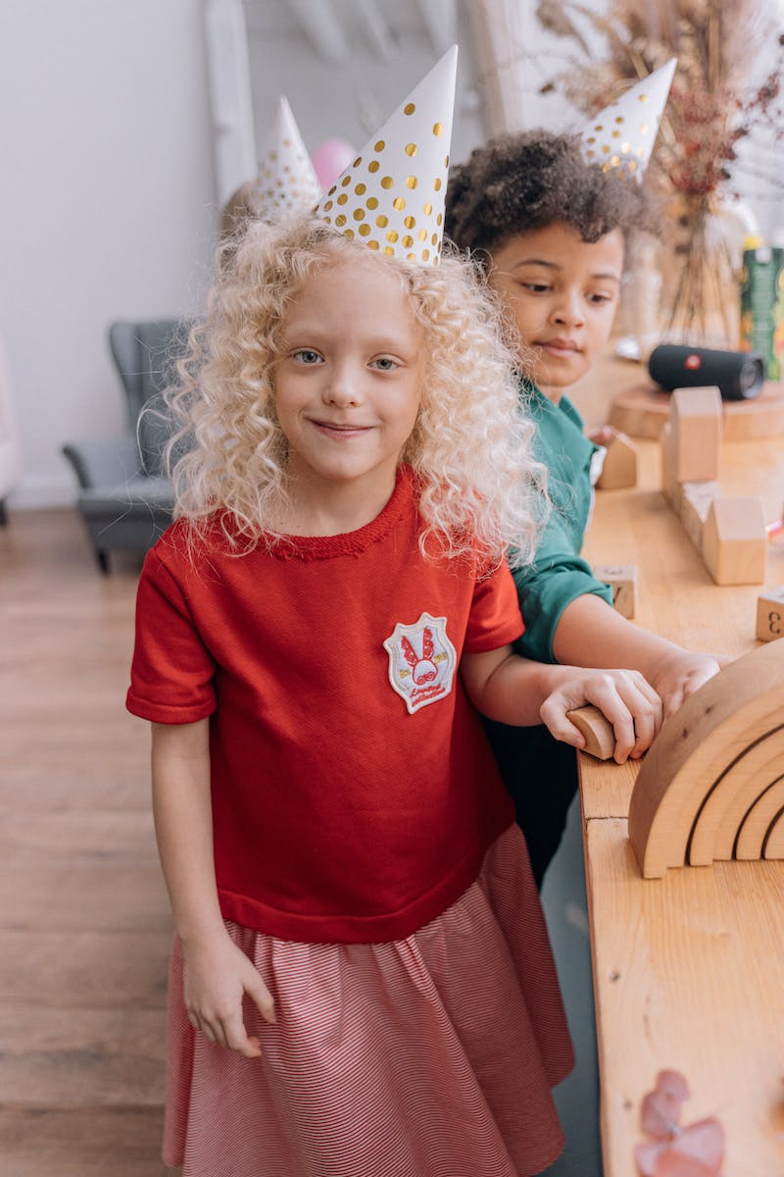
Enhancing Child Development
• Advantages of starting in a small residential lot
• Taking advantage of children's activities lot trait
• Enrolling the child in a good school
• Character development through parental interactions and activities
Photo by Pexels

Slide 7
Preparing for the Future
• Instilling responsibility through daily tasks
• Becoming a young president
• Completing elementary goals for faster skill development
• Discussions on the child's maturation process
Photo by Pexels

Slide 8
Building Romantic Relationships
• Becoming a teenage romantic
• Experiencing romantic relationships with various parties
• Completing romantic goals for further skill development
• Balancing career aspirations and romantic endeavors
Photo by Pexels

Slide 9
Advancing in Career
• Introduction of a new character, Marcus
• Building connections to gain support and votes
• Advancing in the political career
• Utilizing the benefits of the Serial Romantic aspiration
Photo by Pexels

Slide 10
Conclusion
• Reflecting on the growth and achievements of the character
• Completing generational challenges
• Setting future life goals
• Inviting audience participation in choosing the next generation's color theme
Photo by Pexels

