Slide 1

Угрозы информационной безопасности и их предотвращение Understanding and Preventing Digital Security Threats
Photo by Pexels

Slide 2
01
Understanding Information Security
Table of Contents
02
Common Cyber Threats
03
Prevention Strategies
04
Human Factor
05
Future of Information Security

Slide 3

1
Understanding Information Security
The Foundation of Digital Protection
Information security involves protecting digital information from unauthorized access, use, disclosure, disruption, modification, or destruction. In today's digital world, information security is crucial for protecting personal data, business operations, and national infrastructure from cyber threats. The core principles include confidentiality, integrity, and availability - often referred to as the CIA triad in security terminology. As technology evolves, so do security challenges, requiring continuous adaptation and innovative protection strategies.

Slide 4
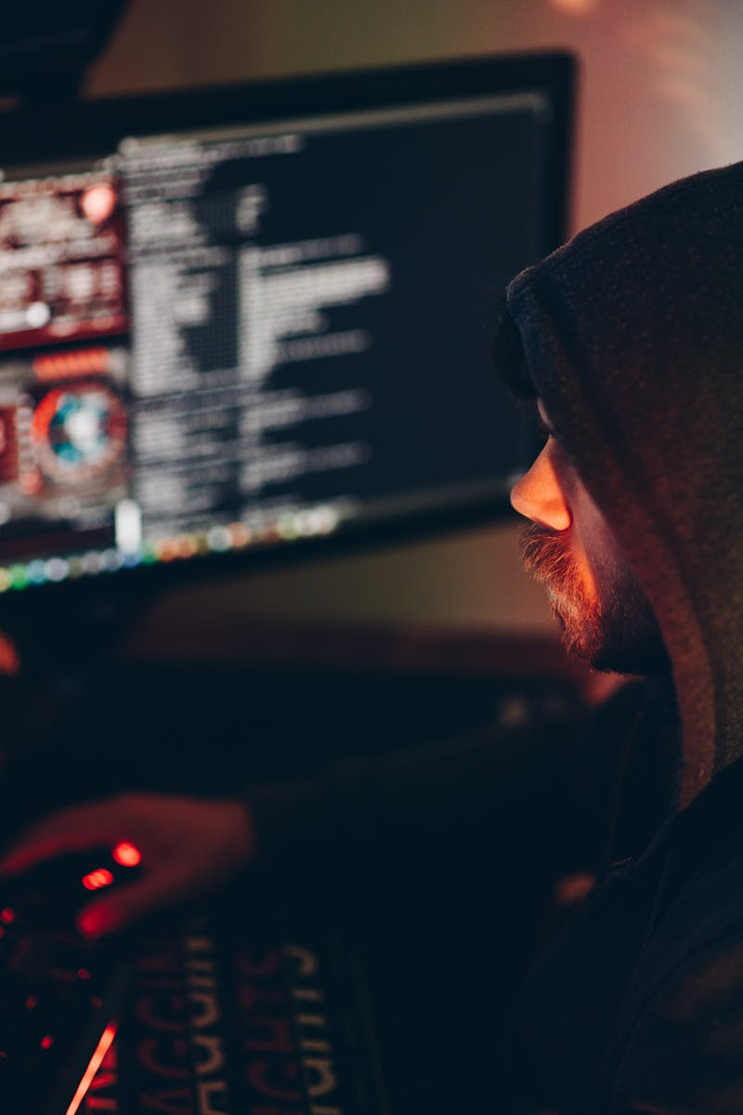
2
Common Cyber Threats
Understanding the Enemy
Malicious software including viruses, ransomware, and spyware that can damage systems, steal data, or hold information hostage. Deceptive attempts to obtain sensitive information through fake emails, websites, or messages that appear legitimate. Psychological manipulation techniques that trick people into revealing confidential information or performing actions that compromise security. Attacks that overwhelm systems with traffic or requests, making services unavailable to legitimate users.

Slide 5

3
Prevention Strategies
Building Strong Defenses
Implementing firewalls, antivirus software, encryption, and intrusion detection systems to create multiple layers of protection. Managing user permissions through strong authentication methods, multi-factor authentication, and regular access reviews. Securing network infrastructure through VPNs, secure Wi-Fi configurations, and network segmentation to limit potential damage. Keeping software, systems, and security patches up to date to protect against known vulnerabilities and exploits.

Slide 6

4
Human Factor
People as Both Target and Solution
Regular security awareness training helps employees recognize threats and understand their role in maintaining information security. Building a culture where security is everyone's responsibility, encouraging vigilance and proactive reporting of suspicious activities. Having clear procedures for responding to security breaches, including containment, investigation, and recovery steps. Staying informed about emerging threats and security best practices through ongoing education and professional development.

Slide 7
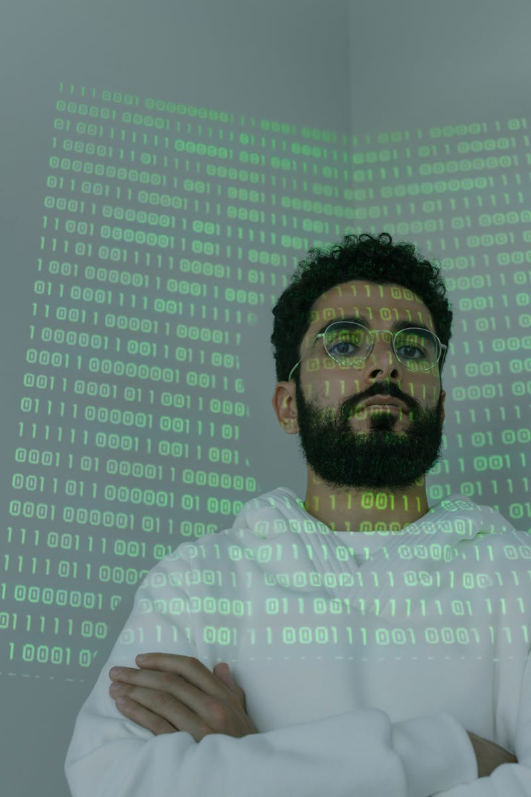
5
Future of Information Security
Preparing for Tomorrow's Challenges
Advanced technologies that can help detect patterns, predict threats, and automate security responses more effectively. A security model that assumes no user or device is trusted by default, requiring continuous verification of all access requests. Emerging technology that will require new cryptographic approaches as current encryption methods may become vulnerable. The need for international collaboration to address cross-border cyber threats and establish common security standards.

