Slide 1
Revolutionizing the Alpha Smartphone Business
A closer look at the success story of Alpha in London

Slide 2
Introduction
• Alpha is reshaping the smartphone industry in London
• A closer look at their innovative business model
• Fueling growth and popularity of Alpha smartphones
• Alpha's success story in the competitive market
Photo by Pexels

Slide 3
Better Alpha Smartphone
• Highlighting the superior features of Alpha smartphones
• Advanced technology and cutting-edge design
• Enhanced user experience and performance
• How Alpha outshines its competitors
Photo by Pexels

Slide 4
Starbucks Collaboration
• Exploring the partnership between Alpha and Starbucks
• Creating synergy between technology and coffee culture
• Exclusive benefits for Alpha users at Starbucks
• How Alpha leverages the popularity of Starbucks
Photo by Pexels

Slide 5
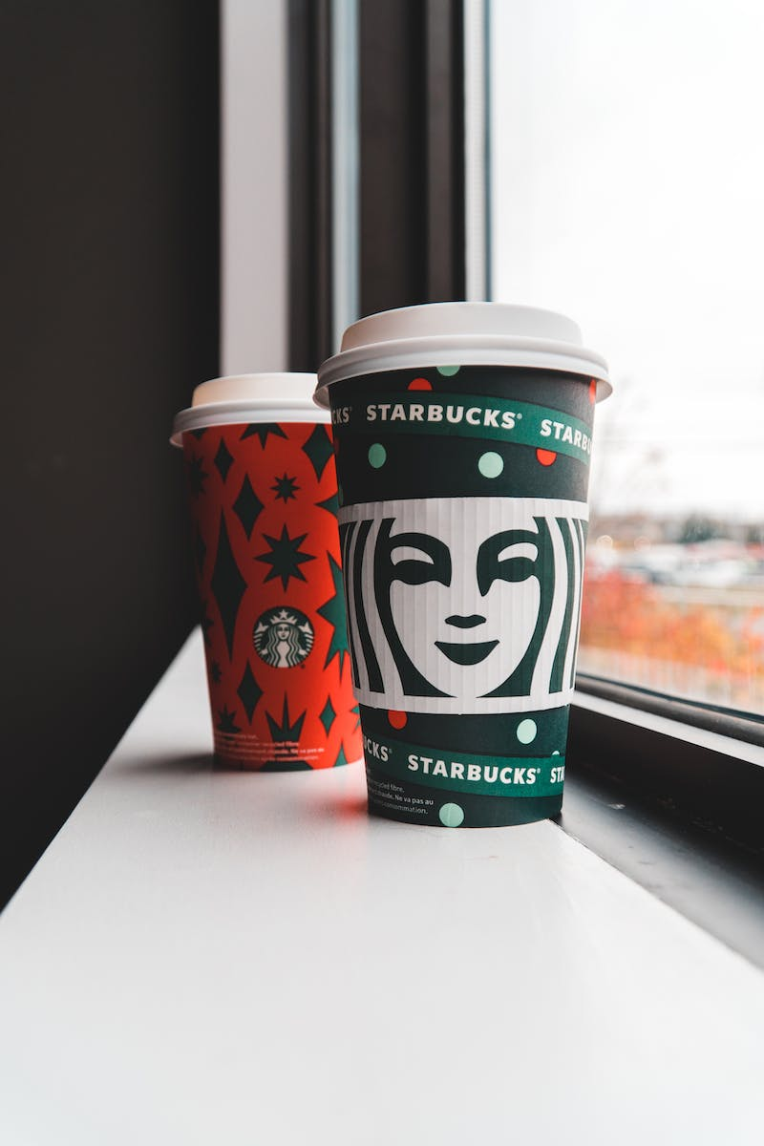
Drinks at Starbucks
• Diverse beverage options available at Starbucks
• Refreshing drinks and customization choices
• How Alpha users enjoy personalized drink recommendations
• Enhancing the Starbucks experience with Alpha smartphones
Photo by Pexels

